Slide 1
Fossils & Fossilization

Slide 2
Preservation- Unaltered Soft Parts
1. Remains of mammoth and rhinoceroses in frozen tundras
of Siberia and North America.
2. Insect exoskeletons and minute appendages have been
preserved in amber, the hardened resin of ancient coniferous
trees.
3. In Poland an Ice Age wooly rhinoceros was well preserved
in asphalt and the La Brea Tar Pits of Los Angeles contain
many Pleistocene animals.
4. In semi-arid South America, parts of mummified ground
sloths have been preserved in caves.
6. Algae and bacteria have been reported preserved in
Precambrian chert (Chert is a microcrystalline sedimentary
rock material composed of silicon dioxide ).

Slide 3
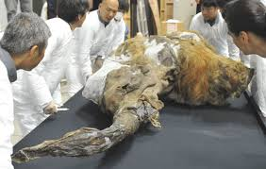
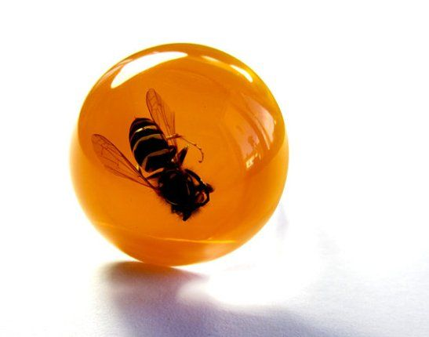
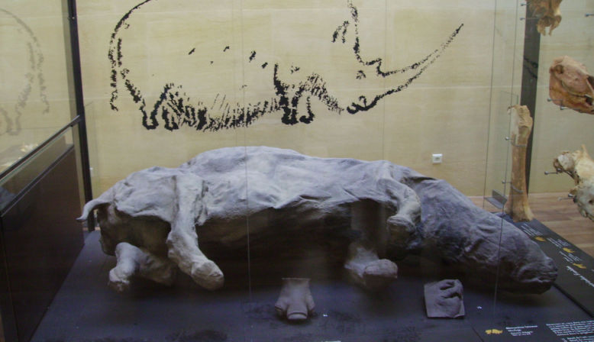
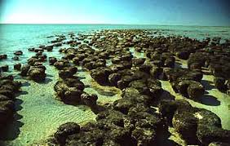

Slide 4
Preservation- Unaltered Hard Parts
1. Calcite (CaCO₃ is the most abundant original skeletal
material found in fossils
2. Aragonite (CaCO₃) is preserved in the shells of some corals
and molluscs. Rare in late Paleozoic fossils, absent from older
ones, since aragonite tends to invert into the more stable
calcite or dissolves.
3. Tricalcium Phosphate (Ca₃(PO₄)₂) is a chemically resistant
mineral found unaltered in vertebrate bones, some
arthropods and brachiopods.
4. Opal (SiO₂H₂O) is an amorphous hydrated silica preserved
in latter geologic time in some Protozoans and sponges. It is
unstable.
5. Chitin is an organic compound that is resistant to bacterial
action and is not readily altered. It is found in many
arthropods and graptolites

Slide 5
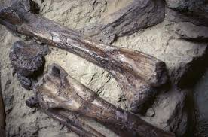
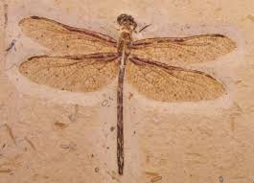

Slide 6
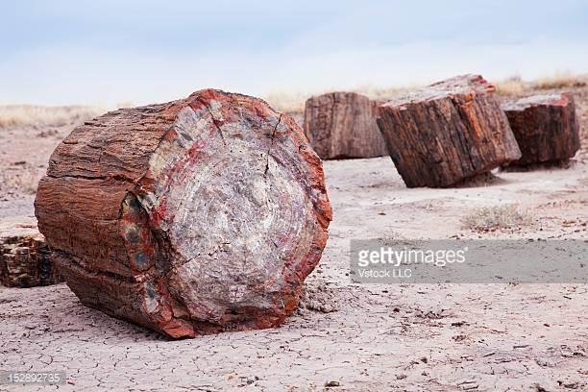
Permineralization
(Petrification) process whereby porous skeletons are made denser and heavier by precipitation of minerals by ground water in the open spaces or pores of the skeletons. E.g. calcite, silica and glauconite
•

Slide 7
Recrystalization
Refers to the process whereby the shell undergoes reorganization that partly or destroys the original microstructure
•
material
completely
•
This is a common phenomenon in shells which were
originally aragonite and/or calcite (both forms of
calcium carbonate- CaCO3).
– Examples, both of which are now calcite, include a gastropod which was originally aragonite and a brachiopod which was originally calcite

Slide 8
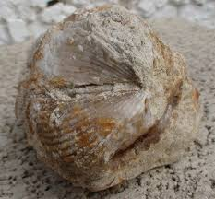

Slide 9
Replacement
Refers to mineral substances being substituted for the hard
parts (sometimes even soft part) of organisms, probably by
simultaneous solution and precipitation.
•
–
–
–
Pyrite (FeS2) frequently replaces shells: pyritization.
Calcite may replace silica, calcite and aragonite:calcification.
Dolomite (CaMg(CO₃)₂) may replace calcite or aragonite shells:
dolomitization.
Replacement may be done by iron minerals such as hematite or limonite.
Silica (chalcedony and quartz) commonly replaces calcareous skeletons: silicification.
Other carbonates (siderite, rhodochrosite) may also replace shells, though less commonly: calcification.
–
–
–

Slide 10
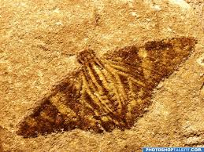
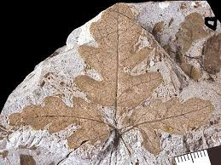
Carbonization
Involves a decrease in volatile constituents of tissues and chitin such as hydrogen, oxygen and nitrogen, leaving a thin film of carbon. E.g. graptolites, plant remains
•

