Slide 1
Layers of Earth

Slide 2
Composition of Earth
Earth Has 4 main systems that interact:
Earth’s systems
Atmosphere
Air/gases
Hydrosphere
water
Biosphere
life
Geosphere
land/rock

Slide 3
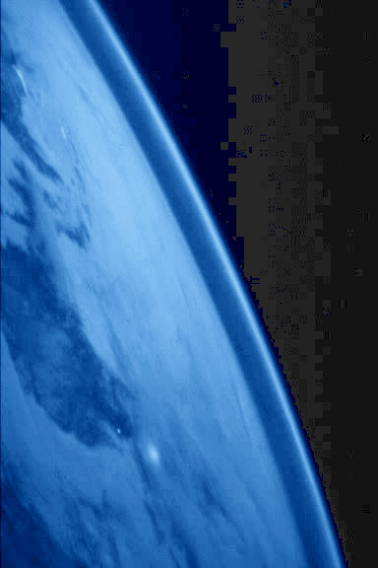
The Atmosphere– layer of gas that surrounds Earth more commonly known as “air”.

Slide 4
Composition of Earth
Earth Has 4 main systems that interact:
The Atmosphere
Mostly Nitrogen and Oxygen→
Water vapor is responsible for clouds and precipitation
Has layers
Protects us from meteors and comets, x-rays, gamma rays, ultra violet light

Slide 5
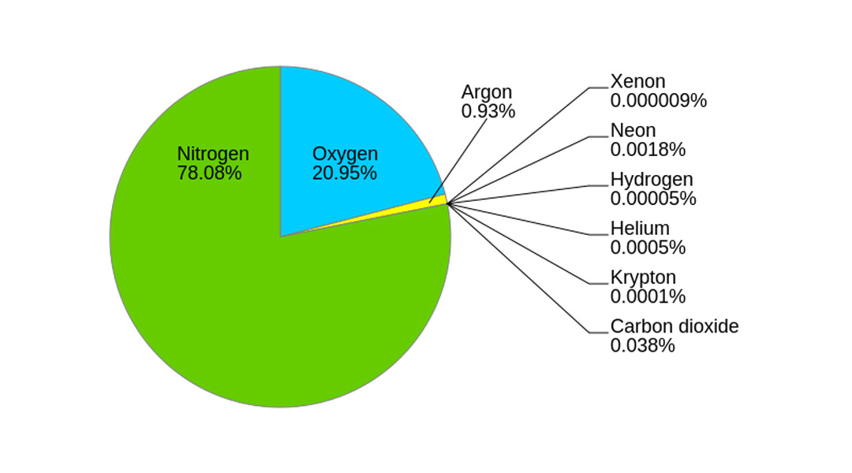

Slide 6
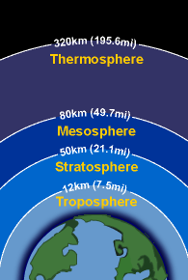
Composition of Earth’s atmosphere
The Atmosphere
layers
Exosphere
Thermosphere
Mesosphere
Stratosphere
Troposphere
Exosphere

Slide 7
Composition of Earth’s atmosphere
Earth Has 4 main systems that interact:
The Atmosphere
Troposphere
Contains most clouds and weather.
Temperature cools as go higher 50% of sun’s energy passes through, 50% is reflected back.
Most of the troposphere’s heat is from Earth (convection).
As the altitude increases, the air temperature decreases.
Exosphere

Slide 8
Composition of Earth’s atmosphere
Stratosphere
10 km to 50 km
contains ozone that absorbs much of the Sun’s ultraviolet radiation.
Gets warmer as go up.

Slide 9
Composition of Earth’s atmosphere
Mesosphere
50-85 km
The coldest part of the atmosphere. It can get down to -90°C in the mesosphere.
As the altitude increases, the air temperature decreases.

Slide 10
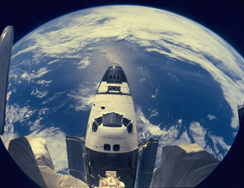
Composition of Earth’s atmosphere
Thermosphere
80-500 km
Temperatures increase up to 1,700°C
Filters out x-rays and gamma rays from the sun.
The space shuttle orbits in the thermosphere of the Earth.

Slide 11
Exosphere
The last layer of the atmosphere
Difficult to tell where it stops and space begins
Very few atoms in this layer of the atmosphere

Slide 12
Ionosphere
Within the mesosphere and thermosphere is a layer of electrically charged particles. This layer allows radio waves to travel across the country to another city.
The region beyond the ionosphere is known as the exosphere.

Slide 13
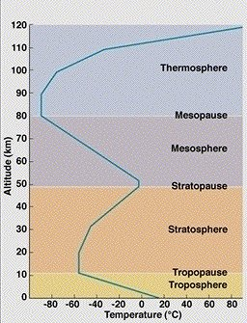

Slide 14
Hydrosphere

Slide 15
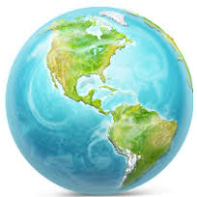
Hydrosphere
Oceanic waters
Oceans
Seas
Continental waters
Rivers
Icebergs
Lakes
Underground water

Slide 16
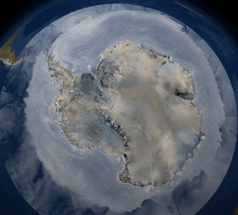
Cryosphere
Sea ice
Lake ice
River ice
Snow cover
Glaciers
Ice caps
Ice sheet
Frozen ground

Slide 17
THE EARTH’SHYDROSPHERE: Distribution of Water on Earth
Volume
Percent of Total
OCEANS 1,350 x 10¹⁵ m³ 97.2
CRYOSPHERE 29 x 10¹⁵ m³ 2.1
(Glaciers & Polar Ice)
UNDERGROUND 8.4 x 10¹⁵ m³ 0.6
(Aquifers)
LAKES & RIVERS 0.2 x 10¹⁵ m³ 0.01
ATMOSPHERE 0.013 x 10¹⁵ m³ 0.001
BIOSPHERE 0.0006 x 10¹⁵ m³ 4 x 10⁻⁵

Slide 18
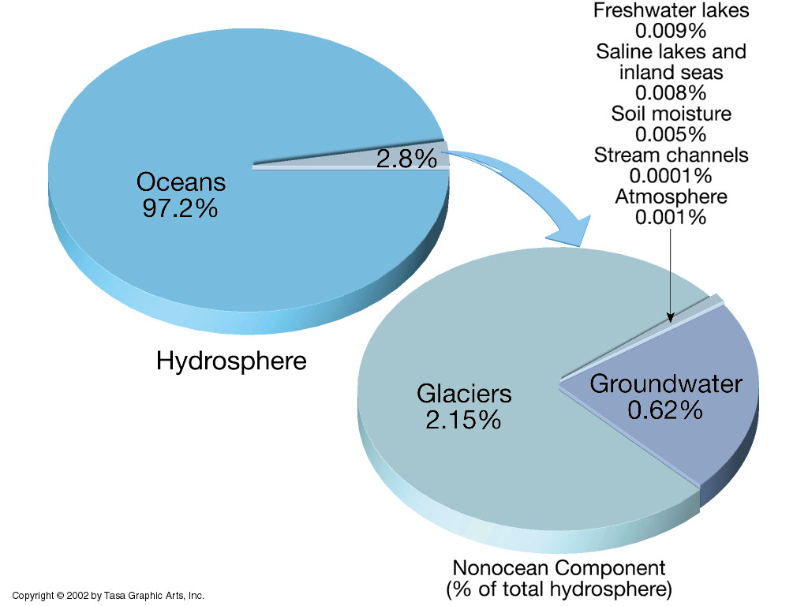
Distribution of Water on Earth

Slide 19
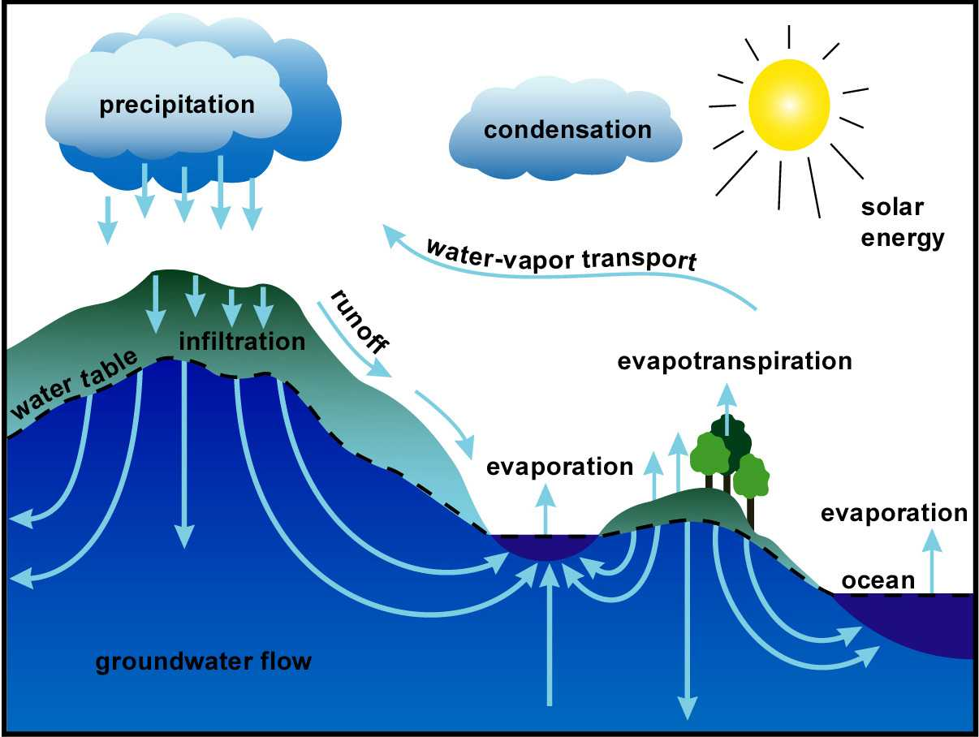
Water cycle

Slide 20
Biosphere
Producers
Consumers
Decomposers

Slide 21
