Slide 1
Glycolysis
Glycolysis is the central pathway for the glucose catabolism in which glucose (6-carbon compound) is converted into pyruvate (3-carbon compound) through a sequence of 10 steps.
Glycolysis takes place in both aerobic and anaerobic organisms and is the first step towards the metabolism of glucose.

Slide 2
Glycolysis
The glycolytic sequence of reactions differs from one species to the other in the mechanism of its regulation and the subsequent metabolic fate of the pyruvate formed at the end of the process.
In aerobic organisms, glycolysis is the prelude to the citric acid cycle and the electron transport chain, which together release most of the energy contained in glucose.

Slide 3
Glycolysis equation
A summary of the process of glycolysis cab be written as follows:
C₆H₁₂O₆ + 2ADP + 2Pi + 2NAD⁺ →
2C₃H₄O₃ + 2H₂O + 2ATP + 2NADH + 2H⁺

Slide 4
Glycolysis enzymes
In most kinds of cells, the enzymes that catalyze glycolytic reactions are present in the extra-mitochondrial fraction of the cell in the cytosol.
One common characteristic in all the enzymes involved in glycolysis is that nearly all of them require Mg²⁺.

Slide 5
The following are the enzymes that catalyze different steps throughout the process of glycolysis:
Hexokinase
Phosphoglucoisomerase
Phosphofructokinase
Aldolase
Phosphotriose isomerase
Glyceraldehyde 3-phosphate dehydrogenase
Phosphoglycerate kinase
Phosphoglycerate mutase
Enolase
Pyruvate kinase

Slide 6
Glycolysis steps
The ten steps of glycolysis occur in the following sequence:

Slide 7
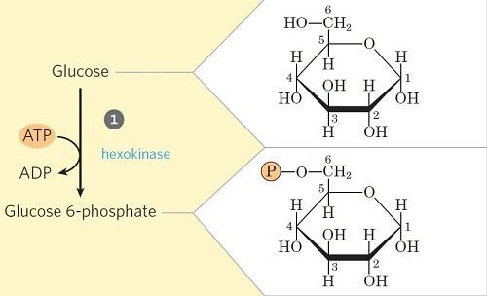
Step 1- Phosphorylation of glucose

Slide 8
Step 1- Phosphorylation of glucose
In the first step of glycolysis, the glucose is initiated or primed for the subsequent steps by phosphorylation at the C₆ carbon.
The process involves the transfer of phosphate from the ATP to glucose forming Glucose-6-phosphate in the presence of the enzyme hexokinase and glucokinase (in animals and microbes).
This step is also accompanied by considerable loss of energy as heat.

Slide 9
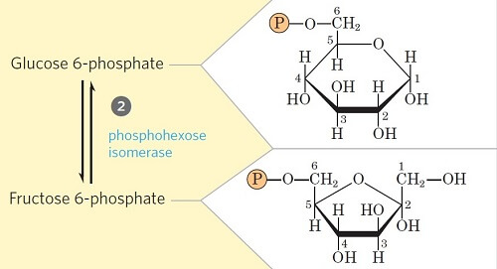
Step 2- Isomerization of Glucose-6-phosphate
Glucose 6-phosphate is reversibly isomerized to fructose 6-phosphate by the enzyme phosphohexoisomerase/phosphoglucoisomerase.
This reaction involves a shift of the carbonyl oxygen from C1 to C2, thus converting an aldose into a ketose.

Slide 10
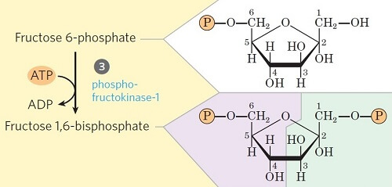
Step 3- Phosphorylation of fructose-6-phosphate
This step is the second priming step of glycolysis, where fructose-6-phosphate is converted into fructose-1,6-bisphosphate in the presence of the enzyme phosphofructokinase.
Like in Step 1, the phosphate is transferred from ATP while some amount of energy is lost in the form of heat as well.

Slide 11
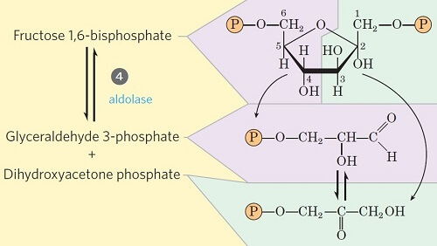
Step 4- Cleavage of fructose 1, 6-diphosphate

Slide 12
Step 4- Cleavage of fructose 1, 6-diphosphate
This step involves the unique cleavage of the C-C bond in the fructose 1, 6-bisphosphate.
The enzyme fructose diphosphate aldolase catalyzes the cleavage of fructose 1,6-bisphosphate between C₃ and C₄ resulting in two different triose phosphates: glyceraldehyde 3-phosphate (an aldose) and dihydroxyacetone phosphate (a ketose).
The remaining steps in glycolysis involve three-carbon units, rather than six carbon units.

Slide 13
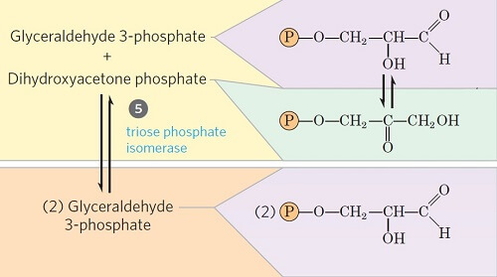
Step 5- Isomerization of dihydroxyacetone phosphate

Slide 14
Step 5- Isomerization of dihydroxyacetone phosphate
Glyceraldehyde 3-phosphate can be readily degraded in the subsequent steps of glycolysis, but dihydroxyacetone phosphate cannot be. Thus, it is isomerized into glyceraldehyde 3-phosphate instead.
In this step, dihydroxyacetone phosphate is isomerized into glyceraldehyde 3-phosphate in the presence of the enzyme triose phosphate isomerase.
This reaction completes the first phase of glycolysis.

Slide 15
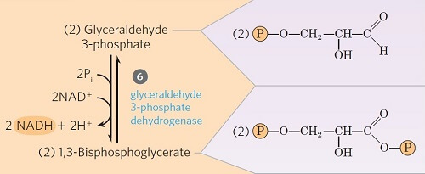
Step 6- Oxidative Phosphorylation of Glyceraldehyde 3-phosphate

Slide 16
Step 6- Oxidative Phosphorylation of Glyceraldehyde 3-phosphate
Step 6 is one of the three energy-conserving or forming steps of glycolysis.
The glyceraldehyde 3-phosphate is converted into 1,3-bisphosphoglycerate by the enzyme glyceraldehyde 3-phosphate dehydrogenase (phosphoglyceraldehyde dehydrogenase).
In this process, NAD⁺ is reduced to coenzyme NADH by the H– from glyceraldehydes 3-phosphate.
Since two moles of glyceraldehyde 3-phosphate are formed from one mole of glucose, two NADH are generated in this step.

Slide 17
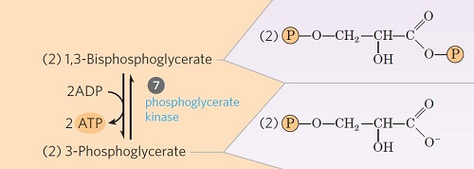
Step 7- Transfer of phosphate from 1, 3-diphosphoglycerate to ADP
This step is the ATP-generating step of glycolysis.
It involves the transfer of phosphate group from the 1, 3-bisphosphoglycerate to ADP by the enzyme phosphoglycerate kinase, thus producing ATP and 3-phosphoglycerate.
Since two moles of 1, 3-bisphosphoglycerate are formed from one mole of glucose, two ATPs are generated in this step.

Slide 18
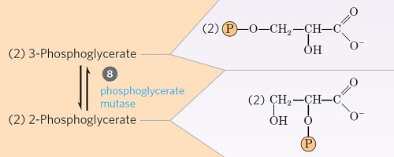
Step 8- Isomerization of 3-phosphoglycerate
The 3-phosphoglycerate is converted into 2-phosphoglycerate due to the shift of phosphoryl group from C3 to C2, by the enzyme phosphoglycerate mutase.
This is a reversible isomerization reaction.

Slide 19
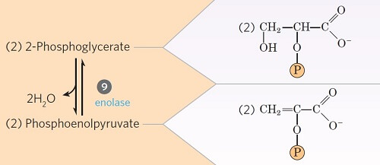
Step 9- Dehydration 2-phosphoglycerate
In this step, the 2-phosphoglycerate is dehydrated by the action of enolase (phosphopyruvate hydratase) to phosphoenolpyruvate.
This is also an irreversible reaction where two moles of water are lost.

Slide 20
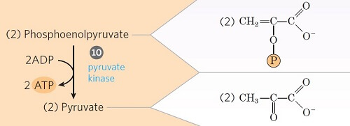
Step 10- Transfer of phosphate from phosphoenolpyruvate

Slide 21
Step 10- Transfer of phosphate from phosphoenolpyruvate
This is the second energy-generating step of glycolysis.
Phosphoenolpyruvate is converted into an enol form of pyruvate by the enzyme pyruvate kinase.
The enol pyruvate, however, rearranges rapidly and non-enzymatically to yield the keto form of pyruvate (i.e. ketopyruvate). The keto form predominates at pH 7.0.
The enzyme catalyzes the transfer of a phosphoryl group from phosphoenolpyruvate to ADP, thus forming ATP.

Slide 22
Result of Glycolysis
The overall process of glycolysis results in the following events:
Glucose is oxidized into pyruvate.
NAD⁺ is reduced to NADH.
ADP is phosphorylated into ATP.

