Slide 1
The biosphere: populations, communities, ecosystem and biogeochemical cycles course title: introduction to environment
Lecture no. 1
Lecturer: Dr. Saffora Riaz
M.Sc. II (evening) 2018-2020
Lahore College for women University
Lahore

Slide 2
Environment:
All the living things that surrounds us
Air, land, oceans and all living things
Environment
Physical environment
Biological environment
solid
Include all the living things
liquid
gas

Slide 3
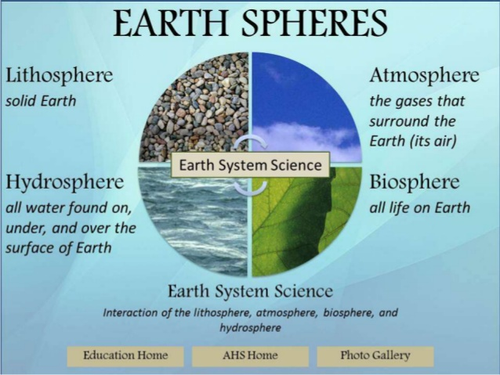
Environment
Four spheres” compose Natural environment
1 Lithosphere_lithos (rocks)
2 Hydrosphere_hydro (water)
3 Atmosphere_atmos (vapor)
4 Atmosphere_bios (life)
These spheres form outermost
layer of earth

Slide 4
Three major points
1. four spheres make the Earth Dynamic Planet
Lithosphere create rocks by internal heat engine
Atmosphere weathers & degrades rocks by chemically reactive gasses
Hydrosphere erode rocks & transport them as sediments deposit in ocean basins

Slide 5
continuoue
2. Spheres closely interact with one another
Gases released from litho + biosphere to atmosphere
3. Dynamic and interactive sphere evolved through time
Earth is about 4.6 billion Y/O
Lithosphere originated 4 billion years ago
Atmosphere originates 3.8 billion years ago
Biosphere originates at least 3.5 billion years

Slide 6
Major Aspects of Physical Environment
Earth almost covered with water
Atmosphere composed of
N2 (78.1%)
O2 (20.9%)
Atmosphere composed an envelope around earth

Slide 7
Conti…….
Separated from each other on the basis of temp.
Atmospheric Envelope
Troposphere
stratosphere
Mesosphere
Thermosphere

Slide 8
Conti…..
Earth is an open system in term of Energy Flow
30% of solar energy reflected back to space
19% absorbed by water vapors
51% reaches to earth
Less then 1% photosynthesis

Slide 9
Hydrologic cycle
Movement of water on earth surface constitutes the Hydrological Cycle
97.4% water in ocean and seas
remaining found in form of ice caps, ground water
Role
shifting of water over the earth
weathering and decomposition of rocks

Slide 10
Biosphere interactions
Ecology
How the organisms interacts with each other and to their physical environment
Organisms grouped in
Populations
communities
ecosystem
communities
Biosphere

Slide 11
Population Dynamic
Population
Group of individuals of same species living at same place at same time
Population under go three distinct phases
1) Growth available resources exceed number individuals able to exploit them
2) Stability environment becomes saturated with the population
3) Decline inevitable decrease in number of individuals that leads to extinction

Slide 12
Conti…..
All phases affected by many of factors
How these factors interact is called Population Dynamics

Slide 13
Growth of populations
All populations have one key trait common
Grow exponentially, if left unchecked
Intrinsic rate of increase (r)
potential for increase of a give population
varies among populations by several factors (death and birth rate)
Intrinsic rate of increase = Birth rate Death rate

Slide 14
Population stability: Regulation of Growth
Growth limited by complex interaction of many factors (including other species)
For example
Take microbes in a glass
Individuals will experience rapid growth (first admitted)
At a point, space and food becomes limited
Multiplication growth enters to slower growth
Continually slow until it reach to population size stabilizes, depends on Carrying capacity

Slide 15
Four basic Abundance controls
Factor external to population limits reproductive and survival rate
Two basic categories of environment that effect population
1 2
Physical environment
Biological environment
Physical limitation
symbiosis
predation
competition

Slide 16
Limitations of Physical environment
Water supply
Space availability
Soil
Light
Physical environment’s constrains can determined by habitat of population
Example
Remaining Florida Panther population lives in a wetland habitat including the Florida Everglades
Growth is limited by the resources in the shortest supply (Justus Leibig, 1840)

Slide 17
Biological Environment
1 Competition
occurs when both populations require same limited resource
Exploitative/ scramble competition
both competing population have equal access to resource
Interference competition
one of the competitors prevents the other from gaining access

Slide 18
Conti……
Competition determined by organism’s niche
Niche how the organism fits into local “system”
Competition Exclusion
Niche overlap is very great and competition is so intense that one species eliminates the second species from an area
Example
Paramecium aurelia and closely related species

Slide 19
conti….
Ecological release
one of the two competing species removed, remaining may increase in number
2. Predation
one organism consume other living organisms
prey on animals prey on plants
Predation
carnivores
herbivores

Slide 20
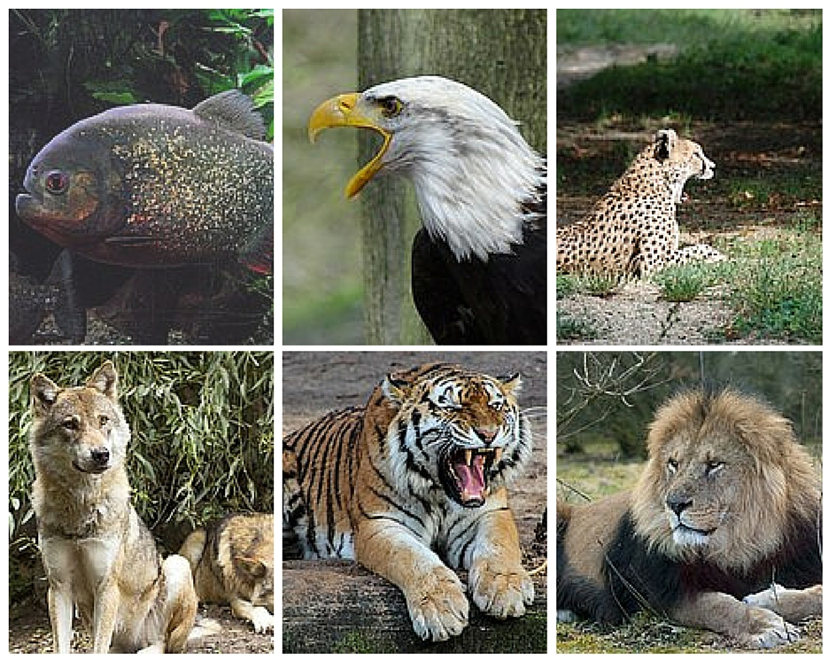
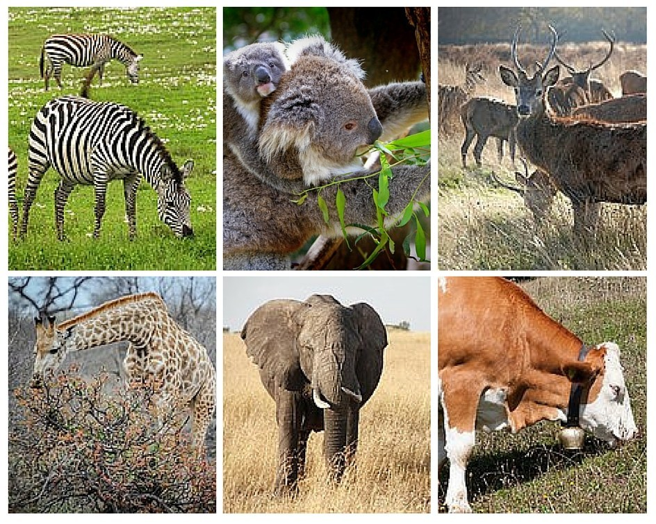
Carnivores
Herbivores

Slide 21
Conti……..
Predation leads to extinction
More commonly, predation limits abundance, do not drive prey to extinction
Prey species have protective traits
camouflage
poisons
spines
large size
if prey become scarce, predator switch to other prey
Allow the first prey to rebound in numbers

Slide 22
Symbiosis
Living together, include many kind of interaction, competition and predation
Mutualism
benefits both species
e.g., coral reef and algae exist in mutualistic relation, supply shelter and food to each other
Parasitism
One species benefits while harming other
Similar to predation

Slide 23
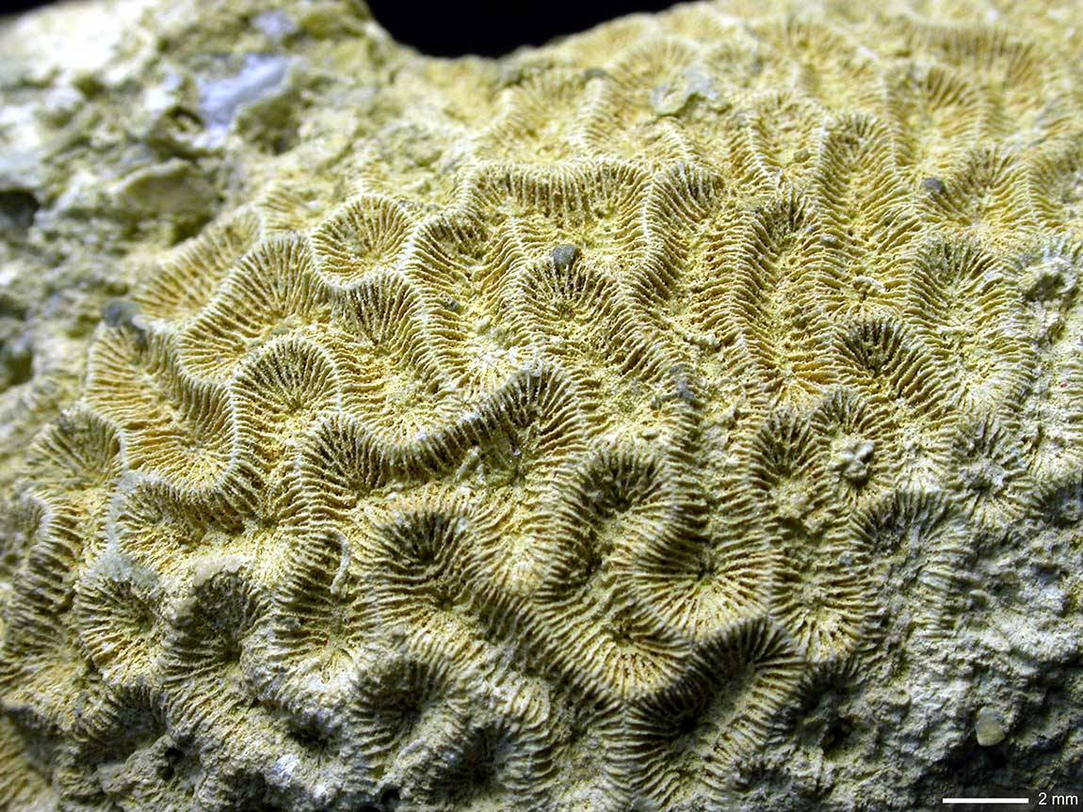
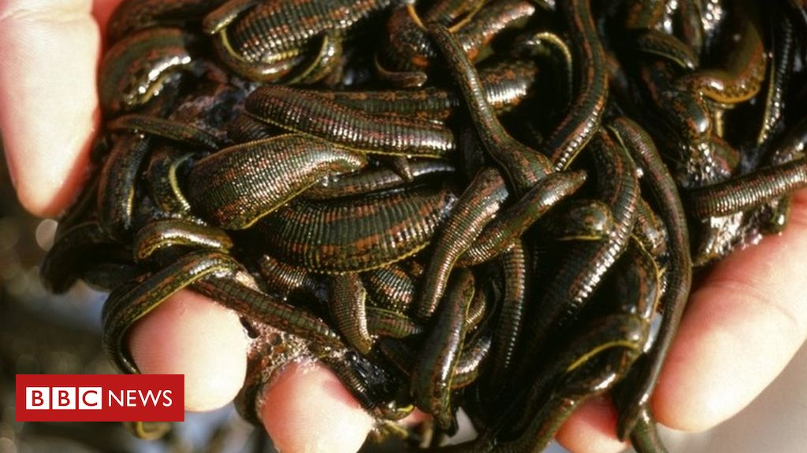
Mutualism Parasitism
Coral reef and algae
Parasites, such as leeches, often do not kill their hosts
.

Slide 24
Commensalism
One species benefits other neither infected nor benefited
E.g., Spanish moss hangs from trees for support, cause trees no harm or benefit
Amensalism
one inhabit another while being uninfected itself and accidentally harm the other
E.g., elephant crash vegetation, while gaining few benefit

Slide 25
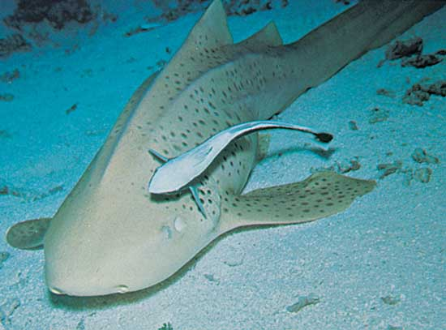
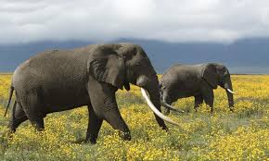
commensalism
Amensalism

Slide 26
Population decline
Extinction
Elimination of all individuals in a group from an area
Earth’s energy budget
The flow of all Pathways of all energy on Earth
Nonrenewable resources
Take too long to form
e.g., Fossil Fuel
Renewable resources
can be recycle easily
e.g., solar energy, tidal energy

Slide 27
