Slide 1
BIOSTATISTICES Definition, Scope and Applications

Slide 2
Statistics
It is the science which deals with collection, classification and tabulation of numerical facts as the basis for explanation, description and comparison of phenomenon.
- Lovitt

Slide 3
BIOSTATISTICS
Biostatistics can be defined as the application of the mathematical tools used in statistics to the fields of biological sciences and medicine. Biostatistics is a growing field with applications in many areas of biology including epidemiology, medical sciences, health sciences, educational research and environmental sciences.
It is the science that helps in managing medical uncertainties.
Notes:
Is an applied branch of statistics is very heavily utilized for medical research methodology.

Slide 4
Branches of Biostatistics
Descriptive Biostatistics
Methods of producing quantitative summaries of information in biological sciences.
Tabulation and Graphical presentation
Notes:
Concerned with the presentation , organisation and summarization of data

Slide 5
Branches of Biostatistics…
Inferential Biostatistics
Methods of making generalizations about a larger group based on information about a sample of that group in biological sciences.
Primarily performed in two ways:
Estimation
Testing of hypothesis
Notes:
Are used to generalize the data from sample to a larger group of patients

Slide 6
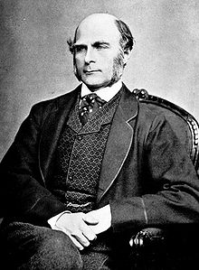
HISTORY
Sir Francis Galton
is considered as the
Father of Biostatistics.

Slide 7
He was the first to apply statistical methods to the study of human differences and inheritance of intelligence, and introduced the use of Questionnaires and Surveys for collecting data on human communities, which he needed for genealogical and biographical works and for his anthropometric studies.

Slide 8
Basis of Biostatistics

Slide 9
Intrinsic variation as a source of medical uncertainties
Biological due to age, gender, heredity, height, weight etc. Also due to variation in anatomical, physiological and biomechanical parameters.
Environment due to nutrition, smoking, pollution, facilities of water and sanitation, road traffic, stress and strain etc.

Slide 10
Everything in medicine be it research, diagnosis or treatment, depends on counting or measurement.
High or low blood pressure has no meaning, unless it is expressed in figures.
Thus medical statistics or biostatistics can be called Quantitative medicine.

Slide 11
In nature, blood pressure, pulse rate, action of a drug or any other measurement or counting varies not only from person to person but also from group to group.
Variation more than natural limits may be pathological, i.e., abnormal due to the play of certain external factors. Hence biostatistics may also be called a science of variation.

Slide 12
It is the science which deals with development and
application of the most appropriate methods for the:
Collection of data.
Presentation of the collected data.
Analysis and interpretation of the results.
Making decisions on the basis of such analysis.

Slide 13
ROLE OF BIOSTATISTICIANS
Identify and develop treatments for disease and estimate their effects.
Identify risk factors for diseases.
Design, monitor, analyze, interpret, and report results of clinical studies.
Develop statistical methodologies to address questions arising from medical/public health data.
Locate , define & measure extent of disease
Ultimate objective → improve the health of individual & community

Slide 14
Scope of Biostatistics
Research starts from a problem. You have to find out a problem from surrounding to investigate.
We have to conduct experiment or collect data about the problem.
When we conduct an experiment or collect a data, our purpose is to conclude something from it.
To organize our data or experimental results and to reach a conclusion, we need statistics which is in the case of biological data it is biostatistics.
Application of biostatistical methods is a requirement for publication of research work.

Slide 15
APPLICATIONS OF BIOSTATISTICS
To define what is normal or healthy in a population.
To find the limits of normality in variables such as weight and pulse rate etc. in a population.
To find the difference between means and proportions of normal at two places or in different periods.
e.g : The mean height of boys in Gujarat is less than the mean height in Punjab. whether this difference is due to chance or a natural variation or because of some other factors such as better nutrition playing a part, has to be decided.

Slide 16
IN PHARMACOLOGY

Slide 17
To find the action of drug – a drug is given to animals or humans to see whether the changes produced are due to the drug or by chance.

Slide 18
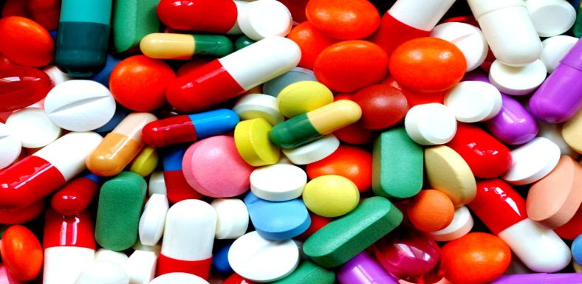
To compare the action of two different drugs or two successive dosages of the same drug.
To find the relative potency of a new drug with respect to a standard drug.

Slide 19
IN MEDICINE

Slide 20
To compare the efficacy of a particular drug, operation or line of treatment – for this, the percentage cured, relieved or died in the experiment and control groups, is compared and difference due to chance or otherwise is found by applying statistical techniques.

Slide 21
Clinical Study
Documentation of medical history of diseases.
Planning and conduct of clinical studies.
Evaluating the merits of different procedures.
In providing methods for definition of ‘normal’ and ‘abnormal’.

Slide 22
Preventive Medicine
To provide the magnitude of any health problem in the community.
To find out the basic factors underlying the ill-health.
To evaluate the health programs which was introduced in the community(success/failure).
To introduce and promote health legislation.

Slide 23
Epidemiology and biostatistics
Epidemiology and biostatistics are the basic sciences of public health.
Public health investigations use quantitative methods.
Epidemiology is about the understanding of disease development and the methods used to uncover the etiology, progression, and treatment of the disease.
Information (data) is collected to investigate a question.
The methods and tools of biostatistics are used to analyze the data to aid decision making.

Slide 24
In epidemiological studies – the role of causative factors is statistically tested.
Deficiency of iodine as an important cause of goiter in a community is confirmed only after comparing the incidence of goiter cases before and after giving iodized salt.

Slide 25
Role of Quantitative Methods in Public Health
Address a public health question
Generate a hypothesis.
Based on observations or anecdotal evidence (not scientifically tested).
Based on results of prior studies.
− Examples of a hypothesis. The risk of developing lung cancer remains constant in the last five years .
The use of a cell phone is associated with developing brain tumor.

Slide 26
Conduct a study
Survey study is used to estimate the extent of the disease in the population.
Surveillance study is designed to monitor or detect specific diseases.
Observational studies investigate association between an exposure and a disease outcome.
They rely on “natural” allocation of individuals to exposed or non-exposed groups.
Experimental studies also investigate the association between an exposure, often therapeutic treatment, and disease outcome.
Individuals are “intentionally” placed into the treatment groups by the investigators.

Slide 27
In Biotechnology
Biotechnology can focus on a whole range of topics, from genetic modification of plants and animals to gene therapy, medicine and drug manufacturing, reproductive therapy, and even energy production.
In all cases, research is carried out by developing something and testing whether or not it has the desired performance.
Determining performance requires statistical analysis of results.
Notes:
(through the bioengineering of bacteria and algae).

Slide 28
Agricultural Statistics
Agricultural statistics play an important role in country’s sustainable development.
Conventionally it was believed that agricultural statistics revolves around crop statistics.
Main parameters of agricultural statistics regarding crop are:
Crop area, Production, Yield
But now agricultural statistics cover statistics relating
Crops , live stock, fishery, forestry.

Slide 29
Purpose & Objective of Agricultural Statistics
To provide comprehensive knowledge of the basic information of agriculture, rural areas and the farmers.
To provide the scientific basis for the study of the development of economic and social development , planning and decision making.
To provide statistical information services to the planners, scholars and public.

Slide 30
Importance of Agricultural Statistics
Is of prime importance for agricultural industry.
Are important in designing development policies in the agricultural sector and the national economy at large.
Ascertain the crop production, crop yield, qualities of crop produced.
Furnish information about different operations and different methods which can be adopted for improving crop output.
Helps to compare the different yields of crops and quality check of crops.

Slide 31
In GENETICS
Statistics and Human Genetics are twin subjects, having grown with the century together, and there are many connections between the two.
Some fundamental aspects in particular the concept of Analysis of Variance, first arose in Human Genetics, while statistical and probabilistic methods are now central to many aspects of analysis of questions is human genetics.

Slide 32
The most common areas where one can find an extensive applications of statistical methods in human genetics is
* Human Genome Project
* Linkage Analysis
* Sequencing

Slide 33
Statistics supports the development of genomic resources
In accommodating sequencing errors for genome assembly
In rating the significance of sequence matches by alignment algorithms

Slide 34
Statistics supports analyses to determine the function of genes/transcripts/proteins
Gene regulation
Gene expression
Example: oxygen transport
According to the Gene Ontology (GO) project,
46 different genes are involved in this biological process

Slide 35
Statistics is critical in analyzing patterns of genomic variation within populations, and in relating this variation to disease states or other phenotypes
Genomes differ from the reference copy
(single nucleotide polymorphisms, structural variants)
Gene mapping by linkage and association methods

Slide 36
Statistics is critical in analyzing patterns of genomic variation between populations/species
Phylogenetic analysis

Slide 37
“Nothing in biology makes sense except in the light of evolution”
-T. Dobzhansky
Tree of life project

Slide 38
In NUTRITION
Nutritionists now have the advanced methodologies for the analysis of DNA, RNA, protein, low-molecular-weight metabolites, as well as access to bioinformatics databases.
Appropriate statistical analyses are expected to make an important contribution to solving major nutrition-associated problems in humans and animals (including obesity, diabetes, cardiovascular disease, cancer, ageing, and intrauterine growth retardation).

Slide 39
IN ENVIONMENTAL SCIENCE
Statistics with Populations
Use statistics to describe statistical populations
Statistics in everyday Life
Understanding the News
The news contains statistics in everyday life.
We have a 60% chance of rain today.

Slide 40
Thinking about risk
Probability of an unwanted outcome
You do it everyday
Not studying for a test
Scientists calculate the risk to large communities of people in order to inform policy decisions in government
Involve using data on historical events
Projections for the future
Scientific evidence for adverse outcomes
Ex. The risk of getting cancer when exposed to pollution

Slide 41
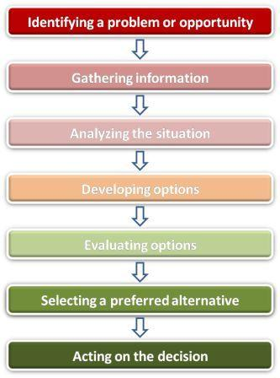
Environmental Decision-making model
Conceptual model that provides
a systematic process
for making decisions

Slide 42
How to use the Decision Making Model
Gather Information
Consider values
Explore consequences
Make your decision!

Slide 43
Computational Biology
Computational biology uses mathematical and informational techniques including statistics to solve biological problems.
By using computer programs or mathematical models or creating both.
One of the major areas of computational biology is data mining which includes the analysis of the data collected by several genome projects.
Genome projects are scientific projects that are utilized to map the genome of a living being.

Slide 44
Conclusion:
Bio-statistical techniques can assure that the results found in such a study are not merely because of chance.
In every case of our life, Statistics plays a major role for better gaining and accurate results.
A well-designed and properly conducted study is a basic prerequisite to arrive at valid conclusions.

Slide 45
REFERENCES
Biostatistics – A foundation for Analysis in the Health Sciences: Wayne W. Daniel, Seventh Edition, Wiley Students Analysis.
A First Course in Statistics with Application: A.K. P. C Swain, Kalyani Publishers
Methods in Biostatistics sixth edition : BK Mahajan
Fundamentals of Biostatistics : Sanjeev BS

