Slide 1
DEFINITION OF MATING
In biology mating is the pairing of either opposite sex or hermaphroditic organism , usually for the purpose of sexual reproduction.

Slide 2
MATING IN FROGS
In almost all frogs , eggs fertilization happens outside the females body instead of inside.
The female releases her eggs and male releases his sperms at the same time . In order to make sure that the sperms reach the eggs ,the male and female get into the mating posture called Amplexus

Slide 3
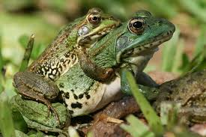

Slide 4
MATING SEASON OF FROGS
Common frogs breed in shallow , still , fresh water such as ponds , with spawning commencing sometime between March and late June, but generally in April over the main part of their range.

Slide 5
MATING IN BIRDS
Unlike mammals , most birds don’t have penises.Instead both male and female birds have cloacal.
During mating seasons, the cloacal openings of both male and female swell, protruding slightly outside their bodies .
When birds are feeling frisky , they rub their swollen cloacas together

Slide 6
Birds reproduce by internal fertilization , during which the egg is fertilized inside the female .
Like reptiles , birds have cloaca ,or a single exit and entrance for sperm , eggs and waste. The male brings his sperm to the female cloaca .The sperm fertilizes the eggs.

Slide 7
BIRDS USE COURTSHIP RITUALS
The inticrate moves of a mating dance and the charming songs used to woo partners can help distinguish species so birds are sure to choose genetically compatible mates.
Different courtship behaviour also reduce territorial aggression ,letting two birds relax together to form a pair bond.

Slide 9
MATING IN INSECTS
Internal fertilization by insertion of the male intromittent organ into the female genital track for deposition of sperm is the usually method of copulation .
The female then grasps one droplet with her genital opening , which leads to fertilization.

Slide 10
MATING BEHAVIOUR
Most insects reproduce oviparously i.e; by laying eggs.The eggs are produce by the female in a pair of ovaries. Sperm ,produced by the male in one testis or more commonly two ,is transmitted to the female during mating by means of external genitalia.
The sperm is stored with in the female in one or more spermathecae.

Slide 11
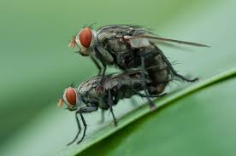

Slide 12
THANK YOU

