Slide 1
Blood Flow
Blood flow is movement of blood through a vassel,tissue,or organ.
Blood flow is denoted in terms of volume of blood flowing in unit time.
Ventrical conteraction is responsible for the blood flow from major arteries and result in flow of blood from higher pressure region to lower pressure regions.

Slide 2
BLOOD FLOW IN VERTIBRATES AND ANIMALS
In vertebrates and animals with a closed circulation, the blood flow in continuous circuit .
Water is incompressible, blood pumped by the heart causes the flow of equivalent volume in every part of the circulation.

Slide 3
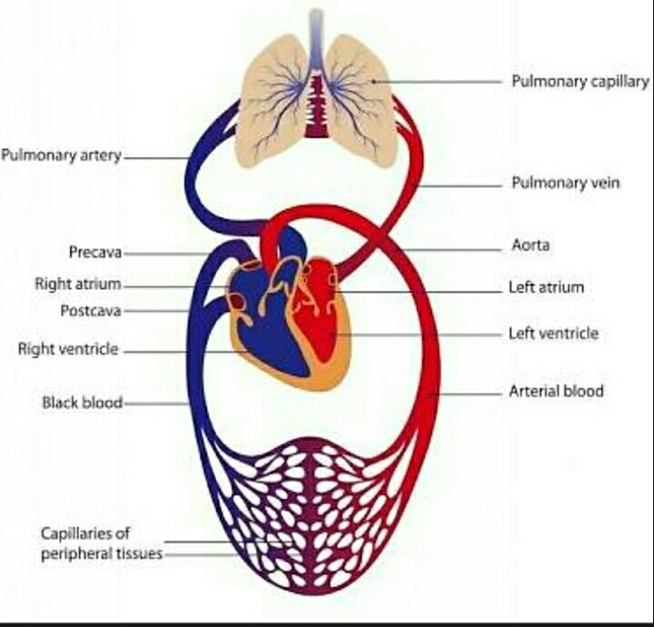
Circulation Of Blood

Slide 4
BLOOD VELOCITY
Blood velocity is inversely proportional to the cross-sectional area of the circulation at any given point.
Blood velocity is higest in the arteries and lowest in the capillaries the cross-section.

Slide 5
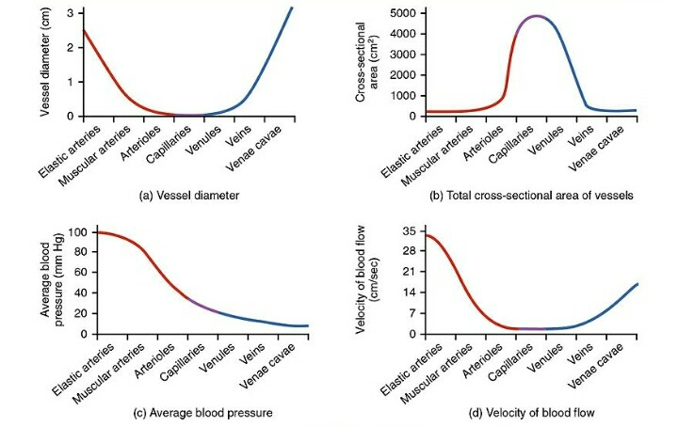

Slide 6
TYPES OF BLOOD FLOW
There are the two types of blood flow.
Continuous Laminar Flow.
Pulsatile Laminer Flow.

Slide 7
CONTINUOUS LAMINAR FLOW
In smaller vessels of the circulation, the blood flow is streamlined.
Such continuous laminar flow is characterized by a parabolic velocity profile across the vessel.
A thin layer of blood adjust to the vessel wall called the boundry layer.

Slide 8
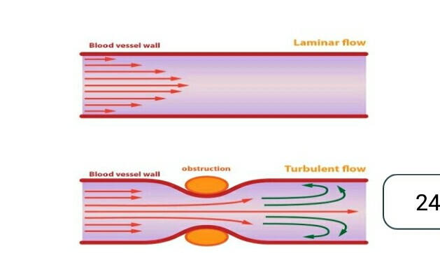
Continuous Laminar FLOW

Slide 9
PULSATILE LAMINAR FLOW
The pulsatile laminar flow characteristic of large arteries has more complex velocity profile than the laminar low.
In large arteries, blood is first accelerated and then slowed with each heartbeat.

Slide 10
Pulsatile Laminar Flow

Slide 11
BLOOD FLOW THROUGH BODY
As heart pumps blood through the entire ciuculatory system.
Oxygenated blood is pumped away from the heart to the rest of the body.
While,deoxygenated blood is pumped to the lungs where it is reoxygenated.

Slide 12
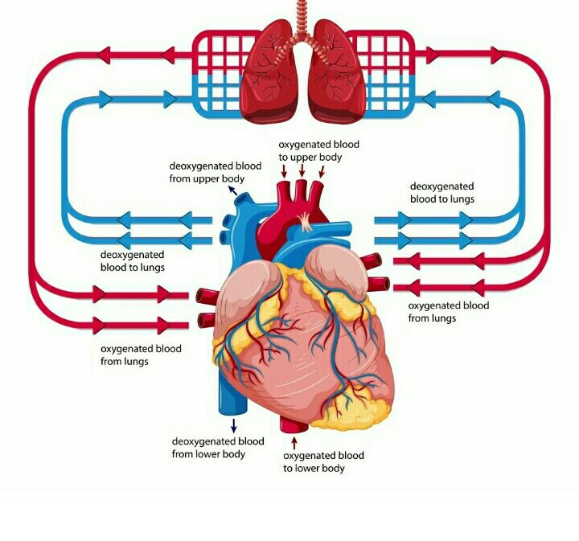
Blood Flow Through Body

Slide 13
BLOOD FLOW THROUGH HEART
The right atrium receive oxygen-poor blood from the body and pumps the right ventricle through the tricapsid.
The right ventricles pumps the oxygen poor blood lungs through the pulmonary valve.

Slide 14
Blood Flow Through Heart

Slide 15
BLOOD FLOW THROUGH LUNGS
Once blood travel through the pulmonic valves it enters in lungs.
At the same time carbon dioxide passes from the blood into the air sacs.
Once the blood is oxygenated it travels back to the left atrium through the pulmonary veins.

Slide 16
BLOOD FLOW THROUGH LUNGS

Slide 18
GENERAL PHYSIOLOGY-II
Topic: Relation Between Pressure And Resistance.
Presented By: Nasreen Akhtar
Roll No: 1925438041
Presented To: Dr. Safoora Riaz

Slide 19
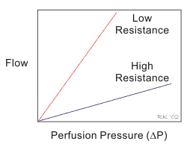
Relationship between pressure and flow Flow can occur between two sites where there is a difference between them in potential energy, which can be measured as a difference pressure.
Thus differences in pressure between two points.
1.Pressure Gradient.
2.Direct flow of high to low pressure.

Slide 21
Poiseuile,s Law It state that the flow rate of a fluid,Q,is directly proportional to the pressure difference P1-P2along the length of the tube r and inversely proportional to to the tube length L and viscosity

Slide 22
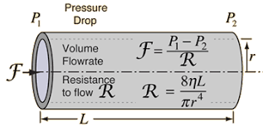
Resistance to Flow Vessel resistance(R) is directly proportional to the length (L)of the vessel and the viscosity of the blood, and inversely proportional to the radius to the fourth power…Therefore a vessel having twice the length of the another vessel will have twice the resistance flow.

Slide 23
Viscosity of flow The resistance to flow of a fluid and the resistance to the movement of an object through a fluid are usually stated in terms of the viscosity of the fluid… The constant of proportionality is called viscosity.

