Slide 1
Nonparametric Methods for Comparing Survival Distributions

Slide 2
Comparison of Two Survival Distribution
n₁=Patients who receive treatment 1
n₂=Patients who receive treatment 2
x₁,x₂,……x_{r1} =r₁ Failure observations in group 1
x_{r1+1},……x_{n1} =n₁-r₁ Censored observations in group 1
y₁,y₂,……y_{r2} =r₂ Failure observations in group 1
y_{r2+1},……y_{n2} =n₂-r₂ Censored observations in group 2

Slide 3
Hypothesis

Slide 4
Wilcoxon Test
The Wilcoxon test
weights the observed number of events minus the expected number of events by the number at risk across the event times
can be biased if the pattern of censoring is different between the groups.

Slide 5
Gehan’s Generalized Wilcoxen Test
Computation of R_{1i}
Rank from left to right omitting censored observations
Assign next higher rank to censored observations
Reduce the rank of tied observations to the lower rank for the value
R_{1i}
Computation of R_{2i}
Rank from right to left
Reduce the rank of tied observations to the lowest rank for the value
Reduce the rank of censored observations to 1
R_{2i}
U_{i}=R_{1i}- R_{2i}

Slide 6
Gehan’s Generalized Wilcoxen Test

Slide 7
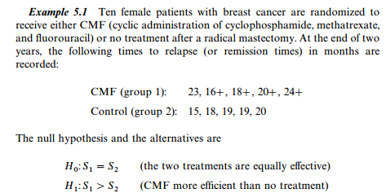

Slide 8
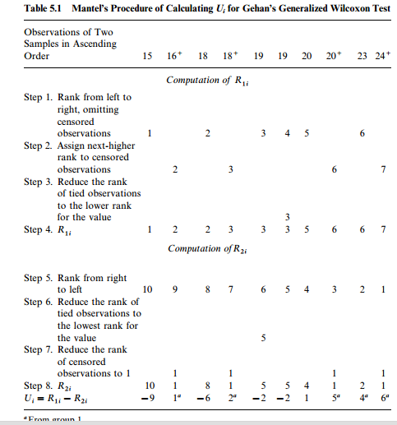

Slide 10
Cox Mantel Test
Arrange survival time in ascending order for two groups together
Compute m_{i}
Where m_{i} is the no. of failure times equal to t_{i},or multiplicity of t_{i .}So that
R(t)=risk set at time t (whose failure times are at least t)
be the n
o. of patients in R(t) that belongs to group 1 and 2
is the proportion of r_{i} That belongs to group 1

Slide 11
Cox Mantel Test

Slide 12
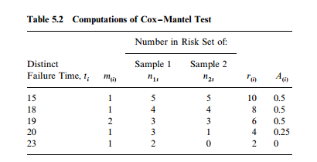
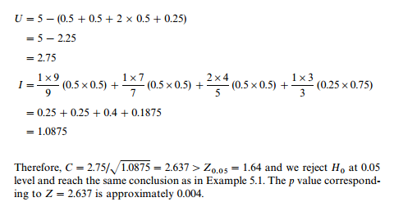

Slide 13
Log-Rank Test
The log-rank test
tests whether the survival functions are statistically equivalent
is a large-sample chi-square test that uses the observed and expected cell counts across the event times
has maximum power when the ratio of hazards is constant over time.

Slide 14
Log-Rank Test
Arrange survival times of both samples in ascending order together
Compute m_{i} and r_{i} for uncensored observations only
Take ratio of m_{i} /r_{i}
Compute
Calculate w_{i} scores suggested by Peto and Peto

Slide 15
Log-Rank Test

Slide 16
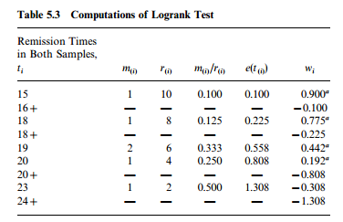
V(S)=1.210
L =2.751/ 1.210=2.5
p=0.0064

Slide 17
Log-rank test
Log-rank test is just a Cochran-Mantel-Haenszel chi-square test!
Anyone remember (know) what this is?

Slide 18
CMH test of conditional independence
Event
No Event
K Strata = unique event times
Group 1
a
b
Group 2
c
d
N_{k}

Slide 19
CMH test of conditional independence
Event
No Event
K Strata = unique event times
Group 1
a
b
Group 2
c
d
N_{k}

Slide 20
CMH test of conditional independence
Event
No Event
Group 1
a
b
How do you know that this is a chi-square with 1 df?
Group 2
c
d
Why is this the expected value in each stratum?
Variance is the variance of a hypergeometric distribution

Slide 21
Log-rank versus Wilcoxon Test
Log-rank test
is more sensitive than the Wilcoxon test to differences between groups in later points in time.
Wilcoxon test
is more sensitive than the log-rank test to differences between groups that occur in early points in time.

