Slide 1
Parametric Methods for Comparing Two Survival Distributions Chapter 10

Slide 2
LIKELIHOOD RATIO TEST FOR COMPARING TWO SURVIVAL DISTRIBUTIONS
Case 1. All parameters are unknown
CR:
Example (Weibull Distribution):
CR:

Slide 3
Case 2. A subset of the parameters of the two survival distributions are known and equal
known and equal
Comparing two Weibull distributions:
CR:

Slide 4
Case 3. A subset of the parameters of the two survival distributions are equal but unknown
If Known

Slide 5
Case 4. A subset of the parameters of the two survival distributions are known but not equal
Unequal

Slide 6
COMPARISON OF TWO EXPONENTIAL DISTRIBUTIONS
For both Censored/uncensored data
Likelihood ratio test
F-test suggested by Cox (1953

Slide 7
Likelihood Ratio Test
or
For

Slide 8
Example 10.1
Consider the remission data of the two treatment groups given in Example 5.1. The remission times in months are as follows: CMF: 23, 16+, 18+, 20+, 24+
Control: 15, 18, 19, 19, 20
Assume that the two distributions are exponential. Using the likelihood ratio test, test the following null hypothesis.

Slide 9
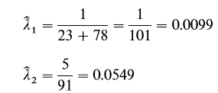
Example 10
1.
2. Computations:
Do not reject Ho
3. CR:

Slide 10
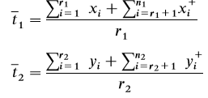
Cox’s F-Test for Exponential Distributions
Times to failure assumed to follow the exponential distribution in both treatment groups.
Whether or not censored observations are present.
Test Statistic:
1.CR:
2. CR:
3. CR:

Slide 11
Cox’s F-Test for Exponential Distributions
Test Statistic:
Confidence Interval:

Slide 12
Example 10.2 (Cox’s F-Test )
Thirty-six patients with glioblastoma multiforme were divided into two groups; the experimental group contained 21 patients who had surgery and chemotherapy, and the control group contained 15 patients who had surgery only. The survival times in weeks are available about one year after the start of the study (Burdette and Gerhan, 1970):
Experimental: 1, 2, 2, 2, 6, 8, 8, 9, 13, 16, 17, 29, 34, 2+,9+, 13+, 22+, 25+, 36+, 43+, 45+
Control: 0, 2, 5, 7, 12, 42, 46, 54, 7+, 11+, 19+, 22+, 30+, 35+, 39+

Slide 13
Example 10.2 (Cox’s F-Test )
1.
2. Computations:
Ho is not rejected.
3. CR:

Slide 14
Cox’s F-Test for Exponential Distributions
In the case of nonzero guarantee time, it can be subtracted from every observation in the group and the test then applied.
F-test is the most powerful test among the parametric or nonparametric tests

Slide 15
COMPARISON OF TWO WEIBULL DISTRIBUTIONS
If T follows Weibull distribution with parameter
then
follows Exponential distribution
If are known Cox’s F-test can be applied to the transformed observations.
If parameters unknown use likelihood ratio test

Slide 16
COMPARISON OF TWO WEIBULL DISTRIBUTIONS: Thoman and Bain (1969) for uncensored samples
Assume that independent random samples of equal size are obtained from Weibull distributions.
1.
2.Test Statistic:
3.
Table B-12
If
If above null Hypothesis is not rejected then Test other Parameter
Table B-13
Table B-13
Test Statistic:

Slide 17
COMPARISON OF TWO WEIBULL DISTRIBUTIONS: Thoman and Bain (1969) for uncensored samples (Generalized)
1.
2. Test Statistic:
3. Critical Value:
Table B-12

Slide 18
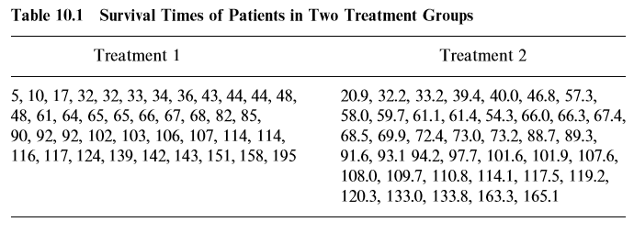
Example 10.3 The data are adapted and modiﬁed from Harter and Moore (1965).

Slide 19
Example 10.3
1.
2. Computations:
Reject at alpha=0.05
Test Statistic:
3. Critical Value:
1.
Do not reject Ho
2. Computations:
Test Statistic:
3. Critical Value:
B-13

Slide 20
COMPARISON OF TWO GAMMA DISTRIBUTIONS
1.
2. Test Statistic:
3. Critical Value:

Slide 21
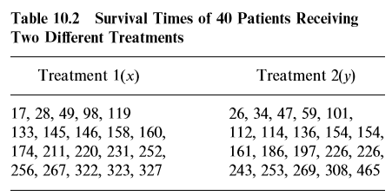
Example 10.4 : COMPARISON OF TWO GAMMA DISTRIBUTIONS
Consider the survival time of the two treatment groups in Table 10.2. The two populations follow the gamma distributions with a common shape parameter

Slide 22
Example 10.4 : COMPARISON OF TWO GAMMA DISTRIBUTIONS
1.
2. Test Statistic computations:
3. Critical Value:
Do not reject Ho

