Slide 1
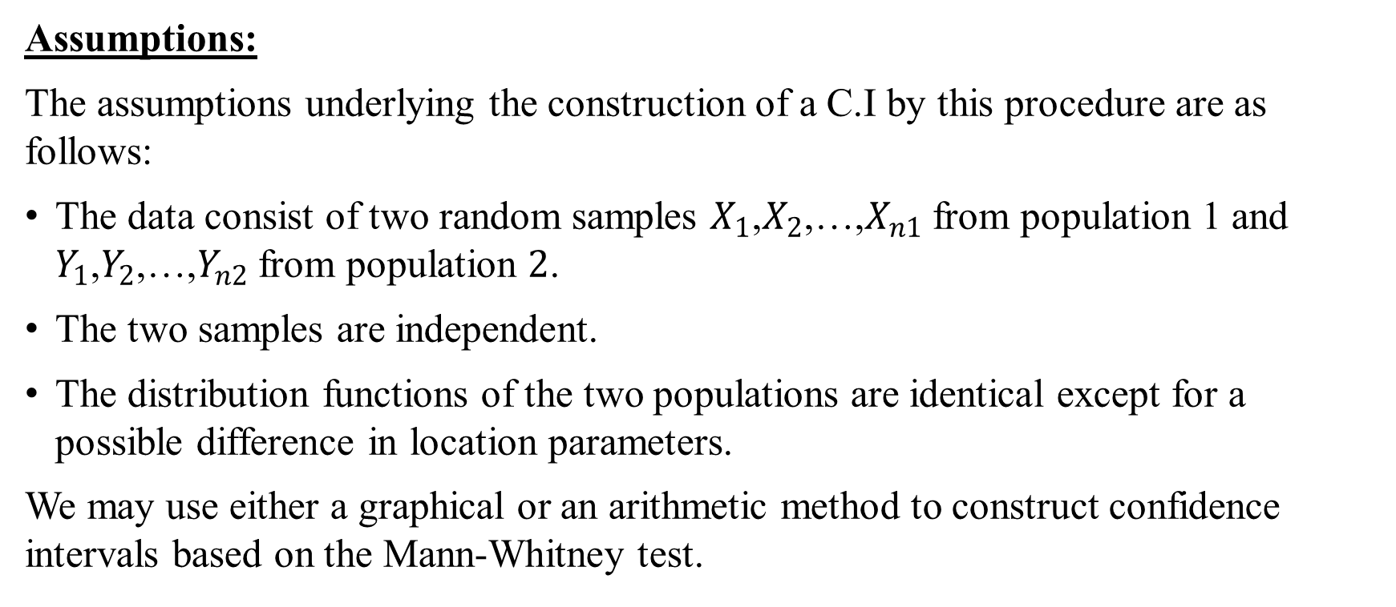
Confidence interval for difference between two location parameters:
Assumptions:
The assumptions underlying the construction of a C.I by this procedure are as follows:
The data consist of two random samples $X_{1}$,$X_{2}$,…,$X_{n1}$ from population 1 and $Y_{1}$,$Y_{2}$,…,$Y_{n2}$ from population $2$.
The two samples are independent.
The distribution functions of the two populations are identical except for a possible difference in location parameters.
We may use either a graphical or an arithmetic method to construct confidence intervals based on the Mann-Whitney test.

Slide 2
Graphical Method:
To use the graphical method:
We begin with an X-axis and a Y-axis intersecting at the origin(0,0). Both axes use the same scale.
We locate $n_{2}$ Y values on the vertical axis and draw lines parallel to the horizontal axis through their corresponding points. Similarly, we plot points corresponding to the X values on the horizontal axis and draw lines parallel to the vertical axis through these points.
The same constant may be subtracted from each value of X and Y to bring the lines closer to the origin.
We draw dots at each intersection of a horizontal line with a vertical line.
To represent any duplicate values of either variable, we can circle the first dot at an intersection once for each additional value.
Find $w_{α/2} f$or $n_{1}$and $n_{2}$.
Draw ${45}^{0}$ line leaving $w_{α/2}$ points on its left or on the line. Also, draw ${45}^{0}$ line leaving $w_{α/2}$ points on its right or on the line.
L: Point at which upper cuts U: Point at which lower cuts

Slide 3
Arithmetic Method:
The arithmetic method is easier to use, for this:
Arrange the values in each sample.
Find the differences by subtracting each Y value from each X Value and arrange the differences.
Find $w_{α/2}$ in Table A.7 corresponding to $n_{1}$ $n_{2}$ and $α/2$.
The lower limit L of the confidence interval is the $w_{α/2}$th the smallest difference, and the upper limit U is the $w_{α/2}$th largest difference.

Slide 4
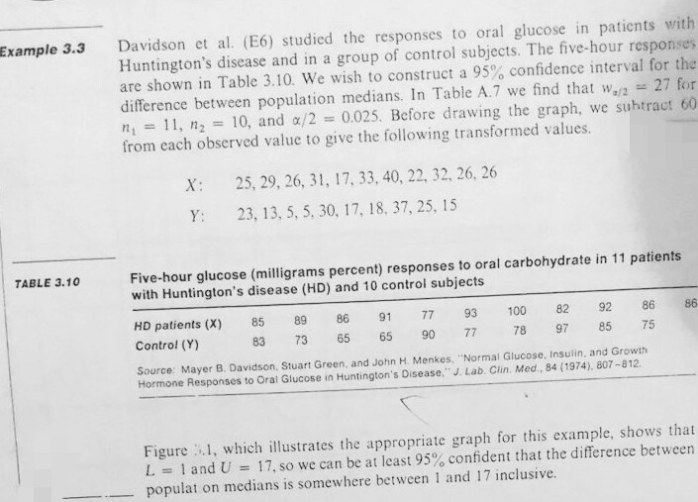
Example 3.3 from Daniel’s Book:

Slide 5
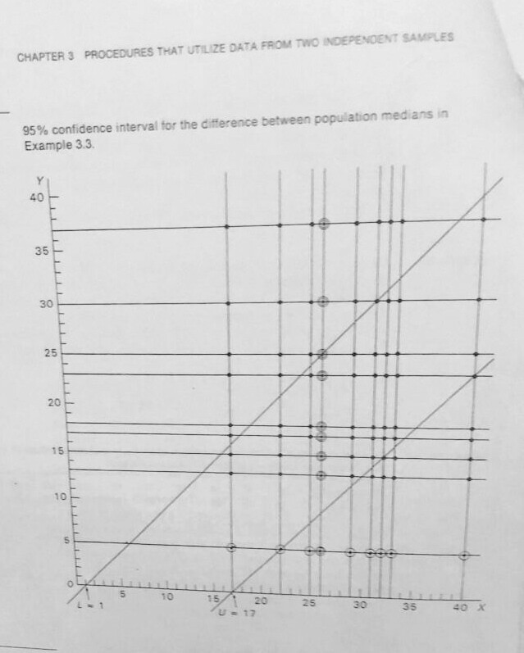
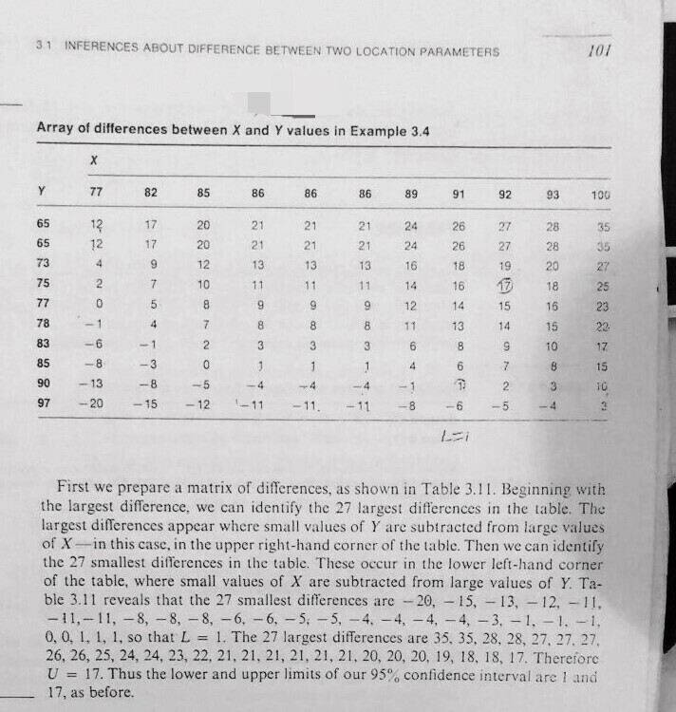
Graphical Method
Arithmetic Method

