Slide 1
Development Its concepts, Nature & Scope, Factors and Indicators : Social Development,Economic Development and Under Developmet

Slide 2
What is Development
Development is the sustained increase in income of all members of society so as to be free from material want. One aspect of that challenge is to achieve development in an interdependent world, that is a world in which goods, services, people, capital and knowledge flow relatively easily across national borders with large net benefits to economies (Trevor Manuel, 2 December 2004, University of Sussex).
Development is a good and positive change which can be measured in two dimensions; Economically and culturally.

Slide 3
Two Dimensions of Development
Social Development
Economic Development

Slide 4
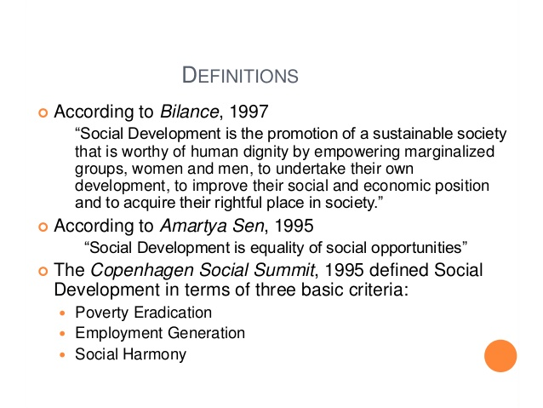
Social development is the progressive improvements in the living conditions and quality of life enjoyed by people of any society and society itself.

Slide 7
Economic Development

Slide 8
Economic Development
the economic development is a process in which the people in a country become wealthier , healthier, better educated and have greater access to good quality life
economic development takes into account the following information:
_{average life expectancy, i.e.,}
_{education standards.}
literacy rates, i.e., what percentage of the population can read.
_{environmental standards.}
availability of housing, plus the quality of housing.
access to healthcare. this takes into account the number of doctors per thousand people, access to affordable medicine, etc.
_{income per capita.}

Slide 12
Key Differences Between Developed and Developing Countries
The following are the major differences between developed countries and developing countries
The countries which are independent and prosperous are known as Developed Countries. The countries which are facing the beginning of industrialization are called Developing Countries.
Developed Countries have a high per capita income and GDP as compared to Developing Countries.
In Developed Countries the literacy rate is high, but in Developing Countries illiteracy rate is high.
Developed Countries have good infrastructure and a better environment in terms of health and safety, which are absent in Developing Countries.
Developed Countries generate revenue from the industrial sector. Conversely, Developing Countries generate revenue from the service sector.
In developed countries, the standard of living of people is high, which is moderate in developing countries.
Resources are effectively and efficiently utilized in developed countries. On the other hand, proper utilization of resources is not done in developing countries.
In developed countries, the birth rate and death rate are low, whereas in developing countries both the rates are high.

Slide 13
Basis for Comparison | Developed Countries | Developing Countries
Meaning | A country having an effective rate of industrialization and individual income is known as Developed Country. | Developing Country is a country which has a slow rate of industrialization and low per capita income.
Unemployment and Poverty | Low | High
Rates | Infant mortality rate, death rate and birth rate is low while the life expectancy rate is high. | High infant mortality rate, death rate and birth rate, along with low life expectancy rate.
Living conditions | Good | Moderate
Generates more revenue from | Industrial sector | Service sector
Growth | High industrial growth. | They rely on the developed countries for their growth.
Standard of living | High | Low
Distribution of Income | Equal | Unequal
Factors of Production | Effectively utilized | Ineffectively utilized
Comparison Chart

Slide 14
Thanks

