Slide 1
Quality Control of Vaccines
Pharm D 4TH prof
Sumera latif

Slide 2
What are vaccines
Vaccines for human use are preparations containing antigens capable of inducing a specific and active immunity in man against an infecting agent or the toxin or antigen elaborated by it.
Immune responses include the induction of the innate and adaptive (cellular, humoral) parts of the immune system.
Vaccines for human use may contain whole microorganisms (bacteria, viruses or parasites) inactivated by chemical or physical means that maintain adequate immunogenic properties; whole live microorganisms that are naturally avirulent or that have been treated to attenuate their virulence whilst retaining adequate immunogenic properties; antigens extracted from microorganisms or secreted by microorganisms or produced by genetic engineering or chemical synthesis.
The antigens may be used in their native state or may be detoxified or modified by chemical or physical means and may be aggregated, polymerized or conjugated to a carrier to increase their immunogenicity.
Vaccines may contain an adjuvant where the antigen is adsorbed on a mineral adjuvant, the vaccine is referred to as “adsorbed”.

Slide 3
Vaccines differ from chemical drugs
Vaccines can be easily distinguished from chemical pharmaceuticals due to their complex physical, chemical and molecular compositions
Moreover, the inherent variability of living organisms, the potential of contamination coming from starting materials and the environment must require strict control measures to ensure product consistency, safety and efficacy of each batch.
Not meeting the definition of generics – a specific terminology, biosimilar is used.
Their characteristics may vary from batch to batch therefore, each batch is considered to be unique
Test methods needed to characterize products are biological in nature
Bioassays
Potency (activity)
Immunogenicity
Safety
.

Slide 4
Available vaccines
Hepatitis A vaccine
Inactivated Polio vaccine
Tetanus vaccine
Diphtheria vaccine
Human Tetanus Immunoglobulin
Acellular Pertussis vaccine
Whole cell pertussis vaccine
Tetanus/Diphtheria Vaccine
Tetanus Toxoid
Rabies vaccine

Slide 5
Production of vaccines
Production of vaccines is based on a system of master and working seed lots and cell banks (viral bank, bacterial bank, protozoal bank).
Seed lots and cell banks are established in a suitably controlled environment to protect the seed lot or the cell bank and the personnel. Requirements are
Cell culture lab
Microbiological lab
Immunological lab
Molecular lab
Animal facility
Virological lab

Slide 6
Production of vaccines by seed lot system
Isolation of appropriate infectious agent (seed) from human infections
bacterial strains may need to be selected for high toxin yield or production of abundant capsular polysaccharide; viral strains may need to be selected for stable attenuation or good growth in cell cultures.
To grow , from a single viable unit, a substantial volume of culture which is distributed in small amounts in a large number of ampoules and then stored at −70°C or below, or freeze-dried. This is the original seed lot or seed bank
From this seed lot, one or more ampoules are used to generate the working seed from which a number of batches of vaccine are generated.

Slide 7
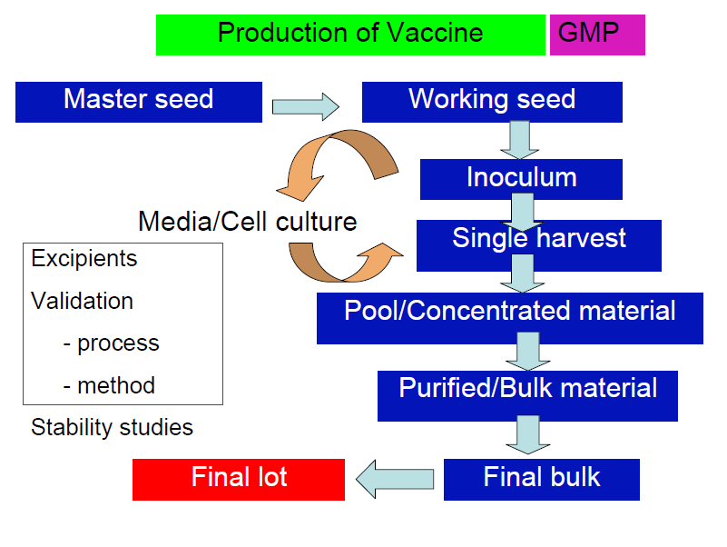
Seed lot system for vaccine production

Slide 8
Quality control of vaccines
Seed bank characterization (Historical Record, Identity Test, Purity Test, Safety Test, Efficacy Test, Stability Test)
Cell substrates (viral contamination of cell banks and biological products)
Cell culture/fermentation to produce active substances
Cultivation and harvesting
Downstream processing
Separation and purification of product
Detailed product characterization
Testing and release

Slide 9
Quality control of vaccines - Issues
Different bacterial/virus strains are used by different manufacturers for same vaccines, e.g., measles vaccine can be produced from Schwarts or Edmonston Zagreb
Vaccines can be produced in one fermentation tank or in several bottles
Same host can be grown in one type of cell in one company and different in others
Different stabilizers or preservatives for different companies.

Slide 10
Quality control of vaccines
Starting materials
Raw materials
Labelling
Packaging
Qualifications of suppliers
Intermediate products
Finished products

Slide 11
Antigenic cartography
Analysis of antigenic variation of viruses is generally done by serological methods and is qualitative.
By integrating antigenic data with sequencing data it is possible to quantify antigenic variation and determine its correspondence with sequence change
This approach is called “antigenic cartography” and offers the possibility of understanding how antigenic variation evolves.
Future method for selecting suitable vaccines and possibly predicting the appearance of new variant strains.

Slide 12
Quality control of intermediate products
1. Gross bacterial contamination test
2. Testing aerobic contaminants
3. Testing for anaerobic contaminants
4. Testing for Salmonella species
5. Testing for contamination with fungi
6. Stability study

Slide 13
Gross bacterial contamination
Measured immediately after harvesting to test contamination in fluid with extraneous microorganisms
Involves inoculation and incubation of a general purpose sterile broth (9ml) with wet vaccine (1ml).
Allowed to stand for overnight
If free of growth, vaccines can be divided into fractions and stored as a wet vaccine or as freeze dried.

Slide 14
Testing aerobic contaminants
Use a general purpose broth culture medium that supports growth of most likely contaminants, e.g., Tryptic soy broth or Nutrient broth.
Inoculate 1 mL of wet or reconstituted freeze dried vaccine into 9 mL of broth
Incubation at 30°C to 37°C for 24 hours
If gross contamination is found after 24 hours, retest in twice number of cultures.
If contamination is evident after second culture, discard vaccine

Slide 15
Testing anaerobic contaminants
Anaerobic bacteria have fastidious growth requirements.
Using aseptic technique minimizes environmental contamination of harvesting fluid by anaerobes during harvesting.

Slide 16
Testing Salmonella species
Inoculate 9 mL of one of liquid media with 1 mL of vaccine
Liquid media (Selenite broth, Tetrathionate broth)
Incubate at 37°C for 18 to 24 hours
Inoculate a loopful of incubated broth onto one of solid media
Solid media: MacConkey agar, Salmonella-Shigella agar, Brilliant Green agar, Desoxycholate citrate agar, Xylose Lysine Deoxycholate, XLD agar

Slide 17
Testing Salmonella species
Incubate 18 to 24 hours.
If no Salmonella growth is detected, incubate again for 18 to 24 hours
Discard vaccine, if Salmonella are detected

Slide 18
Testing contamination with fungi
Inoculate Sabouraud dextrose agar with 100 mL of vaccine and spread over plate.
Add 0.05 g/L chloramphenicol to inhibit bacterial growth
Inoculate a control plate with diluent only.
Incubate at 25°C to 30°C for one week.
Observe daily and record results.
Growth on control plate invalidates test, which should then be repeated.

Slide 19
Testing safety or susceptibility
Administration of certain doses of vaccine to appropriate living organism (animals, rodents, chickens or birds)
Collection of serum and testing with appropriate method for presence of maternal antibodies to test virus of disease
To pass test, animals should not have maternal antibodies to virus of disease or clinical signs of disease after 21 days

Slide 20
Quality control of finished products
1. Testing extraneous microorganisms and safety
2. Test of inactivation
3. Testing in-vivo potency (efficacy)
4. Testing pyrogens
5. Stability test of diluents and reconstituted vaccine

Slide 21
Quality control of finished products
6. Safety testing
A). Residual toxicity or reversion to toxicity
B). Testing neurovirulence
C). Chromogenic assay

Slide 22
Test of inactivation of virulent viruses
Test for ability of inactivated pathogen to cause disease
Real time PCR, which quantify amount of nucleic acids, cannot provide a direct measure of virulence (because the RNA/DNA of a dead pathogen would still show up, even though it cannot cause disease).
Traditionally virulence is tested by injecting a given organism (rabbits, pigs, chickens, etc) and checked colonization/spread (and consequently) production of disease.
Notes:
Real time PCR technique monitors the progress of a PCR reaction wherein, a relatively small amount of PCR product (DNA, cDNA or RNA) is quantified. PCR is based on detection of fluorescence produced by a reporter molecule which increases, as the reaction proceeds. This occurs due to the accumulation of the PCR product with each cycle of amplification. PCR monitors reaction as it progresses. One can start with minimal amounts of nucleic acid and quantify the end product accurately.

Slide 23
Test of inactivation of virulent viruses
Alternatively same pathogen can be inoculated into a cell culture system.
Cultured cells are observed to determine how many have been infected
Or obtain a bleed from animal and titer how much pathogen is present (and then compared it to how much was inoculated).

Slide 24
Testing in-vivo potency
Potency assay is one of the main methods used for assuring the quality of vaccine which is based on the measurement of one or several parameters that have been shown to be related directly or indirectly with product efficacy (the ability to produce an effective level of protection in the target species)

Slide 25
Testing potency
The main types of potency tests performed by vaccine manufacturers includes in-vitro titration of live organisms), enzyme-linked immunosorbent assays (ELISAs) and in-vivo methods involving immunization of small laboratory animals (e.g., mice, rats & guinea pigs) followed by challenge with a toxin/virus/bacteria or titration of immune sera to measure the antibody response.
For live, attenuated vaccines, in-vitro potency assay is mainly used but it is not commonly used for inactivated vaccines. Since, production of vaccine occurs in batches, there is an obviousness of variation in their characteristics if strict controls are not ensured. Therefore, all the manufacturer and regulatory bodies has duty to formulate quality procedures for potency testing using various in-vivo or in-vitro assays.

Slide 26
Testing potency
Testing in-vivo potency/efficacy/assay or virus content of vaccine to ensure that vaccinated vaccine recipient receives enough virus to induce a protective immunity.
Potency is quantitative measure of biological activity
Virus content/load is a measure of amount of infective disease virus in vaccine.
In this test, infectivity titre of vaccine is measured

Slide 27
Testing in-vivo potency
For killed bacteria/virus vaccine, potency assay is performed using animals
Potency of test vaccine may be expressed as a percentage of potency of standard vaccine.
Amount of vaccine required to protect animals from a defined challenge dose of pathogen is compared with the amount of a standard vaccines that is required to provide same protection
Number of survivors in each group is used to calculate potency of test vaccine relative to the potency of standard vaccine by statistical method

Slide 28
Testing in-vivo potency
Test animals are divided into two groups of 8-10 animals per group and housed separately
One group of animals (adult mice, suckling mice and guinea-pigs, control eggs) is vaccinated.
Other group remained unvaccinated to act as control group
Serum of animals from both groups is collected two weeks after vaccination
Antibody response of animals to vaccine is measured

Slide 29
Testing in-vivo potency
Serum is tested for presence of antibodies to disease virus.
An adequate antibody response to vaccine can be measured in two ways:
1. Testing serum collected from vaccinated animal (serological test) for level of antibodies titres
2. Challenging vaccinated animal with a virulent virus strain of disease under test
Method 1 is carried mostly
Titre level indicates that animal would be protected against disease if challenged in method 2
Notes:
Concentration of a solution as determined by titration.

Slide 30
Testing in-vivo potency by challenge studies
Further testing of efficacy of vaccine may be carried out by challenging vaccinated and un-vaccinated (control) groups of animals with virulent disease virus
Implement reasonable biosecurity measures to minimize the risk of uncontrolled introduction of disease virus to either of the groups
The treatment group receives one vaccine dose per animal
Bleed both groups at weekly intervals
Test serum to measure the antibody response to vaccination and to indicate levels of protection after 2 to 3 weeks of vaccination

Slide 31
Testing in-vivo potency
Make daily observations of the animal/chickens and record the results
At least 90 percent of the vaccinated chickens should survive the challenge and show no clinical signs of the Newcastle disease
All unvaccinated control chickens should die of disease

Slide 32
Testing in-vivo potency
Checking serum for antibodies is called serological test
Results of biological assays is usually expressed in units of activity calibrated against a reference standard
Match the titres with that which is considered protective

Slide 33
Testing in-vivo potency
Vaccine containing live microorganisms are generally tested for potency by determining their content of viable particles
Dilutions of vaccine are prepared in media
Fixed volumes of diluted vaccines are dropped on to solid media capable of supporting viral/bacterial growth
After fortnight, the colonies generated by drops are counted and the live count of undiluted vaccine is calculated.

Slide 34
Testing pyrogen
Endotoxin LAL test
Rabbit test
Both methods are limited in products and range of pyrogens which can be detected, e.g., LAL test can only detect endotoxins.
Both also have a high level of animal consumption.
Problematic in testing of products that affect body temperature regulation (e.g., antipyretic drugs and steroids), drugs that cause immunological reactions (e.g., immunoglobulins)

Slide 35
Testing pyrogen (MAT Test)
Human whole blood Monocyte- Activation Test (MAT), introduced into European Pharmacopoeia (EP) in 2010 overcome limitations of above tests
MAT is an alternative to Rabbit Pyrogen/ Endotoxin test and is used to detects or quantifies endotoxin and non-endotoxin pyrogens.
MAT is based on principle of the human immune system response

Slide 36
Testing pyrogen
In human when pyrogens come into contact with blood stream, host’s innate immune defense mechanisms cause monocytes/macrophages to produce prostaglandins and pro-inflammatory cytokines such as interleukin-1 (IL-1), interleukin-6 (IL-6) and tumor necrosis factor-α (TNF- α)
An in vitro pyrogen detection test mimics above biological response by utilizing cryo-preserved human whole blood as a source of monocytes and determining pyrogenicity of sample by measuring Interleukin-1β production in an immunological assay (ELISA).

Slide 37
Testing pyrogen
It simulates human fever reaction better than any animal-based pyrogen test.
MAT generates an interleukin-1ß response when pyrogens are present.
Using whole human blood (cryoblood or fresh blood), MAT initiates innate immune response to a fever reaction caused by pyrogens.
MAT is highly robust and provides a high level of reliability due to including both a positive and a negative control.

Slide 38
Testing pyrogen
MAT assay detects Gram-positive and Gram-negative organisms and parasitic, viral, fungi and other biological pyrogens (e.g., yeast) ad non-biological pyrogens.
It also offers a solution for testing of products that prove problematic in other in vitro endotoxin tests, such as antipyretic drugs and steroids and immunoglobulins

Slide 39
Safety Testing
As per regulatory guideline, new batches of vaccines must be tested to ensure that they are safe and can provide protective immunity. In general, the routine testing typically involves immunization of several groups of animals with different dilutions of the vaccines followed by exposure of the animals to the infectious agent of interest. Animals with insufficient protective immunity develop induced infections. Unprotected animals often develop the disease which is frequently lethal. Although regulatory authorities have in the past typically required death as an endpoint for such studies, some authorities now allow the humane killing of moribund animals

Slide 40
Safety testing
Bacterial vaccines containing killed bacteria/bacterial products must show that they are completely free from the living micoorganisms used in the production process
Vaccines prepared from toxins require a test system capable of revealing inadequately detoxified toxins
To prove that, test toxin sensitive ginea pigs are inoculated
Observation for the symptoms of disease

Slide 41
Safety testing
In killed vaccines, tested the incomplete virus inactivation, a consequent presence of residual live virus
With attenuated viral vaccine, tested the reversion of visus during production to a degree of virulence capable of causing disease in recipients.

Slide 42
In-vitro safety testing
Availability of fast and accurate in vitro alternatives for in vivo safety tests make vaccine production feasible.
Examples are the use of a PCR method to measure virulent poliovirus in oral polio vaccine preventing neurovirulence testings in monkeys and a very sensitive in vitro Vero cell assay for the detection of residual diphtheria toxin.
Vaccine safety is guaranteed further by developing consistent production processes and postmarketing surveillance.

Slide 43
Techniques for measuring the concentration and integrity of antigens
This category includes colorimetric assays and analytical separation techniques used for the quantification of intermediate and final products and for the detection of impurities in the vaccine. In general, colorimetric assays are easy to perform. They are applied to measure protein concentrations, polysaccharide content, number of primary amine groups and host cell DNA, among others. Separation techniques, such as liquid and gas chromatography and gel electrophoresis, are often used to determine the stability and purity of protein and polysaccharide vaccines. Mass spectrometry is increasingly used to characterize antigens and impurities. Identification, fragmentation and other structural degradation (oxidation and deamidation) can be measured relatively easily and quickly.

Slide 44
Production of vaccines

Slide 45
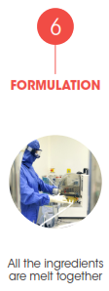
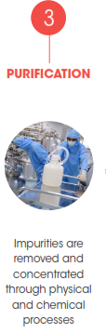
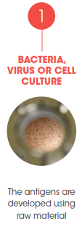

Slide 46
