Slide 1
Modern Persian Prose in Iran Semester: 5th Major Course Code: 303 Lecture No. 10-11-12
Instructor: Dr. Sara Bukhari

Slide 2
داستان کوتاہ مجلس عیادت

Slide 3
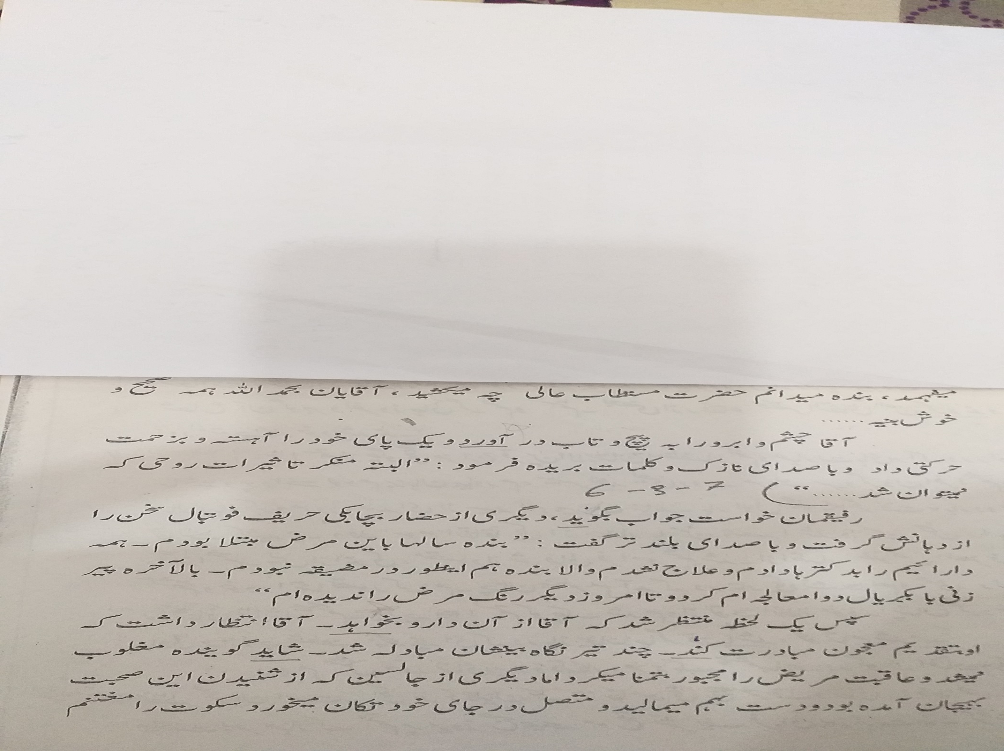

Slide 4
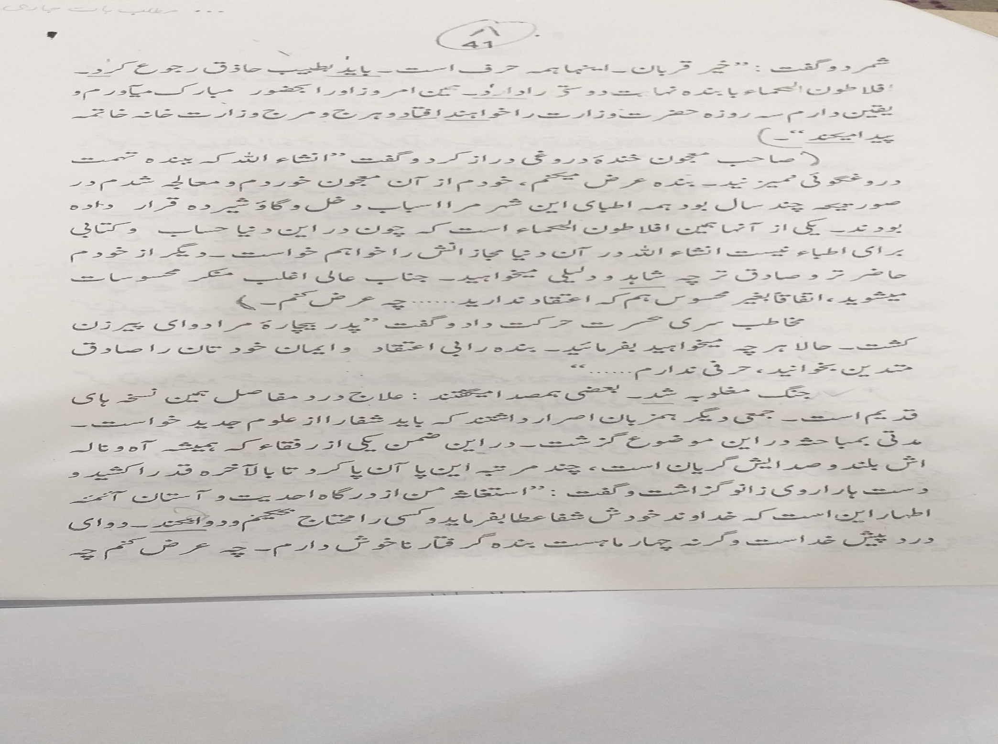

Slide 5
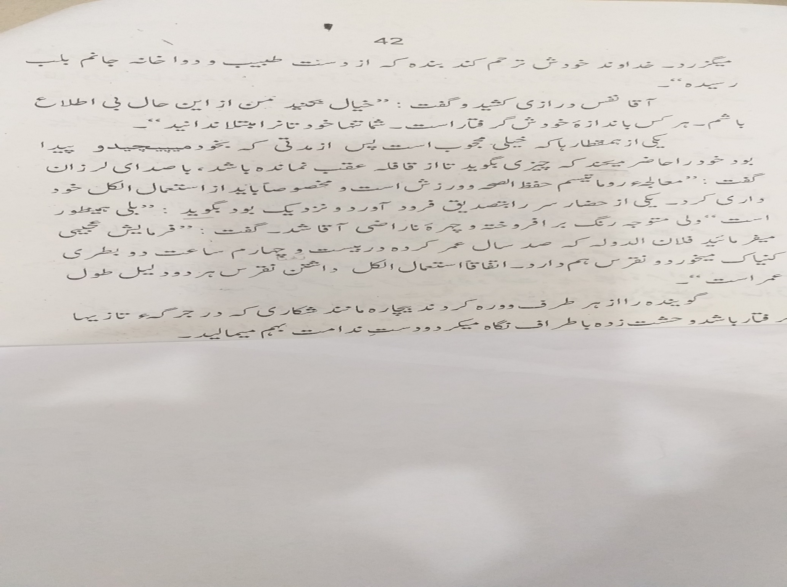

Slide 6
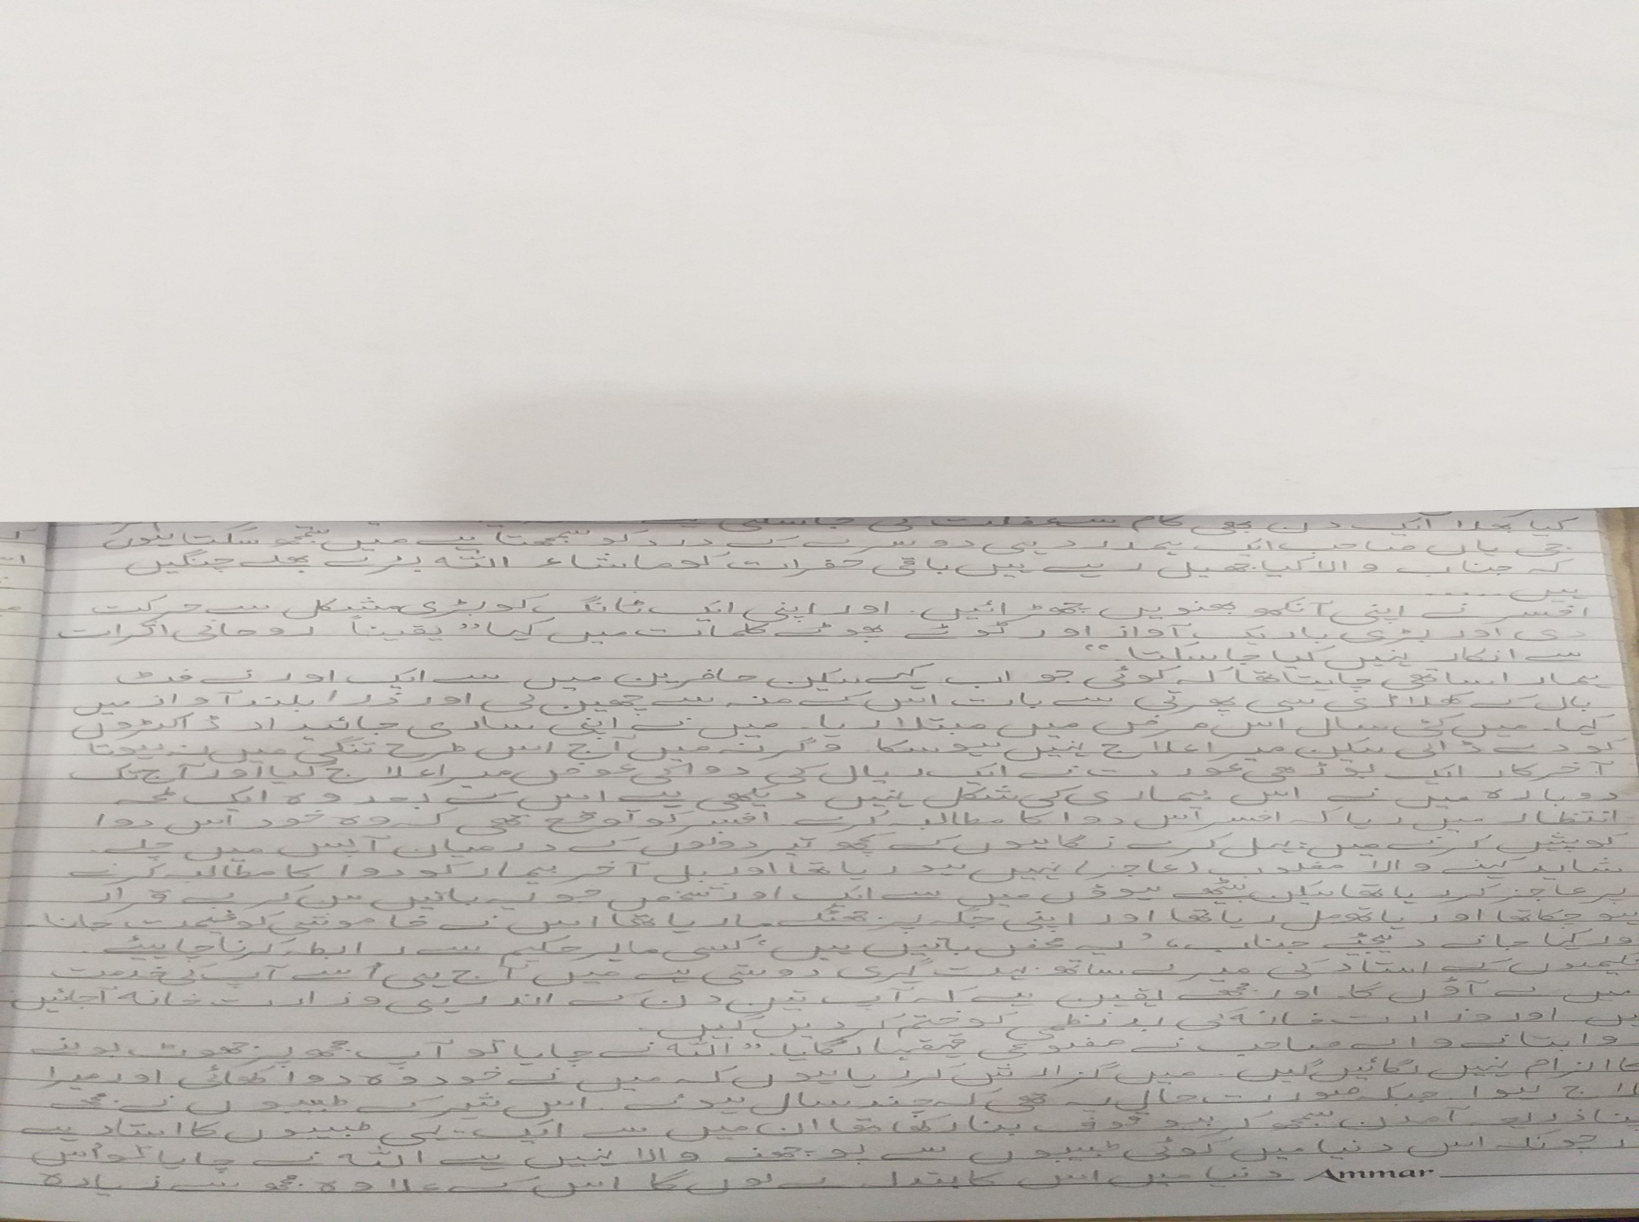

Slide 7
