Slide 1
Types and forms of Precipitation

Slide 2
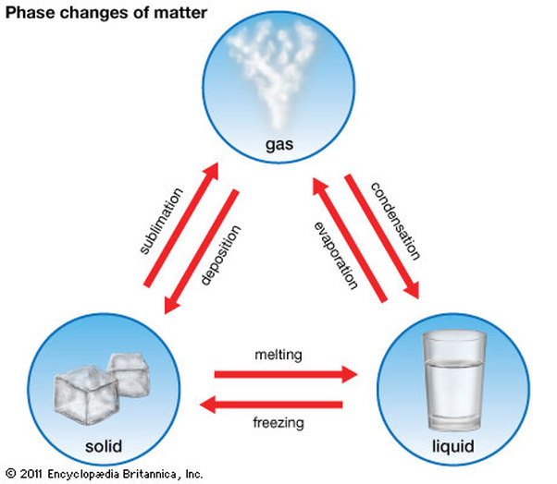
What is precipitation
The Fall of moisture from the atmosphere is called precipitation.
Three states of Water.

Slide 3
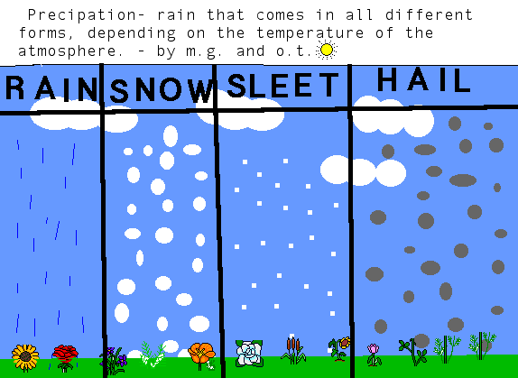
Types of Precipitation

Slide 4
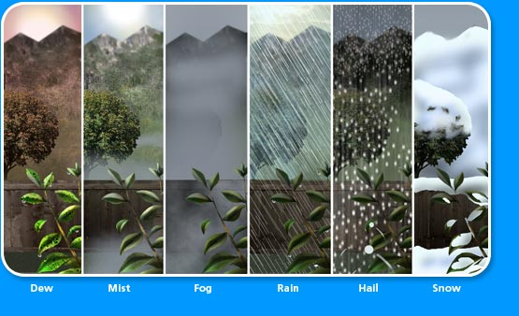

Slide 5
Forms of Precipitation
Dew: the moisture deposit on the earth surface on grass.
Mist: 1.a cloud of tiny water droplets suspended in the atmosphere at or near the earth's surface that limits visibility (to a lesser extent than fog; strictly, with visibility remaining above 1 km.
Fog: Cloud on the ground
Frost: a deposit of small white ice crystals formed on the ground or other surfaces when the temperature falls below freezing.
Snow: atmospheric water vapor frozen into ice crystals and falling in light white flakes or lying on the ground as a white layer.
Sleet: Mixture of snow and rain.
Glaze: A coating of smooth ice.
Hail: rounded lump of ice about 0.5 to 5 cm in diameter.
Drizzle: water droplet extremely small. 0.2 to 0.5 cm diameter.

Slide 6
Types of Rainfall.
Physical/ orographic/ relief rainfall
Convectional Rainfall
Frontal/cyclonic rainfall
Coastal Rainfall.

Slide 7
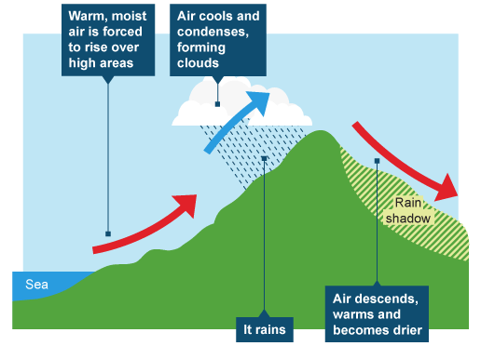
Physical Rainfall

Slide 8
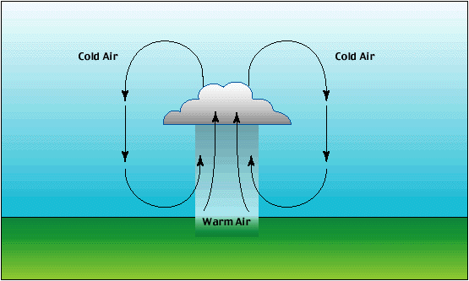
Convectional rainfall

Slide 9
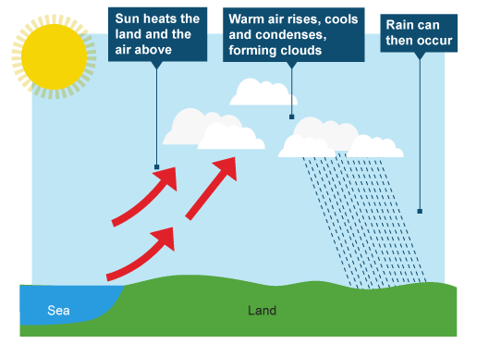
Coastal rainfall

Slide 10
Humidity
The air is like sponge and can hold moisture in the form of water vapor. We can see rain but we cannot see the moisture in the air. This is because the moisture in the air is in the form of water vapor which we cannot see. The amount of water vapor present in air is called humidity.

Slide 11
Humidity
Types of humidity:
Relative humidity.
Absolute humidity.
Specific humidity.

Slide 12
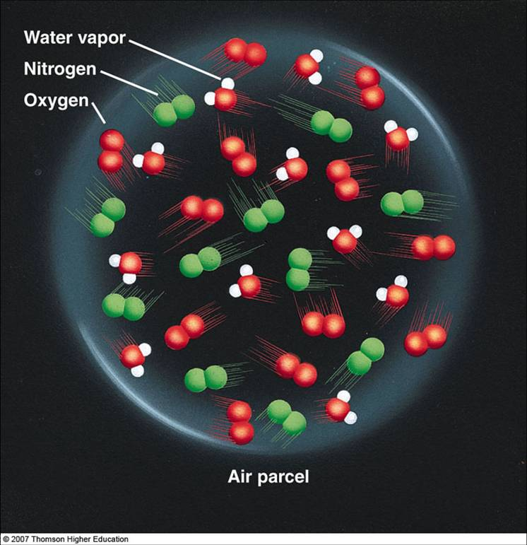
Specific Humidity
The actual quantity of water vapor held by parcel of air is its specific humidity.

Slide 13
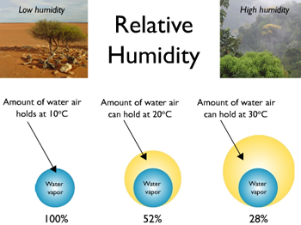
Relative humidity:
The proportion of water vapor present in a parcel of air, relative to the maximum amount of water vapor, that air could hold at the same temperature.
Or
The measure of humidity that we encounter every day is relative humidity.

Slide 14
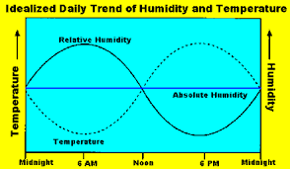
Absolut humidity:
This term is used to describe the actual amount of water vapor that is saturating the air. Absolute humidity is calculated by finding the mass of water vapor in an area and dividing it by the mass of air in the same area.

Slide 15
instrument
Hygrometers are instruments used for measuring humidity.

