Slide 1
Air Masses & Fronts

Slide 2
Air masses

Slide 3
Definition of Air masses
A very large parcel of air, that possesses relatively uniform qualities of temperature, density an humidity in the horizontal dimension.

Slide 4
Fronts

Slide 5
Introduction

Slide 6
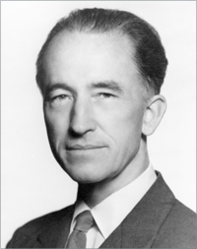
Jacob Bjerknes
He was the meteorologist.
He first coined the term “front”

Slide 7
What is a front?
A narrow transition zone, or boundary, between disparate synoptic scale air masses whose primary discontinuity is density.

Slide 8
Definition
The discontinuity b/w two air masses of different characteristics is called a front.
A zone of discontinuity b/w unlike air masses is called a front.

Slide 9
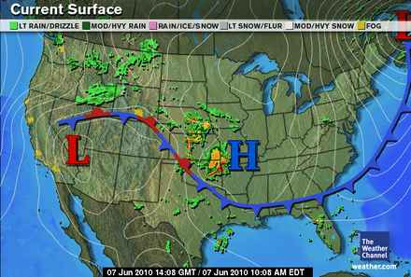

Slide 10
Types of Fronts
Cold
Warm
Occluded
Stationary

Slide 11
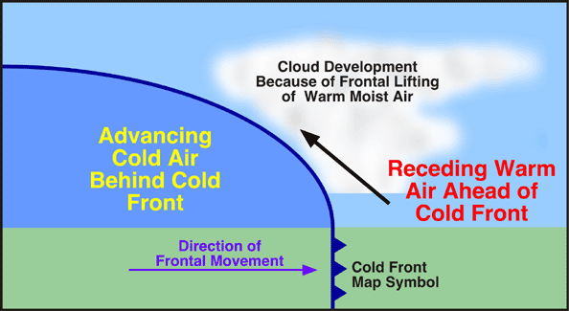
Cold front
When the cold air is the aggressor,
It undergoes the warmer air and forces it upwards it is called a cold front.

Slide 12
Symbol:
Marked on a map with a blue line and blue triangles pointing towards the warm air.
Slopes of 1/50 to 1/150.

Slide 13
Cold front
3-D image:

Slide 14
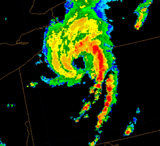
Squall line
It result when several storms align themselves on a cold front .

Slide 15
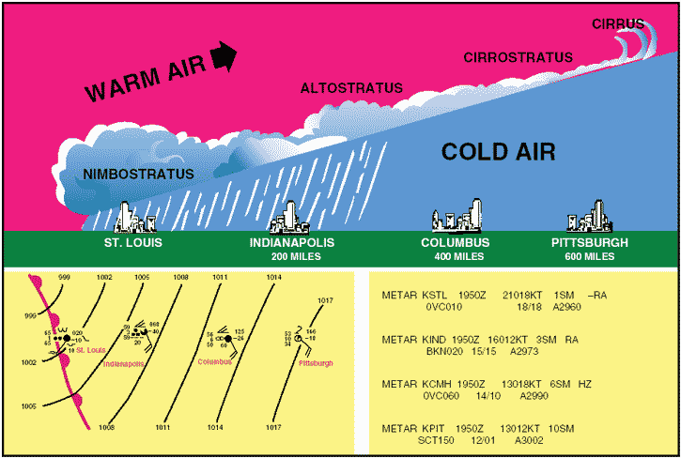
Warm front
When the warm air mass infringes upon a cooler one, the lighter warmer air overrides the cooler air this produces a boundary called a warm front.

Slide 16
Symbol:
Marked on a map by a red line with red semi-circles pointed towards the cool air.
Slope ranges from 1/100 to 1/300.

Slide 17
Warm front
3-D image

Slide 18
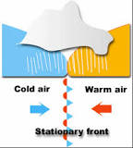
Stationary front
When neither air masses displaces the other, their common “boundary” is a stationary front.

Slide 19
Symbol:
Marked by alternating blue lines & blue triangles ) and red lines & red semi-circles

Slide 20
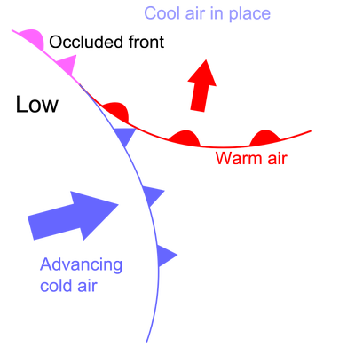
Occluded front
When a cold front overtakes a warm front, an occluded front is formed.

Slide 21
Symbol:
Marked by a purple line with alternating purple triangles and purple semi-circles, all pointing in the direction of the frontal movement.

Slide 22
Frontal zone
‘’The areas where air masses having different characteristics are collided with one another are said to be as frontal zones.’’

Slide 23
Important frontal zones
Arctic and Antarctic frontal zones
Polar frontal zones
Mediterranean frontal zones

Slide 24
Arctic and Antarctic
Arctic and Antarctic air masses collide with polar maritime air masses.
Frontal zones lie over Central Alaska, Northern Canada, Greenland, and Antarctica.

Slide 25
Polar frontal zone
Cool air masses of sub polar area are collided with cold air masses of polar areas.
Frontal zones lie Central north America, Southern Greenland and Siberia.

Slide 26
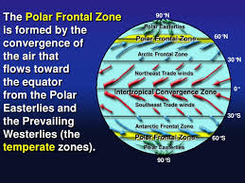

Slide 27
Mediterranean frontal zone
Cool air masses of Europe collide with hot dry air masses of Africa.
Frontal zones lie over Mediterranean sea.

Slide 28
Movement Of Fronts
Predicting the movement of fronts can be more complex than forecasting the baroclinic low.
Fronts may extend for hundreds of miles and not all portions of the front will move at the same speed.

Slide 29
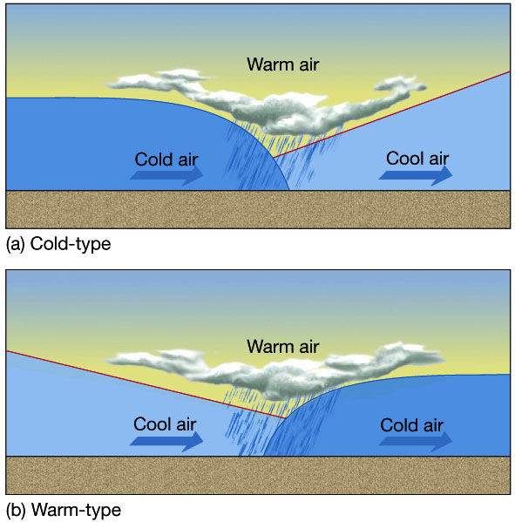
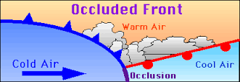
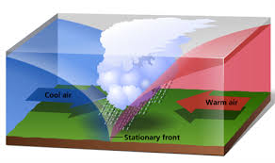
Movements of Fronts

Slide 30
Methods Of Frontal Movements
There are two types of frontal movements.
Continuity/Extrapolation
Persistence

Slide 31
Method of Movements of Fronts
Continuity/Extrapolation:
Its predicts a trend based on the entire history
of past movements of the front
Persistence:
Its similar to Extrapolation but is less reliable
because it only looks at the front's activity in the
last two-three hours, rather than the entire
history.

Slide 32
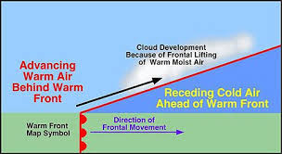
Specific Fronts Movements
Warm fronts most often extend from the northeast through southeast .
They generally move toward the northeast at an average speed of 10 knots.

Slide 33
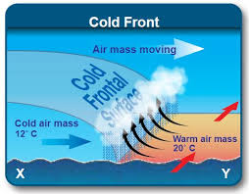
Specific Fronts Movements
Cold fronts most often extend from the southwest but may extend from the west or northwest quadrant.
They generally move toward the southeast.

Slide 34
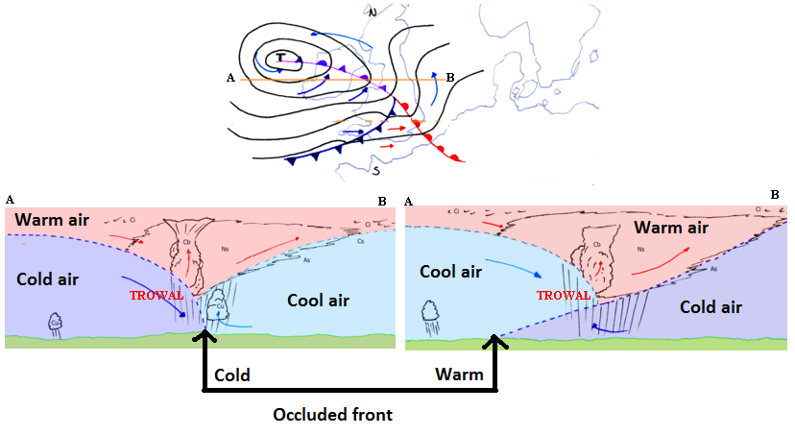
Occluded front
Occluded front "wraps around" the baroclinic low as the low moves off of the frontal boundary back into the colder air.

Slide 35
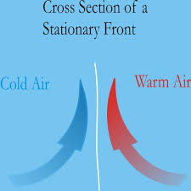
Stationary front
When warm air meets cold air no movement occur
Rain may fall for many days

Slide 36
Depressions and anticyclones

Slide 37
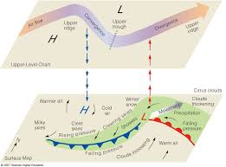
Depression
Under a depression air is rising, forming an area of low pressure at the surface. This rising air cools and condenses and helps encourage cloud formation, so the weather is often cloudy and wet. In the Northern Hemisphere winds blow in anticlockwise direction around a depression.

Slide 38
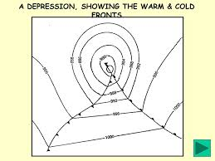
Depression in fronts
Rising air lead to a low pressure system or depression.
Frontal depressions from where the warm air mass (from equator) meets the cold air mass (from the poles).

Slide 39
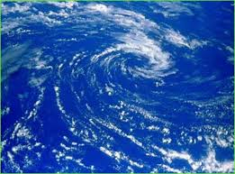
Anticyclone
An atmospheric high- pressure cell, involving the divergence of air, which subsides at and flow spirally out of the center, is called an anticyclone.

Slide 40
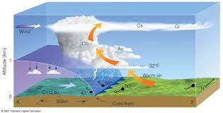
Fronts in Anticyclone
Anticyclone also known as high pressure system.
Anticyclone occurs when the weather is dominated by stable conditions.
Due to stable condition, cloud formation is inhibited so weather is usually settled with only small amounts of cloud cover.

Slide 41
Conclusion

Slide 42
Any questions

