Slide 1
Image pre processing

Slide 2
Image interpretation
relies on one or both of these approaches:
  Photo interpretation: the interpreter uses his/her knowledge and experience of the real world to recognize scene objects (features, classes, materials) in photo like renditions of the images acquired by aerial or satellite surveys of the targets (land; sea; atmospheric; planetary) that depict the targets as visual scenes with variations of gray-scale tonal or color patterns (more generally, spatial or spectral variability that mirror the differences from place to place on the ground)
  Machine-processing manipulations (usually computer-based) that analyze and reprocess the raw data into new visual or numerical products, which then are interpreted either by approach 1 or are subjected to appropriate decision-making algorithms that identify and classify the scene objects into sets of information

Slide 3
Image Processing
Computer-Assisted Scene Interpretation (CASI); also called Image Processing
The techniques fall into three broad categories:
  Image Restoration and Rectification (Preprocessing)
  Image Enhancement
  Image Classification
There are a variety of CASI methods:
Contrast stretching, Band ratioing, Band transformation, Principal Component Analysis, Edge Enhancement, Pattern Recognition, and Unsupervised and Supervised Classification

Slide 4
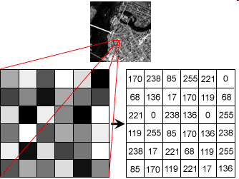
Image Processing
Digital Images:remote sensed images can also be represented in a computer as arrays of pixels (picture elements), with each pixel corresponding to a digital number, representing the brightness level of that pixel in the image. In this case, the data are in a digital format. These types of digital images are referred to as raster images in which the pixels are arranged in rows and columns

Slide 5
Data visualization
The images that we view are visual representations
of the digital output from the sensor
8-bit gray shade image is the case when the
sensor output is converted to one of 256 gray
shades (0 to 255)
24-bit color does the same except in shades or
red, green, and blue

Slide 6
Image Processing: Pixel Values
Pixel Values: The magnitude of the electromagnetic energy captured in a digital image is represented by positive digital numbers.
The digital numbers are in the form of binary digits (or 'bits') which vary from 0 to a selected power of 2
Image Type Pixel Value Color Levels
8-bit image 2⁸ = 256 0-255
16-bit image 2¹⁶ = 65536 0-65535
24-bit image 2²⁴ = 16777216 0-16777215

Slide 7
Online Reading
Image Type | Pixel Value | Color Levels
8-bit image | 2⁸ = 256 | 0-255
16-bit image | 2¹⁶ = 65536 | 0-65535
24-bit image | 2²⁴ = 16777216 | 0-16777215

Slide 8
Image Processing: Image Resolution
Image Resolution: the resolution of a digital image is dependant on the range in magnitude (i.e. range in brightness) of the pixel value. With a 2-bit image the maximum range in brightness is 2² = 4 values ranging from 0 to 3, resulting in a low resolution image. In an 8-bit image the maximum range in brightness is 2⁸ = 256 values ranging from 0 to 255, which is a higher resolution image

Slide 9
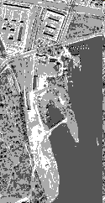
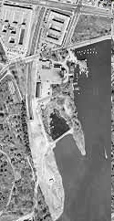
2-bit Image (4 grey levels)
8-bit Image (256 grey levels)

Slide 10
Image Quality
Many remote sensing datasets contain high-quality, accurate data. Unfortunately, sometimes error (or noise) is introduced into the remote sensor data by:
  the environment (e.g., atmospheric scattering, cloud),
  random or systematic malfunction of the remote sensing system (e.g., an uncalibrated detector creates striping), or
  improper pre-processing of the remote sensor data prior to actual data analysis (e.g., inaccurate analog-to-digital conversion).

Slide 11
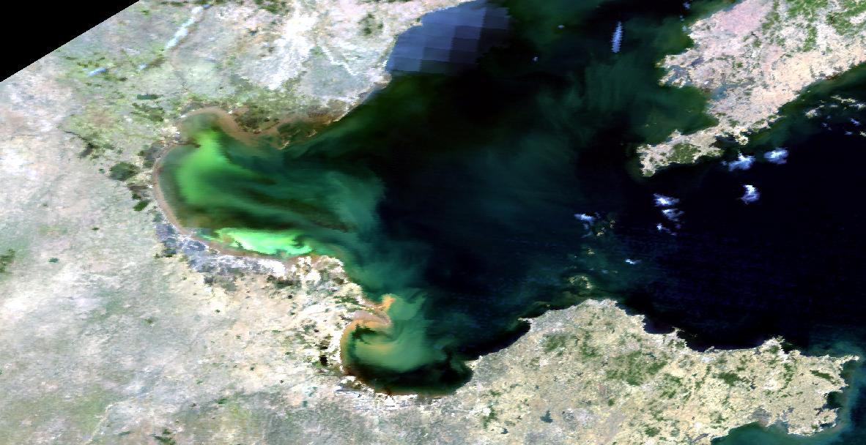
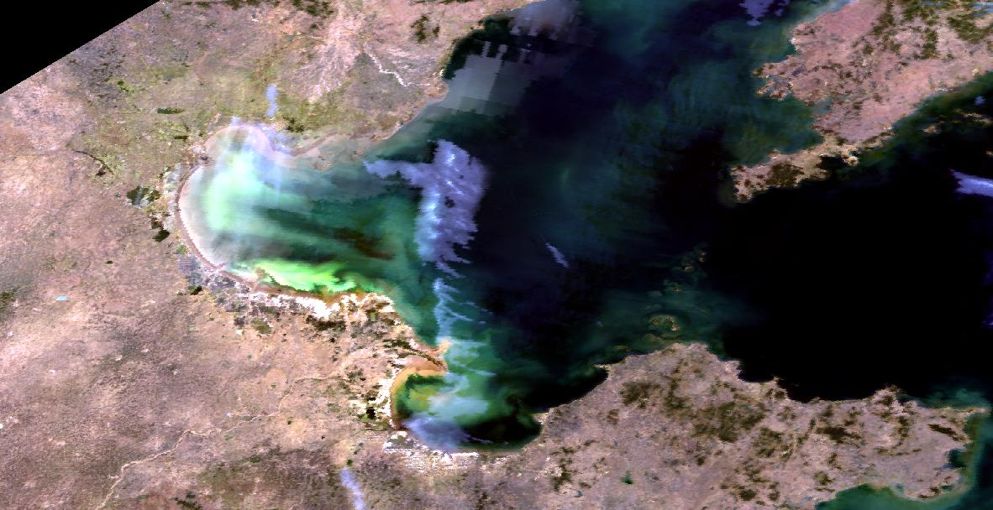
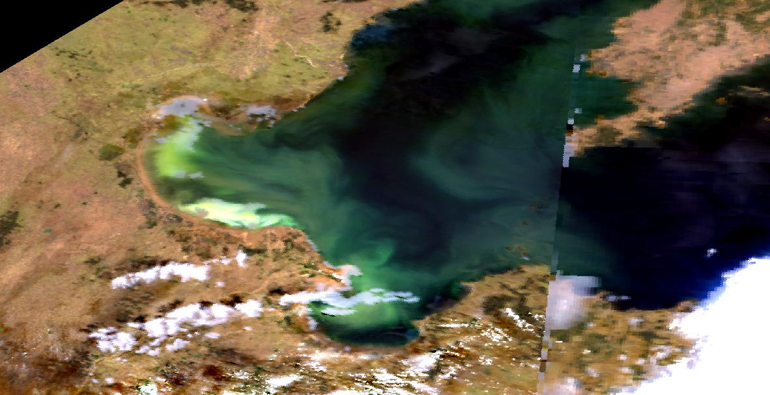
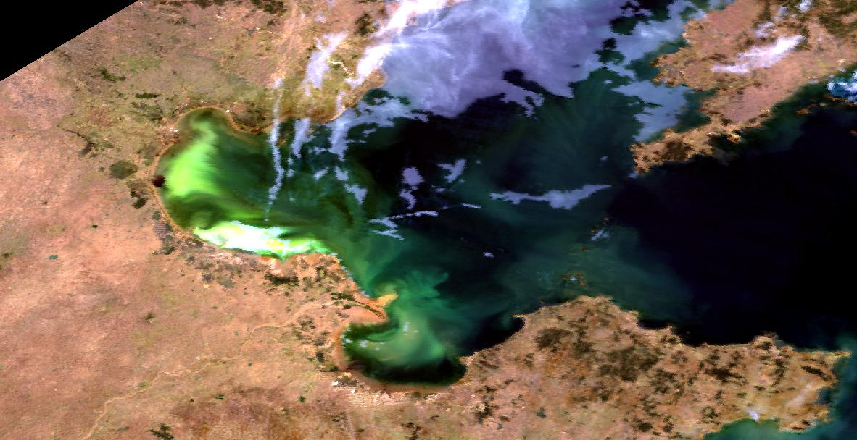
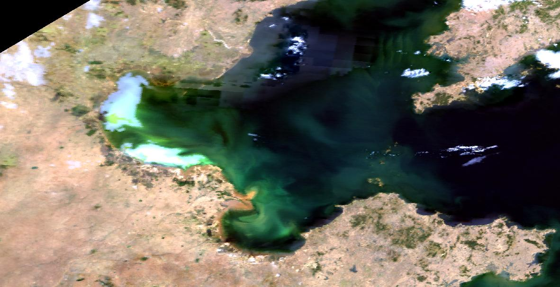
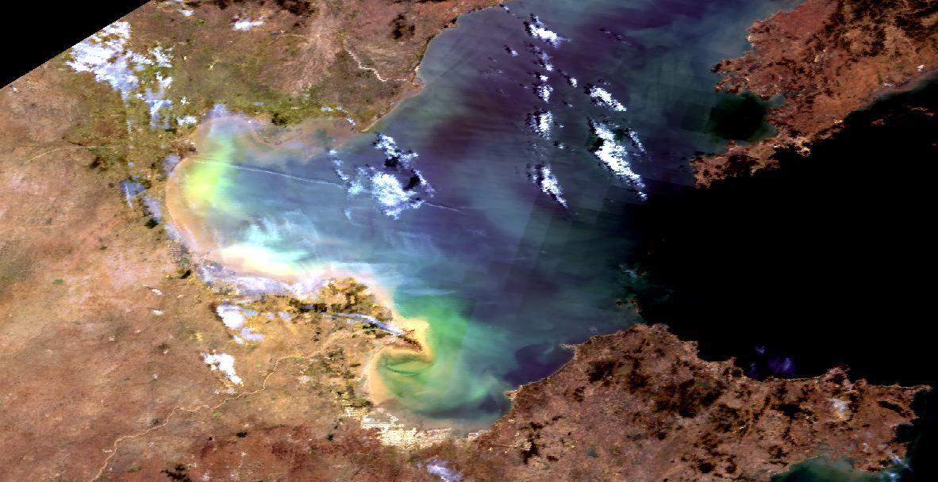
154
155
Cloud
155
160
162
MODIS
True
143
163
164

Slide 12
Preprocessing
Preprocessing functions involve those operations that are normally required prior to the main data analysis and extraction of information, and are generally grouped as radiometric or geometric corrections.
Pre-processing operations, sometimes referred to as image restoration and rectification, are intended to correct for sensor- and platform-specific radiometric and geometric distortions of data.

Slide 13
Geometric Correction
Raw digital images usually contain geometric distortions so significant that they cannot be used directly as a map base without subsequent processing.
Distortion-changes in shape and position of objects with respect to their true shape and position.
The source of distortions:
  Variations in altitude, attitude (position), and velocity of sensor platform
  Panoramic distortion
  Earth curvature
  Atmospheric refraction
  Relief displacement

Slide 14
Image Registration (or Resampling)
Re sampling -The calculation of new DN for pixels created during geometric correction of a digital scene, based on the values in the local area around the uncorrected pixels.
In the Nearest Neighbor technique, the transformed pixel takes the value of the closest pixel in the pre-shifted array.
Bilinear Interpolation uses the 4 closest pixel values surrounding the transformed output pixel is used.
Cubic Convolution uses the 16 closest pixel values

Slide 15
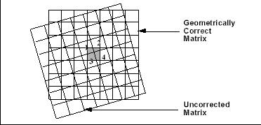
Image registration (or resampling)

Slide 16
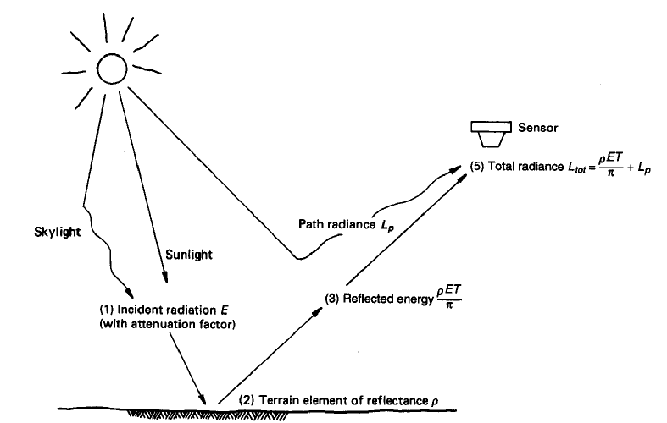
(Radiometric correction)
Atmospheric Effects
L_{app}=apparent radiance measured by sensor
ρ = reflectance of object
T = atmospheric transmittance
E = irradiance on object, incoming
Lp = path radiance/haze, from the atmosphere and not from the object

Slide 17
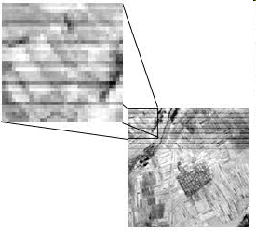
Image Processing Procedures
Image Restoration: most recorded images are subject to distortion due to noise which degrades the image. Two of the more common errors that occur in multi-spectral imagery are striping (or banding) and line dropouts

Slide 18
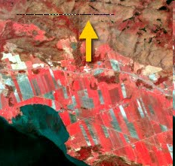
Image Processing Procedures
Dropped Lines are errors that occur in the sensor response and/or data recording and transmission which loses a row of pixels in the image.

