Slide 1
Settlement Geography
Course Code: Maj/Geo-309
Course Instructor: Ms. Amna Afzal

Slide 2
Human Settlement
According to UN Vancouver Declaration on Human settlements (1976):
“human settlements means the totality of the human community – whether city, town or village – with all the social, material, organizational, spiritual and cultural elements that sustain it.”

Slide 3
Scope of Settlement Geography

Slide 4
Introduction:
More than "one billion human beings still lack adequate shelter. They are living in unacceptable conditions of poverty” thus reports the UN Habitat Agenda, in a specific context.
The vast majority of these people live in developing countries and an increasing number of people live in urban areas.

Slide 5
Cont.
Indeed, the sprawling informal settlements and slums of developing countries are the most visual manifestations of poverty itself.
According to an old UN-HABITAT report, some 924 million people were living in slums and informal settlements during 2001 all over the globe.

Slide 6
Cont.
This is a major reason why the improvement of living conditions of slum dwellers was identified as a major target area in the Millennium Declaration, adopted by world leaders in 2000.
It is here, the subject of settlement geography plays an important role.
The primary aim of studying settlement geography is to acquaint with the spatial and structural characteristics of human settlements under varied environmental conditions.

Slide 7
Cont.
It is also to enable people to diagnose special issues related to rural and urban settlements.
An understanding of this subject will certainly
help to develop the socio-economic well-being of human communities and planning of human settlements.

Slide 8
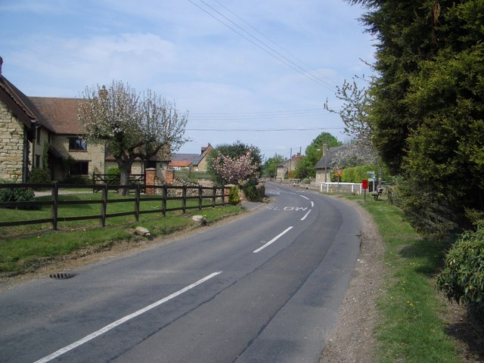
Human Settlements
Hamlet:

Slide 9
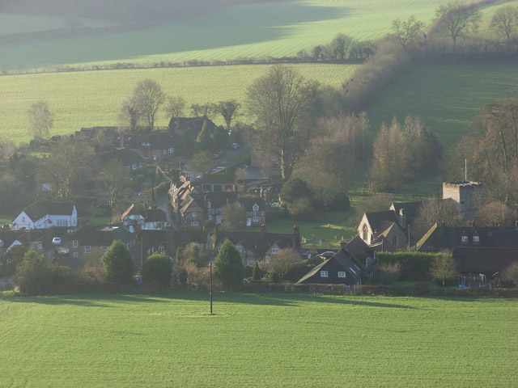
Village:

Slide 10
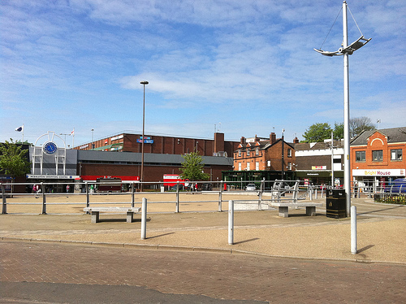
Towns:

Slide 11
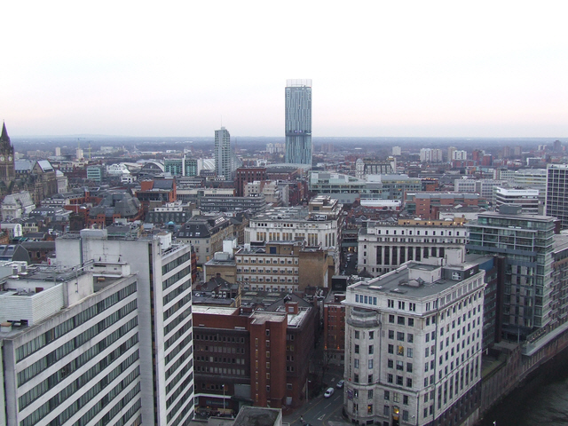
City:

