Slide 1
Introduction to Human Geography
By: Dania Amjad
Lecturer: LCWU Geography Department

Slide 2
Definition of Geography
Scientific and systematic study of both the physical and cultural features of the earth’s surface. It is a spatial perspective looking at patterns and distributions on the earth’s surface
The word geography was invented by the Greek scholar Eratosthenes. It is based on 2 Greek words:
-Geo – “Earth”
-graphy – “to write”

Slide 3
Difference between “Physical Geography” and “Human or Cultural Geography:
Physical Geography is the study of the four spheres (Lithosphere, Atmosphere, Hydrosphere, and Biosphere)
Human (or Cultural) Geography is the study of the spatial differentiation and organization of human activity on the earth’s surface.

Slide 4
Atmosphere
Lithosphere
Hydrosphere
Biosphere

Slide 5
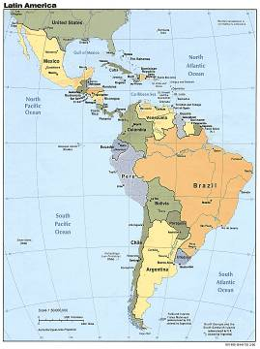
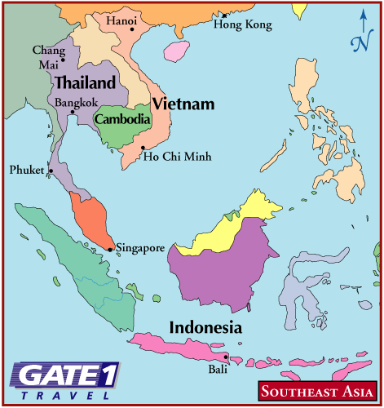
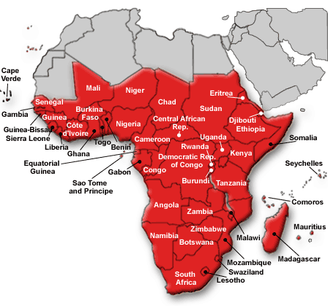
Approaches to the Study of Geography
Latin America
Regional (Latin America, Sub-Saharan Africa, Southeast Asia)
Systematic (Human Geography, Physical Geography, Historical Geography)
Southeast Asia
Sub-Saharan Africa

Slide 6
The different disciplines in Physical Geography.
Geomorphology: studies the form and structure of the surface of the earth
Climatology: involves the study of long term weather conditions on the earth
Hydrography: concerns the distribution of water (oceans, rivers, lakes, and their uses)
Biogeography: studies the flora (plant life) and the fauna (animal life)
Pedology: study of the soils
Ecology: studies the interactions between life forms and the environment
Geology: study of rocks and the earth’s interior

Slide 7
What is Human Geography?
Key Question!

Slide 8
Human Geography
The study of how people make places, how we organize space and society, how we interact with each other in places and across space, and how we make sense of others and ourselves in our locality, region, and world.

Slide 10
Human Geography (Definitions)
The study of how people make places, how we organize space and society, how we interact with each other in places and across space, and how we make sense of others and ourselves in our locality, region, and world. (De Blij)
The scientific study of the location of people & activities on the Earth’s surface, where & why human activities are located where they are, reasons geographers look at the world from a spatial perspective & interaction, and diffusion of people & ideas. (Rubenstein)

Slide 11
What we study in Human Geography?
Historical Geography
Demography and Population Geography
Political Geography: nations, boundaries, geopolitics, military movements, treaties, devolution, choke points, and imperialism
Geography of Religions
Geography of Languages
Urban Geography: settlements, cities, and transportation systems
Economic Geography: industries, economic development, and manufacturing regions
Agricultural Geography
Medical geography
Social Geography
Environmental Geography

