Slide 1
Forestry
Dania Amjad
LCWU

Slide 3
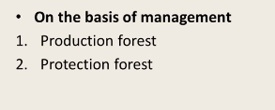
Classification
Productive forest means a forest used for industry, construction, fuel and for other purposes and that can be capable for forest production.

Slide 4
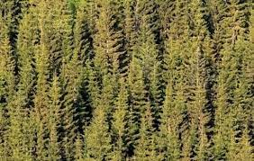
Forestry also includes the Harvesting, Marketing, and Utilization of Forest Products

Slide 6
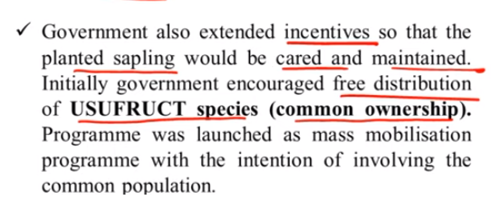

Slide 7
It can provide shelter, pasture and crops.
Some additional earnings, environmental improvement can be forced.
It helps in creating new jobs, industries, capital value for the young generations. “
The least costly and economically the most effective approach to afforestation of the rural areas."

Slide 8
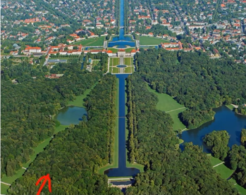

Slide 9
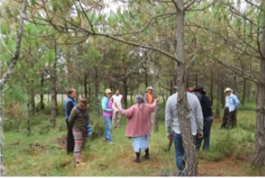

Slide 10
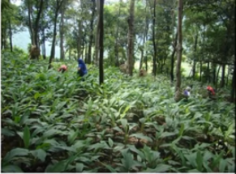

Slide 11
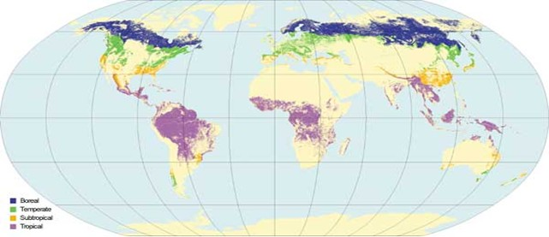

Slide 12
Overview of Pakistan Forestry Sector
Pakistan had very limited forestry resources. Of a total land area of 87.5 million hectares (ha), only 4.2 million ha (4.8%) was forested, with the North-West Frontier Province2 (NWFP) accounting for 40%.
Although small in relation to the whole economy, the sector supplied the country’s industrial wood requirements and almost one-third of its total energy needs in terms of fuelwood.
Forests also played an essential role in stabilizing and protecting important catchment areas, including those of the Tarbela and Mangla reservoirs, which support power generation and supply irrigation water.

Slide 13
According to the Food and Agriculture Organization (FAO 2009), 68 per cent of the country’s population depends on firewood as a major source of household energy and about 100,000 people are involved in the fuelwood trade, generating about Rs. 11.3 billion ($113 million) annually.
In addition to it, more than 500,000 workers are employed by forest-products industries such as furniture, village carpentry, matches, particleboard, plywood, fiberboard, boats, crates, boxes, paper, pulp, and chipboard.
Besides official employment in forest departments, a large number of labours are engaged in either year-round or seasonal forest management activities like raising and maintaining nurseries, preparing sites for planting, protecting planted stocks, weeding, cleaning, thinning, firefighting, and harvesting.
In addition, a large number of people draw their livelihoods from farm forestry, processing of forest-based products, and ecotourism.

