Slide 1
Bioremediation of Gaseous pollutants

Slide 2
Introduction to bioremediation:
A biological process used to treat contaminated media, including water, soil and subsurface material
They altering environmental conditions to stimulate growth of microorganisms
Degrade the target pollutants.
bioremediation is less expensive and more sustainable
It is a form of biological treatment use to treat waste water, industrial waste and solid waste etc.

Slide 3
Air pollution:
The presence of poisonous or harmful substances
Cause adverse effect on the ecosystem
Major pollutants:
PM
NOx
SOx
VOC’s
O3

Slide 4
Treatment methods:
VOC’s can be treated by both biological and non biological methods as above shown.
Biological methods:
Biofiltres
Trickling biofiltres
Bio-scrubbers

Slide 5
Biofiltres:
are fixed-bed reactors,
where the biomass is adhered
performs the biodegradation of the airstream contaminants.

Slide 6
Bio-trickling filters:
water or liquid medium sprinkling occurs on the fixed bed
humidity correction and macronutrient supply.
Addition of the liquid phase to the bioreactor also aims to help the contaminant mass transfer from the gas phase to the biomass.

Slide 7
Bio-scrubbers:
the treatment of the gas effluent containing VOC occurs in four stages:
Contaminant mass transfer from the gas to the liquid phase
Contaminant mass transfer from the liquid phase to the biomass. Biochemical reaction stage, called biodegradation.
Metabolite mass transfer to the medium.

Slide 8
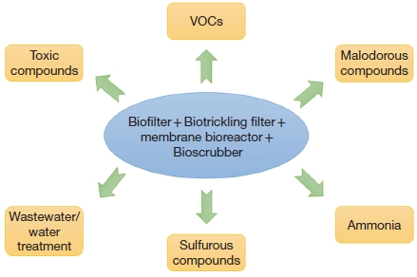

Slide 9
Bioremediation of PM:
Refers to Particulate matter
One of most dangerous pollutants
PM ranges from 2.5-10 micrometer in atmosphere
PM2.5 pollution is more common
Microbes were also found in PMs
Including Fungi, cladosporium and meso-phallic bacteria
Plant canopies are sink for PM due their waxes.

Slide 10
Bioremediation of NOx:
Nitrogen dioxide, nitrous oxide, nitric oxide
Azotobacter, rhizobium and fungus like Mycorrhizae fix atmospheric Nitrogen.
Nitromonas, Nitrosococcus, Nitrococcus oxidizes:
Ammonia to hydroxylamine
Nitrite to nitrate via an enzyme oxidoreductaze
Plants also absorbs harmful nitrogenous compounds
so they collectively take part in bioremediation resulting in Nitrogen fixation cycle.

Slide 11
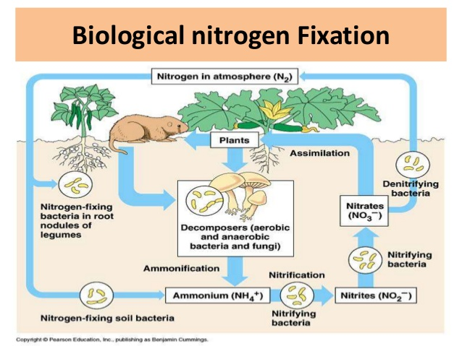

Slide 12
Bioremediation of SOx
Among the first harmful pollutant identified
Fossil fuels are major culprit or sulphur dioxide emission
¼ contribution is from China.
SO3 with water converted into sulphuric acid
Acid rain by sulphuric acid
Sulfur elimination:
sulphate is reduced to “organic sulfhydryl group(R-SH)” by sulphur reducing bacteria, fungi and plants.

Slide 13
Bioremediation of VOC’s:
Volatile organic compounds
Low boiling point and high pressure
High evaporation rate
Found naturally and also made in large amount anthropogenically (PAHs, BTEX and formaldehyde)
Participate in photochemical reactions to form O3

Slide 14
Plant absorbs pollutants via leaf stomata.
Some VOC’s are xenobiotics to plant so they detoxify the plants.
There are also the formaldehyde detoxifying agents
Found in spider and soybean plant
Formaldehyde can also be oxidized and degraded in C1 metabolism in phytodegradation.

Slide 15
Ground level O3:
First, O3 can be removed from the air by chemical reactions with reactive compounds emitted by vegetation, particularly monoterpenes.
Second, semi-volatile organic compounds, such as diﬀerent diterpenoids are an eﬃcient O3 sink.
Tobacco leaves can secret diterpenoid cis-abienol, a powerful chemical protection shield against stomatal O3 uptake by depleting O3 at the leaf surface. As a result, O3 ﬂux through the open stomata is strongly reduced.
As to O3 absorbed by leaves, an oxidative burst occurs as the initial reaction to O3, followed by activation of several signaling cascade and plant antioxidant systems including ascorbate-glutathione cycle and antioxidant enzymes to alleviate the oxidative burden resulting from O3 exposure.

