Slide 1
Bioremediation

Slide 2
INTRODUCTION
6/23/2014
3
Use of different biological systems to destroy or reduce concentrations of contaminants from polluted sites.
Manages microbes and plants to reduce, eliminate, contain or transform contaminants present in soils, sediments, water or air.
Microbes and plants have a natural capability to attenuate or reduce:
Mass
Toxicity
Volume
Concentration of pollutants without human interventions.
(Rittmann, B. E, McCarty, P. L. 2001)

Slide 3


Conventional methods of remediation
6/23/2014
4
Dig up and remove it to a landfill
Cap and contain
Maintain it in the same land but isolate it
Products are not converted into harmless substances. Stay as a threat!
Is there a better approach?

Slide 4

Better approaches
6/23/2014
5
Destroy them completely, if possible
Transform them into harmless substances
Methods already in use
High temperature incineration.
Chemical decomposition like dechlorination.
But, are they effective?

Slide 5


Yes
6/23/2014
6
But only to some extent
Drawbacks
Technological complexity.
The cost for small scale application – expensive.
Lack of public acceptance – especially in incineration.
Incineration generates more toxic compounds.
Materials released from imperfect incineration – cause undesirable imbalance in the atmosphere. Ex. Ozone depletion.
Fall back on earth and pollute some other environment.
Dioxin production due to burning of plastics – leads to cancer.
May increase the exposure to contaminants, for both workers and nearby residents.

Slide 6









6/23/2014
7
Bioremediation makes effective better approach possible.
Either by destroying or render them harmless using natural biological activity.
BIOREMEDIATION
Use of Microorganisms
Use of plants

Slide 7
Bioremediation mediated biodegradation
6/23/2014
8
in general it is “bio” mediated decomposition of paper, paint,
textiles, hydrocarbons and other pollutants.
Superior technique over using chemicals – why?
Microorganisms – easy to handle.
Plants – easy to grow.
Biodegradation is the initial process that results to bioremediation.
(Marshall, F. M., 2009)

Slide 8
Enzymatic processes in bioremediation
6/23/2014
9
Major types of reactions
Oxidation.
Decarboxylation in which the -CO₂H is replaced with an H atom or –OH group.
Hydrolysis which involves the addition of H₂O to a molecule accompanied by cleavage of the molecule into two species.
Substitution in which one group of atom is replaced by another (such as OH for Cl⁻ ).
Elimination whereby atoms or group of atoms are removed from adjacent
carbon atoms, which remained joined by a double bond.
Reduction, dehalogenation , demethylation, deamination, condensation, in which two smaller molecules are joined to produce a larger one: conversion of one isomer of a compound to another with a same molecular formula but different structure ; conjugation; ring cleavage.
(Marshall, F. M., 2009)

Slide 9
Biodegradation has at least 3 outcomes:
6/23/2014
10
A minor change in an organic molecule leaving the main structure
intact.
Fragmentation of a complex organic structure in such a way that the fragments could be reassembled to yield the original structure.
Complete mineralization, which in the transformation of organic molecules to mineral forms.
One example to describe all 3 types
2, 6-Dichlorobenzonitrile
(Marshall, F. M., 2009)

Slide 10
Minor change in a molecule (Dehalogenation)
6/23/2014
11
2,6-Dichlorobenzonitrile is an herbicide and is toxic for humans.
Cl
Cl C N HOH
2, 6-Dichlorobenzonitrile
OH
Cl
C
N
Cl
Cl is replaced with OH
(Prasad MNV., 2003)

Slide 11
Fragmentation
6/23/2014
12
Cl
Cl
C
N
HOH
2, 6-Dichlorobenzonitrile
OH
OH
OH
Cl
NH₂CH₂
Cl is replaced with OH
(Prasad MNV., 2003)

Slide 12
Mineralization
6/23/2014
13
Cl
Cl
C
N
2, 6-Dichlorobenzonitrile
HOH
2Cl
NH3
Completely converted into inorganic forms

Slide 13
IF ANY OF THESE PROCESSES IS TRIGERED / STIMULATED TO GET A LESS CONTAMINATED
PRODUCT
6/23/2014
14
THEN IT IS CALLED AS

Slide 14
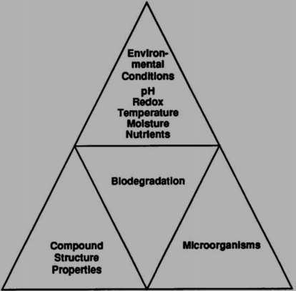
Bioremediation Effectiveness
6/23/2014
15
Depends on:
  Microorganisms
  Environmental factors
  Contaminant type & state
(Prasad MNV., 2003)

Slide 15
Criteria for Bioremediation Strategies
6/23/2014
24
Organisms must have necessary catabolic activity required for degradation of contaminant at fast rate to bring down the concentration of contaminant.
The target contaminant must have bioavailability.
Soil conditions must be favourable for microbial/plant growth and enzymatic activity.
Cost of bioremediation must be less than other technologies of removal of contaminants.

Slide 16
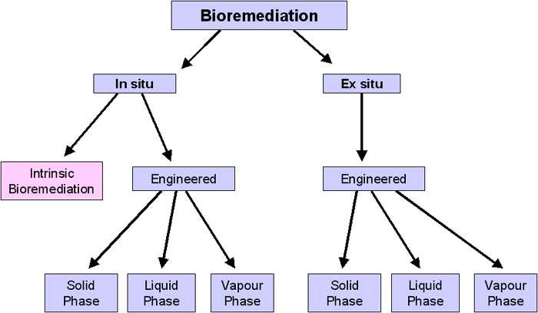
Bioremediation Strategies
6/23/2014
25
(Barathi S and Vasudevan N, 2001)

Slide 17





Bioremediation Strategies
6/23/2014
26
In situ Bioremediation
(at the site)
Ex situ Bioremediation
(away from the site)
(Barathi S and Vasudevan N, 2001)

Slide 18
In Situ Bioremediation
6/23/2014
27
In situ bioremediation is when the contaminated site is cleaned up
exactly where it occurred.
There is no need to excavate or remove soils or water in order to accomplish remediation.
In situ biodegradation involves supplying oxygen and nutrients by circulating aqueous solutions through contaminated soils to stimulate naturally occurring bacteria to degrade organic contaminants. It can be used for soil and groundwater.
It is the most commonly used type of bioremediation because it is the cheapest and most efficient, so it’s generally better to use.
(Wood TK , 2008)

Slide 19


Types of In situ Bioremediation
6/23/2014
28
2 types
Engineered Bioremediation
Intentional changes
Doing nothing
Intrinsic Bioremediation
Simply allow biodegradation to occur under natural conditions
(Wood TK , 2008)

Slide 20
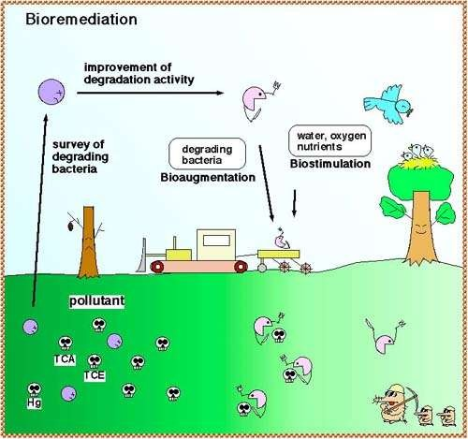
Intrinsic Bioremediation
6/23/2014
29
a bioremediation under natural conditions
  Intrinsic bioremediation uses microorganisms already present in the environment to biodegrade harmful contaminant.
  There is no human intervention involved in this type of bioremediation, and since it is the cheapest means of bioremediation available, it is the most commonly used.
  When intrinsic bioremediation isn’t feasible, scientists turn next to engineered bioremediation.
(Barathi S and Vasudevan N., 2001)

Slide 21
Engineered Bioremediation
6/23/2014
30
The second approach involves the introduction of certain microorganisms to the site of contamination.
When site conditions are not suitable, engineered systems have to be introduced to that particular site.
Engineered in situ bioremediation accelerates the degradation process by enhancing the physicochemical conditions to encourage the growth of microorganisms.
Oxygen, electron acceptors and nutrients (nitrogen and phosphorus) promote microbial growth.
(Barathi S, Vasudevan N., 2001)

Slide 22
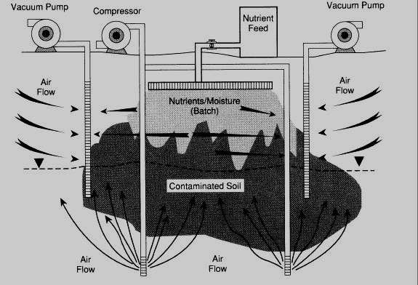
Insitu Engineered bioremediation types
6/23/2014
31
Bioventing
involves supplying air and nutrients through wells to contaminated soil to stimulate the indigenous bacteria.
(Vidali,M., 2001)

Slide 23
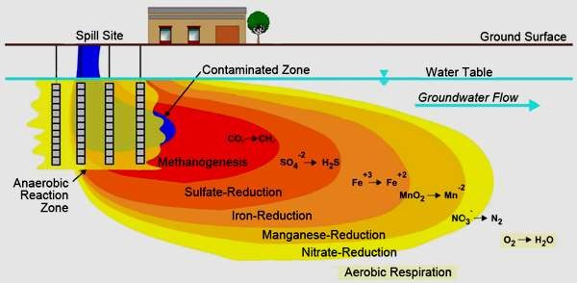
Biosparging
6/23/2014
32
involves the injection of air under pressure below the water table to increase groundwater oxygen concentrations and enhance the rate of biological degradation of contaminants by naturally occurring bacteria.
(Vidali,M.2001)

Slide 24
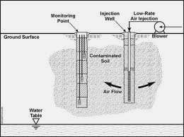
6/23/2014
Bioaugmentation
33
involves practice of adding specialized microbes or their enzyme preparation to polluted sites to accumulate transformation or stabilization of specific pollutants.
(Rittmann B.E and McCarty, P.L. 2001)

Slide 25
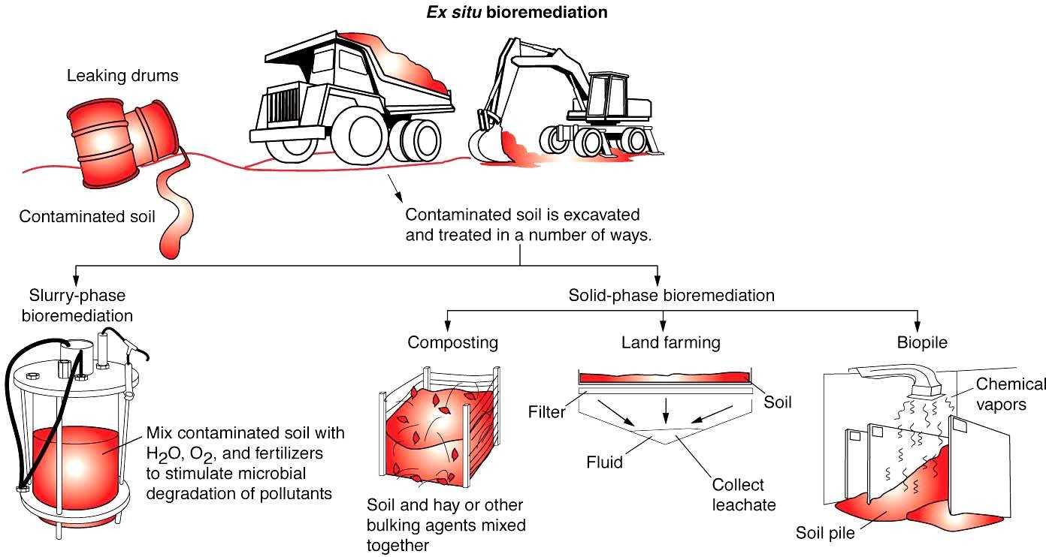
Ex situ engineered bioremediation Strategies
6/23/2014
34
(Source: http://ndpublisher.in/ndpjournal.php?j=IJAEB)

Slide 26
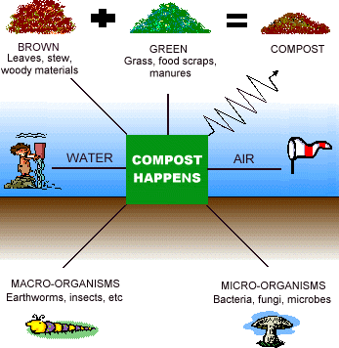
Solid phase system Ex Situ Bioremediation
6/23/2014
35
Composting
is a technique that involves combining contaminated soil
with organic compounds such as agricultural wastes.
The presence of these organic materials supports the development of a rich microbial population and elevated temperature characteristic of composting.
(Source: https://www.google.co.in/search?q=bioremediation+images)

Slide 27
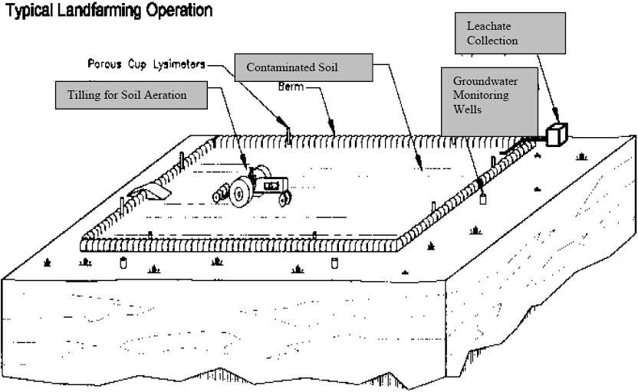
Land farming Operation
6/23/2014
36
Land farming is a simple technique in which contaminated soil is excavated and spread over a prepared bed and periodically tilled until pollutants are degraded. The practice is limited to the treatment of superficial 10–35 cm of soil.
(Rittmann, B.E and McCarty, P.L, 2001)

Slide 28
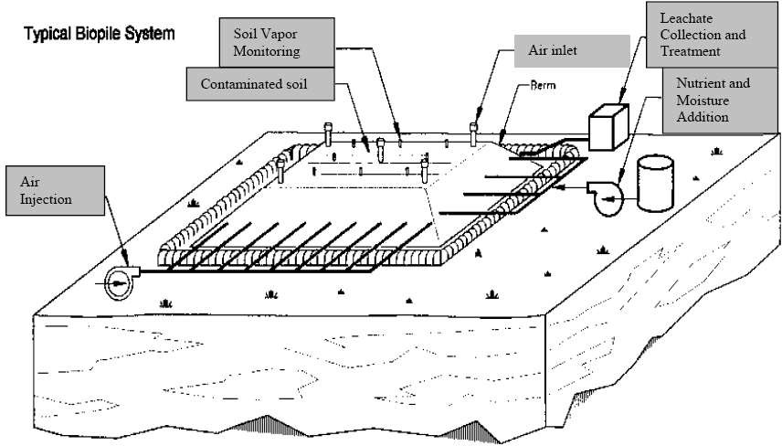
Biopile System
6/23/2014
37
Biopiles are a hybrid of land farming and composting. Essentially, engineered cells are constructed as aerated composted piles. Typically used for treatment of surface contamination with petroleum hydrocarbons they are a refined version of land farming that tend to control physical losses of the contaminants by leaching and volatilization. Biopiles provide a favorable environment for indigenous aerobic and anaerobic microorganisms.
(Rittmann,B.E and McCarty,P.L.2001)

Slide 29
Case study: Oil degradation
6/23/2014
39
Oil-metabolizing bacteria were known to exist, but when introduced into an oil spill, competed with each other, limiting the amount of crude oil that they degraded.
Prof. Chakrabarty discovered a method for genetic cross-linking that fixed all four plasmid genes in place and produced a new, stable, bacteria species (now called pseudomonas putida) capable of consuming oil one or two orders of magnitude faster than the previous four strains of oil-eating microbes.
The new microbe, which Chakrabarty called "multi-plasmid hydrocarbon-degrading Pseudomonas," could digest about two-thirds of the hydrocarbons that would be found in a typical oil spill.

Slide 30
By^{6/23}u^{/20}s¹⁴e of genetic engineering:
40
a). Plasmid transfer:
 CAM OCT XYL
NAH
Recombination
Non-recombination
CAM + OCT
XYL + NAH
SUPERBUG
(Dowling, DN and Doty, SL. 2009)

Slide 31
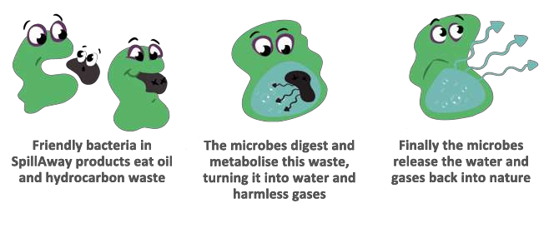
Biodegradation of hydrocarbons and petroleum
6/23/2014
41
Source: https://www.google.co.in/search?q=bioremediation+images

