Slide 1
Stages in water treatment

Slide 2
Tube Settlers
Recently a new type of settlers
Tube settlers offer an inexpensive method of upgrading existing water treatment plant clarifiers and sedimentation basins to improve performance.
Made of lightweight PVC.
They are available in a variety of module sizes and tube lengths to fit any tank geometry, with custom design and engineering offered by the manufacturer.

Slide 3
5.Filtration
After separating most floc, the water is filtered as the final step to remove remaining suspended particles and unsettled floc.
The most common type of filter is a rapid sand filter.
Water moves vertically through sand which often has layers of sand.
If charcoal is used as topmost layer of a filter media then, it removes organic compounds including taste and odor.

Slide 4
Charcoal carbon filters are most effective at removing chlorine, particles such as sediment, volatile organic compounds (VOCs), taste and odor. They are not effective at removing minerals, salts, and dissolved inorganic substances.
Most particles pass through surface layers but are trapped in pore spaces or adhere to sand particles.

Slide 5
Effective filtration extends into the depth of the filter.
This property of the filter is key to its operation: if the top layer of sand were to block all the particles, the filter would quickly clog.
To clean the filter, water is passed quickly upward through the filter, opposite the normal direction (called back flushing or backwashing) to remove embedded particles.

Slide 6
Prior to this, compressed air may be blown up through the bottom of the filter to break up the compacted filter media to aid the backwashing process; this is known as air blowing.
This contaminated water can be disposed of, along with the sludge from the sedimentation (clarifiers) basin, or it can be recycled by mixing with the raw water entering the plant.

Slide 7
Some water treatment plants may employ pressure filters. These work on the same principle as rapid gravity filters differing in that the filter medium is enclosed in a steel vessel and the water is forced through it under pressure.

Slide 8
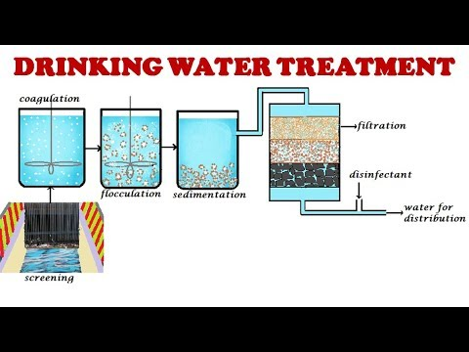

Slide 9
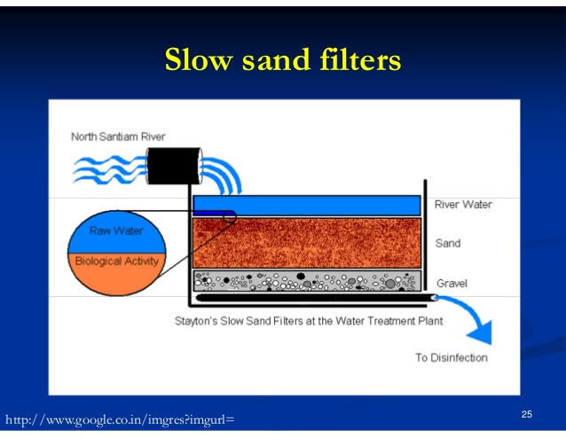

Slide 10
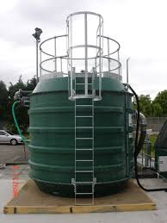

Slide 11
Tertiary treatment
Disinfection is normally the last step in purifying drinking water.
Water is disinfected to destroy any pathogens which pass through the filters.
Possible pathogens include viruses, bacteria, including Escherichia coli, Campylobacter and Shigella, and protozoans, including G. lamblia and other Cryptosporidia.
Mostly public water supplies are required to maintain a residual disinfecting agent throughout the distribution system, in which water may remain for days or hours before reaching the consumer

Slide 12
Following the introduction of any chemical disinfecting agent, the water is usually held in temporary storage – often called a contact tank or clear well to allow the disinfecting action to complete.
Common disinfectants
Chlorine
Chlorine dioxide
Chloramines
Ozone (O3)
UV radiation

Slide 13
1.Chlorine
Chlorine is a strong oxidant that kills many micro-organisms.
Because chlorine is a toxic gas, there is a danger of a release associated with its use. This problem is avoided by the use of sodium hypochlorite, which is a relatively inexpensive liquid that releases free chlorine when dissolved in water.

Slide 14
We can also use TCP/ Bleaching powder. Handling the solid, however, requires greater routine human contact through opening bags and pouring than the use of gas cylinders which are more easily automated.

Slide 15
A major drawback to using chlorine gas or sodium hypochlorite is that they react with organic compounds in the water to form potentially harmful levels of the chemical by-products trihalomethanes (THMs) and halo acetic acids, both of which are carcinogenic and regulated by the U.S. Environmental Protection Agency (EPA).

Slide 16
The formation of THMs and haloacetic acids is minimized by effective removal of as many organics from the water as possible before disinfection. Although chlorine is effective in killing bacteria, it has limited effectiveness against protozoans that form cysts in water.

Slide 17
2.Chlorine dioxide
Chlorine dioxide is another fast-acting disinfectant.
It is, however, rarely used, because it may create excessive amounts of chlorate and chlorite, both of which are regulated to low allowable levels.

Slide 18
3.Chloramines
Chloramines are another chlorine-based disinfectant.
Although chloramines are not as effective as disinfectants, compared to chlorine gas or sodium hypochlorite, they are less prone to form THMs or haloacetic acids.

Slide 19
It is possible to convert chlorine to chloramine by adding ammonia to the water along with the chlorine: The chlorine and ammonia react to form chloramines. Water distribution systems disinfected with chloramines may experience nitrification, wherein ammonia is used a nitrogen source for bacterial growth, with nitrates being generated as a byproduct.

Slide 20
4. Ozone (O3)
Ozone (O3) is a relatively unstable molecule of oxygen which readily gives up one atom of oxygen providing a powerful oxidizing agent which is toxic to most water borne organisms.
It is an effective method to inactivate harmful protozoans that form cysts.
It also works well against almost all other pathogens.
Ozone is made by passing oxygen through ultraviolet light or a “cold” electrical discharge.

Slide 21
To use ozone as a disinfectant, it must be created on site and added to the water by bubble contact.
Some of the advantages of ozone include the production of relatively fewer dangerous by-products (in comparison to chlorination) and the lack of taste and odor produced by ozonation.
Although fewer by-products are formed by ozonation, it has been discovered that the use of ozone produces a small amount of the suspected carcinogen Bromate.

Slide 22
UV radiation
UV radiation is very effective at inactivating cysts, as long as the water has a low level of colour so the UV can pass through without being absorbed.
The main drawback to the use of UV radiation is that, like ozone treatment, it leaves no residual disinfectant in the water.

Slide 23
Because neither ozone nor UV radiation leaves a residual disinfectant in the water, it is sometimes necessary to add a residual disinfectant after they are used.
This is often done through the addition of chloramines, discussed above as a primary disinfectant. When used in this manner, chloramines provide an effective residual disinfectant with very little of the negative aspects of chlorination.

Slide 24
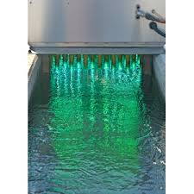
Uv treatment

Slide 25
