Slide 1
PRINCIPLES OF LIFE-II 3(2+1)
BS SEMESTER 2
SESSION 2019-23
Course Tutor: Dr Moneeza Abbas

Slide 2
Overview of earlier theories, Lamarckism,Darwinism,Modern concepts and origin of species.

Slide 3
Chemical Evolution: The term evolution refers to change from one form to another. Change in living organism with time is known as organic or biological evolution. The process of evolution can be understood from the fact that unicellular organism appear first, simple multicellular and later development of complex multicellular organisms such as seed plants and vertebrate animals.

Slide 4
The fishes were the initial early vertebrate and it gradually change to form amphibians. These amphibians has produced reptiles and that has evolved further to give birds and mammals. These hierarchical linking of different species is considered by ladder of chain by Aristotle (Fig.1).
In the same series, mammals have evolved to human involving ape-like primates by acquiring changes over the course of time.

Slide 5
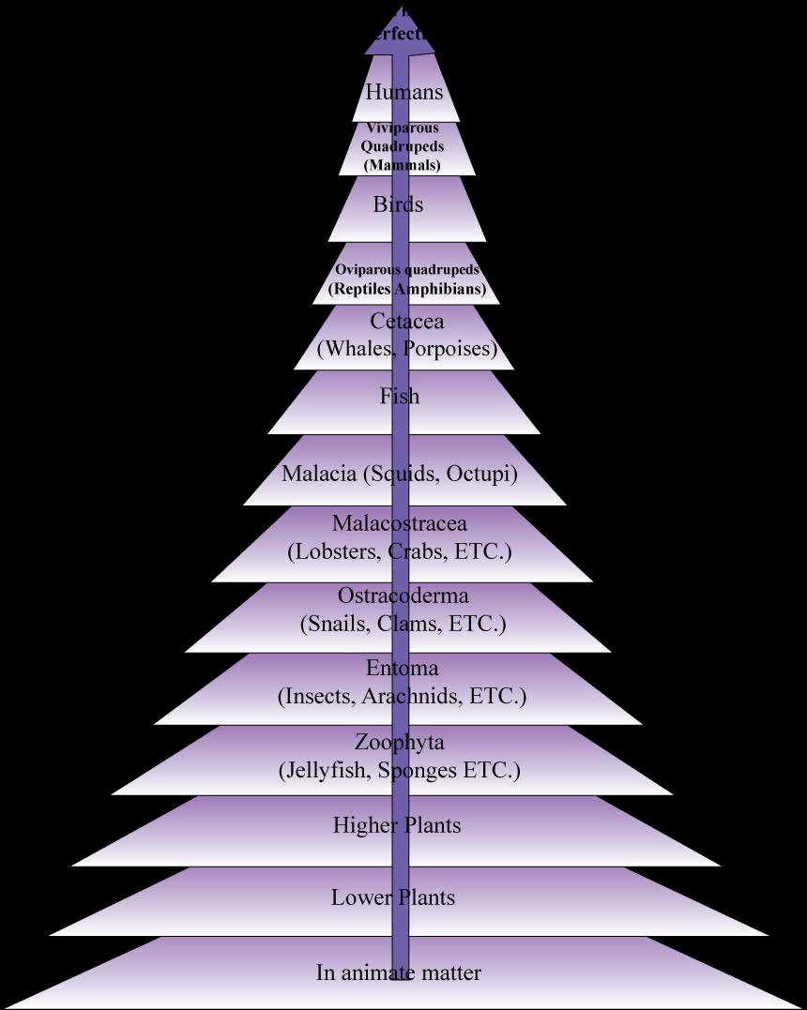
Figure 1 : Aristotle’s ladder of Nature

Slide 6
Theories of Evolution
The mechanism of evolution is not known and several theories have been put forward to explain the process of evolution. These theories are as follows:
1. Theory of inheritance of acquired characters: This theory is proposed by French biologist Chevalier de lemarck in his famous book “Philosphie zoologique”. He proposed that organisms are not fixed and they evolve from the pre-exisiting organisms by modifications. The theory is proposed assuming three different assumptions:
• New Needs: Variation in environment, conditions and the over-all circumstance which affect the existence of organism, needs adaptation in organism to survive. As a result, organism has to put special efforts to fulfil its new needs for adaptation. In few cases, it just needs change in habit or behavior of the organism. New habit includes fresh or extensive use of certain organs or structure of the body or disuse of others.
• Acquisition of Characters: There are 3 ways to acquire the characters required to adopt into changed conditions:
Innate Tendency: There is innate tendency in each organism to acquire greater complexicity and perfection to perform functions. In this process of achieving perfection, organism is better and better adapted to the changed environment.

Slide 7
Use or disuse of organs: Use and disuse of organ affect their structure, shape and efficiency of functioning. More usage of a particular organ brings additional strength, size and more efficient. In contrast, disuse or underusage of organ gradually makes them weaker and smaller and finally they may disappear as well. Thus, differential usage of organ allowed the additional character in the body during the life span of an organism.
Environmental factors: Variation in environmental factors such as temperature, light, humidity, wind, ememies affects the living things and brings changes in life style and habits. The combined effect of use and disuse of organ and influence of environmental factors, results into the change in the body of organism and these characters are known as “acquired characters”.
Inheritence of Acquired Characters: The characters acquired by one generation are transmitted to the new generation and subsequently newer characters are added in next generation to acquire perfection.
Lemarcks proposed that evolution is a slow process where characters are acquired over the course of time in various generations

Slide 8
Explanation of theory with observed evolution:
Lemarck in his book explained the evolution of various animals to elaborate the proposed hypothesis.
Giraffe: Lemarck uses his hypothesis to explain the appearance of Giraffe with long neck and forelimbs. The different evolutionary stages of present giraffe is explained as per Lamarck theory in (figure 2).
As per the theory, the giraffe is evolved from the short height deer like ancestor. These ancestors are living in the barren place with leaves on the trees available to them for eating. In order to reach the leaves on tree, it streacted its neck and forelimbs. As a result, these organs get elongated.
These acquired character in first generation passed on to the subsequent generation and continuous streatching accumules this character over the course of few generations to evolve giraffe with long neck and forearms.

Slide 9
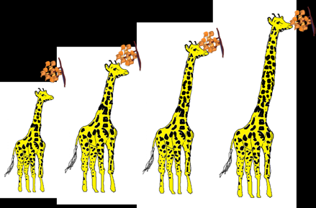
Figure 2: Event in the evolution of giraffe from deer link ancestor.

Slide 10
2. Other examples of use/disuse to support the Lamarck theory are black smith and rabbit. Blacksmith acquires large biceps muscle as they do rigrous hammering for wielding. Whereas, rabbit develop well developed pinna muscle to move the ear to receive sound waves from different direction to protect them selve from the enemy.
3. Aquatic Birds: Aquatic birds such as ducks needs to go into the water for food and protection. To achieve this, they spread their toes to float on water. As a result of continues efforts, they have developed web between the web.
4. Deer: It is believed that deer has acquired speed through continuous running in a process to protect himself from the enemies.
5. Cave animals: cave animals stay in low light environment and does not use eye and as a result they lost their vision over the course of time.

Slide 11
Criticism of the theory: Lamarck theory received initial attention but it could not be able to explain several observations. The initial two assumptions are correct; (1) New needs are created by a change in the environment and (2) these characters are acquired by use/disuse of organ and environmental factors. The inheritance of acquired chacarters to the subsequent generation is arguable. There are evidences against the inheritance of acquired characters.
The major critism is gathered by experiment performed by August Weismann. According to the Weismann’s theory of continuity of germplasm, animal is made up of two types of cells; Somatic cells and germ cells. The nuclei present in germ cell is responsible for inheritance of characters whereas somatic cells contains nucei which respond to the environmental factors and use/disuse. Hence, acquired characters remains within the somatic cells.
As a result this theory supports the idea that acquired characters are not inhereted. Weisman conducted a conclusive experiment on rat where he has cut their tails for 80 generations but it didn’t produce rats tailless.

Slide 12
Boring of ear (pinna) is practiced in women for thousands years but this chacraters never been inherited.
Chinese women wear tight shoes to have small feet but their children have normal waist.
Child of athelete are not born with powerful muscle.
Children of noble laureate may not be as intelligent as the parent.
Pavlov has trained the mice to come for food on bell ring but he found that training is necessarily in each generations.
Neo-lamarckism: There are evidences to support the inheritance of acquired characters. For examples, effect of radiation and chamicals on germ cells and resulting change in the phenotype of the cell. The evidence for the inheritance of acquired character revived the Lamarck theory as neo-lamarckism. The modified neo-lamarckism has following postulates:
1. Germ cells are not always immune from the effect of environment.
2. Germ cells may be affected directly by environment without any effect on the somatic cells.
3. Germ cells may carried acquired character to the next generation.
Even considering these points, Lamarckism could not be able to provide satisfactory mechanism for evolution.

Slide 13
Darwin’s Theory of Evolution
Darwin’s Theory of Evolution: The theory of natural selection was proposed by Charles Darwin and Alfred Russel Wallace in their common publication. Both of them conducted scientific data collection from individual population survey.
Charles Darwin travelled for 5yrs expedition around the world on the ship H.M.S Beagle. During this journey, he made observation of several animals and plants. He keenly observed the similarities among organisms and draw evolutionary relationship.
In addition, economist Thomas Malthus’s report on workers recognized that competition between species leads to the struggle for existence. Considering Wallace’s view and Malthus observations of workers led Charles Darwin to propose the theory of natural selection in his book “Origin of Species”.

Slide 14
The theory of natural selection is based on following points:
1. Rapid Multiplication: Every organism has enormous ability to reproduce to continuance of the species. All animals and plant tend to multiply in geometrical progression. Lets see few example of organism to understand the potential of organism to multiply. These examples are as follows:
Paramecium: it has multiplication rate of 3 times in 48 hrs. if single paramecium will allow to grow and multiply in 5 yrs to give the mass equal to ten thousand times the size of earth.
(ii) Cod Fishes: Cod fish produces over 1 million eggs in a year. If all these eggs will rise to fishes, the whole atlantic ocean will be filled in next 5 yrs.
(iii) Elephant: Elephant has an average life span of 90 years and during the whole life span he can produce only six offsprings. If all the offsprings survived, single elephant pair would produce 19,000,000 elephants in 750 years.
(iv) Plants: Plants produces thousands of seeds every year.

Slide 15
2. Limited natural resources: Inspite the enormous capacity of an organism to reproduce, the number of individual species remain constant. It is due to increase in population in animal or plant requires more space and food. Ultimately the food to plant or animal is provided by the CO2 from air, water and mineral from soil. The amount of thes basic material is limited in universe. Hence, it does not allow the population of organism beyond the limit and an equilibrium is reached.
3. Struggle for existence: Due to shortage of food, water and space, there is severe competition among the off spring for existence. Every individual has few basic requirements, such as food, space, water, mate to reproduce and protection from enemies. In order to achieve basic needs, organisms compete with each other and it is known as struggle for existence.

Slide 16
The struggle for an individual can be of 3 types:
(i) Intraspecific Struggle: The competition of the individuals of the same species. For example, fight between two dogs for a piece of meat. War is another example of intraspecific struggle among different human.
(ii) Interspecific Struggle: The competition of the individuals of the different species. For example, tiger attacks on deer for food.
(iii) Environmental Struggle: Every individual struggle against the change in environment such as temperature, humidity, level of water, rain, climate etc.

Slide 17
4. Variation: Each and every individual varies in several aspects to other individual. Even the offsprings produced by parents also differ in many aspects. The two individuals can be different from each other in their behavior, color, size, strength etc.
5. Natural Selection: Due to variation among different individual, they struggle towards their existence with different potentials. The variation in an individual may allow him to survive and complete its life cycle comfortable. Wheras, if the variations are unfavorable, the individual will struggle against every odds and as a result it may not be able to complete the life cycle.
For example, fast running deer has better chance to escape from the tiger compared to the slow runner. Another factor is ability to adopt into the changed environment. Both Darwin and Wallace, recognized the environment as the principal factor for natural selection. For example, plants with ability to hold more water and can be able to reduce loss of water will ultimately survive, despite the physical strength, height and other characters.

Slide 18
6. Inheritence of useful variations: The individual survived due to unique variation, mate and produces their off spring to complete their life-cycle. As a result, they transfer the useful variations to the next generations and allow the individual to multiply.
Darwin believed that any variation which can help the individual to survive and help to favorable for struggle will be inherited. He considered the variation which may be acquired or inheritable.

Slide 19
Modern understanding
Darwin didn't know anything about genetics, Pobiner said. "He observed the pattern of evolution, but he didn't really know about the mechanism." That came later, with the discovery of how genes encode different biological or behavioral traits, and how genes are passed down from parents to offspring. The incorporation of genetics and Darwin's theory is known as "modern evolutionary synthesis."

Slide 20
“Pobiner said” The physical and behavioral changes that make natural selection possible happen at the level of DNA and genes. Such changes are called mutations. "Mutations are basically the raw material on which evolution acts,“
Mutations can be caused by random errors in DNA replication or repair, or by chemical or radiation damage. Most times, mutations are either harmful or neutral, but in rare instances, a mutation might prove beneficial to the organism. If so, it will become more prevalent in the next generation and spread throughout the population

Slide 21
In this way, natural selection guides the evolutionary process, preserving and adding up the beneficial mutations and rejecting the bad ones. "Mutations are random, but selection for them is not random," But natural selection isn't the only mechanism by which organisms evolve, .
For example, genes can be transferred from one population to another when organisms migrate or immigrate, a process known as gene flow. And the frequency of certain genes can also change at random, which is called genetic drift.

Slide 22
References
Biology Campbell, N.A. 8TH ed. The Benjamin/Cummings PUBLISHING Company Inc. New York. USA, 2008.
Conway Morris, S., 1992, The early evolution of life. Chapter 22, p. 436–457, in Brown, G., Hawkesworth, C., and Wilson, C., Understanding the Earth. Cambridge University Press, 551 p.
https://www.livescience.com/474-controversy-evolution-works.html

