Slide 1
PRINCIPLES OF LIFE-II 3(2+1)
BS SEMESTER 2
SESSION 2019-23
Course Tutor: Dr Moneeza Abbas

Slide 2
origin of eukaryotic cell

Slide 14
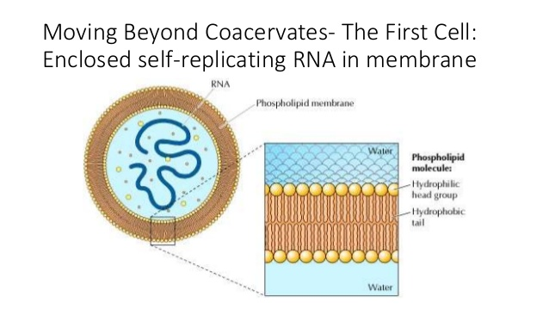

Slide 17
REFERENCES
1.https://www.youtube.com/watch?v=DwbbkH4oV6o&t=169s
2.https://www.infoplease.com/math-science/biology/genetics-evolution/origin-of-prokaryotes-and-eukaryotes-eukaryote-evolution.
3. Campbell Biology. Reece, J.B., Urry, L.A., Cain, M.L. and Wasserman, S.A., 9TH Ed.,Pearson/BenjaminCummingsPublishers, USA.2010.
4.https://www.youtube.com/watch?v=sZfGlgfHkNE

Slide 18
THANK YOU

