Slide 1
PRINCIPLES OF LIFE-II
3(2+1)
Maj/Env-111
BS SEMESTER: 2
SESSION: 2019-23
Course Tutor: Dr Moneeza Abbas

Slide 2
EVOLUTION OF BIOSPHERE

Slide 3
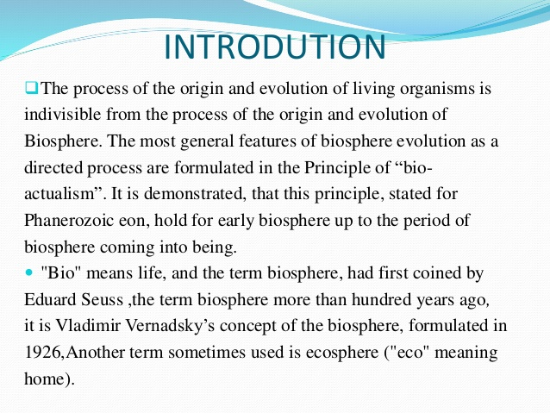

Slide 4
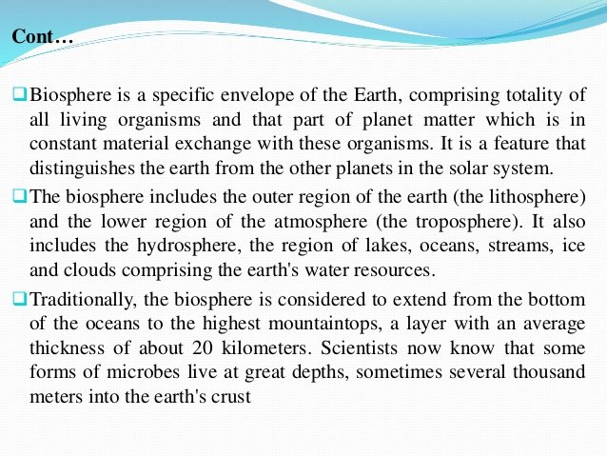

Slide 5
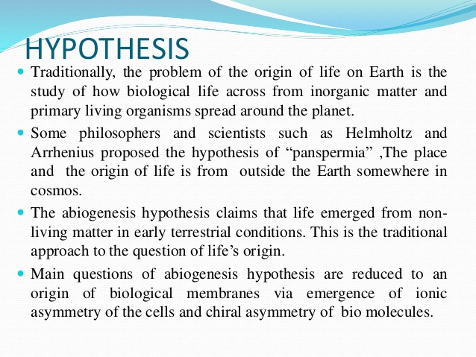

Slide 6
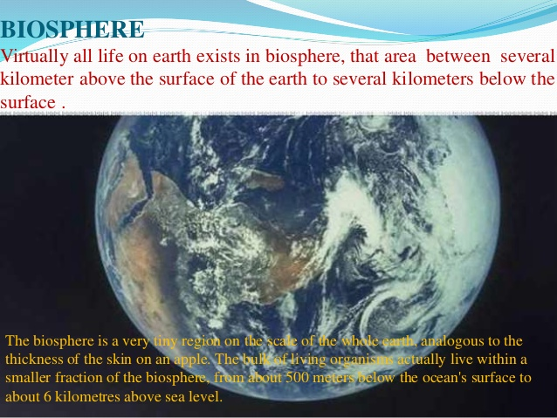

Slide 7
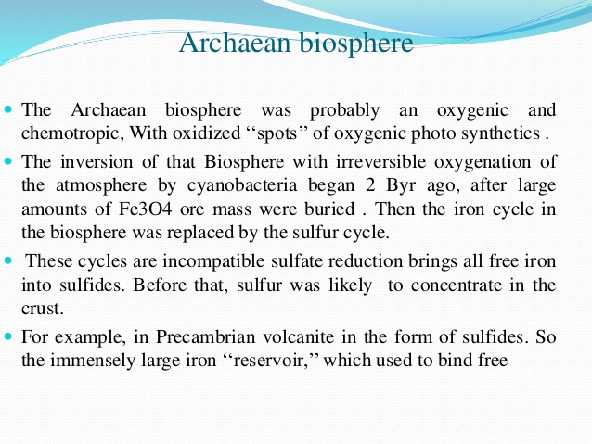

Slide 8
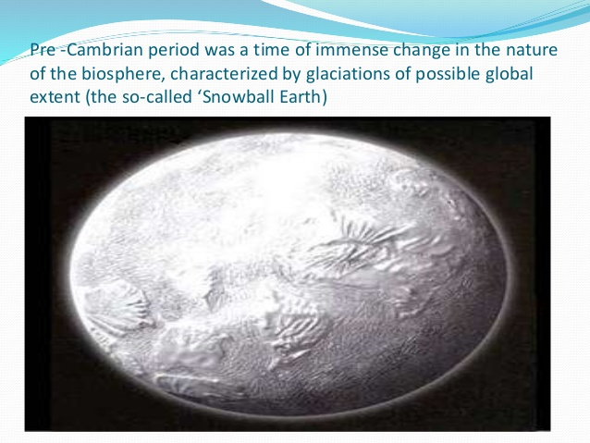

Slide 9
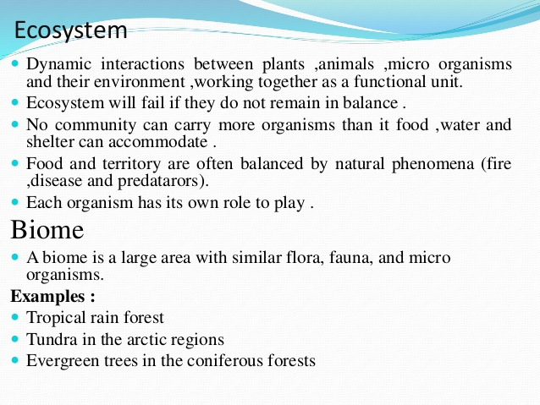

Slide 10
Individual→Population →Community →Ecosystem →Biome →Biosphere

Slide 11
