Slide 1
WASTE WATER TREATMENT
Septic tank disposal system
Conventional method.
Process
Sewer lines from home into-----under ground septic tank----tank separates solids from liquids through biochemical change/digest-----store organic matter----discharge clarified liquid into nearby drain field----through pipes----in which treated sewage seeps into soil—------further soil cleans water by oxidation and filtration when water pass through soil layers.

Slide 2
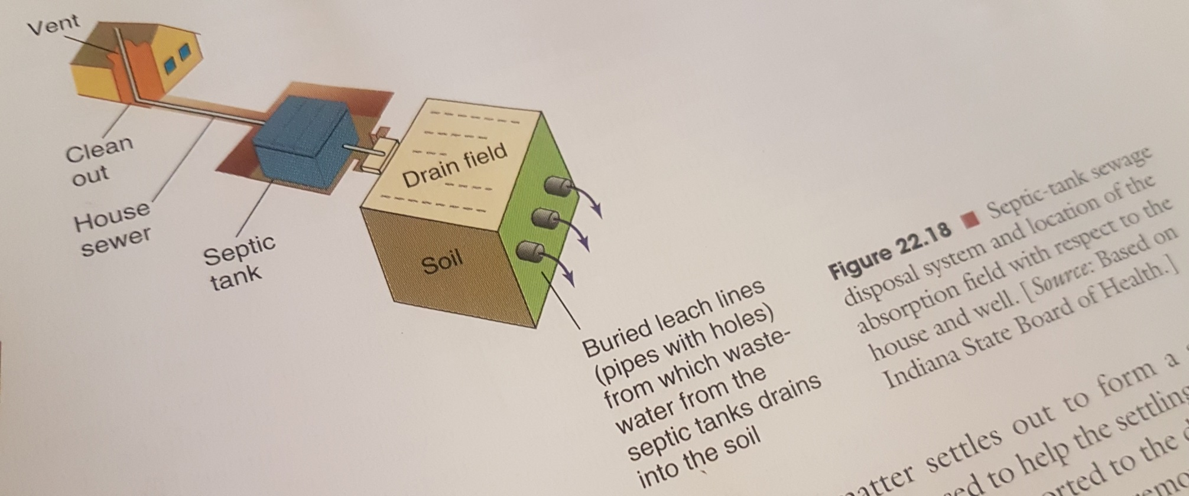
Figure showing Septic tank disposal system

Slide 3
Waste water treatment Plants
Specially designed plants in urban areas.
Municipal sewage from homes etc comes to plants through pipes.
After treatment Waster water is discharged into surface water sources.
Main purpose ---reduce BOD ----kill bacteria through chlorine.
Divided into 3-categories
Primary treatment.
Secondary treatment.
Tertiary/advance treatment

Slide 4
Primary treatment
Screening:
Waste water passed through series of screens----remove large floating Organic material.
Then pass through grit chamber---remove—sand, small stones, grit etc.
Enter primary sedimentation tank----Particulate matter settles---from sludge—may also use chemicals to settle sludge.
Sludge is removed and sent to digester.
Remove app 30-40% BOD.

Slide 5
Secondary treatment
Activated sludge----most common treatment.
Water from Primary sedimentation tank----enters---Aeration tank.
Here----water is mixed with air which is pumped in + some sludge is also mixed.
Sludge has aerobic bacteria---consume organic matter---further reduce BOD from water.
Waste water-----enters----final sedimentation tank---more sludge settles out.
Some activated sludge from this step ----recycled into aeration tank again
To use bacteria again and again.
Most of sludge from final sedimentation tank ----goes—sludge digester.
Sludge from primary & secondary sedimentation tank---treated by anaerobic bacteria----further degrade sludge through microbial digestion.

Slide 6
Methane gas (CH4) ---released from anaerobic digestion.
CH4 can be used as a fuel to run plant/released.
Waste water from final sedimentation tank---disinfected---by chlorination---to eliminate disease organisms.
Waste water ----released into rivers etc or can be used for irrigation.
About 90% BOD is removed.
Advance/ Tertiary treatment
Primary & secondary treatment steps ---not remove all pollutants.
This step involves ----specific treatments.
Such as: filters, carbon filters, use of different chemicals.
To remove different nutrients (Phosphorous, Nitrogen), heavy metals, organic chemicals.

Slide 7
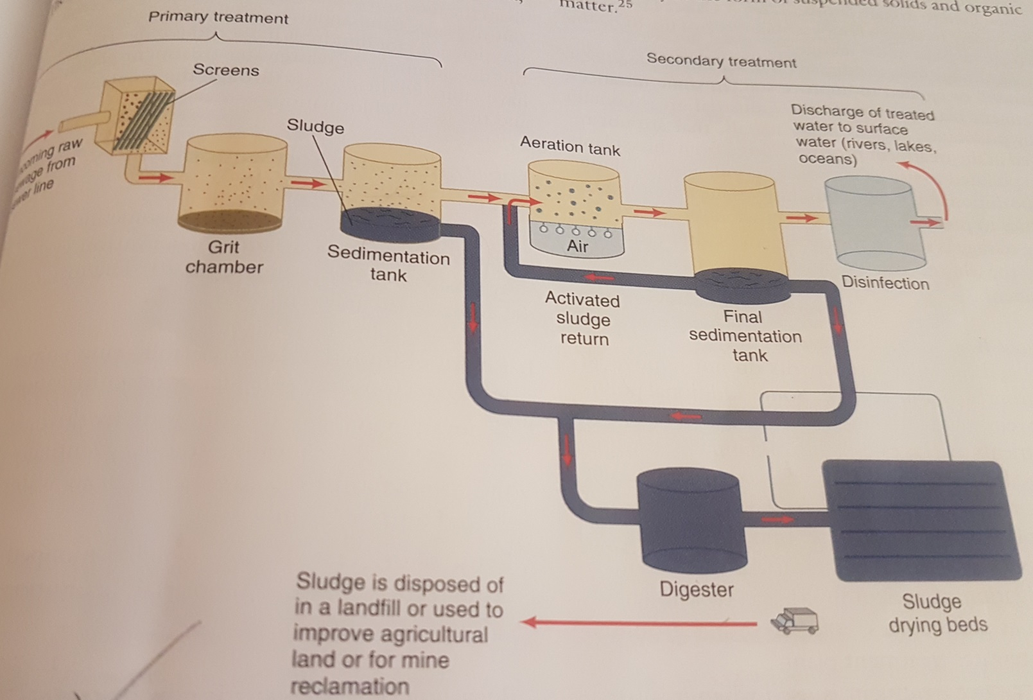
Figure: Sewage treatment Plant

