Slide 1
TEACHING READING

Slide 2
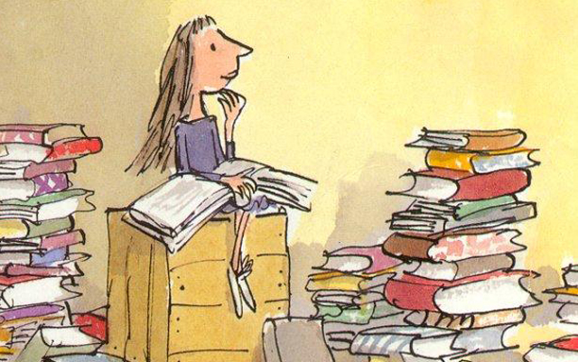
EXTENSIVE READING
IT NOT ONLY TO TELL THE STUDENTS TO READ A LOT , IT IS NECESSARY TO OFFER A PROGRAM

Slide 3
Involves students reading long texts or large quantities for general understanding, with the intention of enjoying the texts.
Students choose the books depending on their interests, and there is not always a follow-up discussion or work in class. Students are encouraged to read for pleasure and should become better readers
To get students reading in English and liking it. To increase in reading fluency.

Slide 4
Characteristics
Reading material
Student choice
Reading for pleasure and information
Extensive reading out of class
Record keeping
Silent reading in class
Language level
Use of dictionaries
The teacher as role model
Motivation

Slide 5
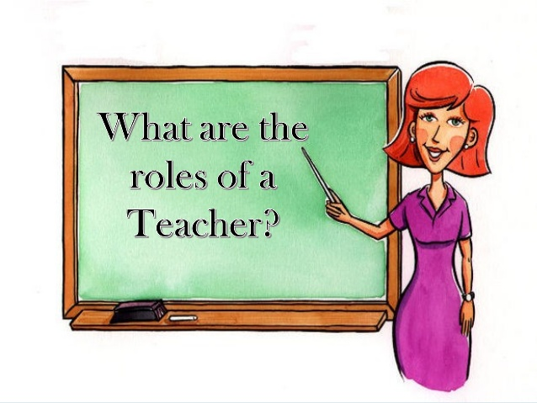
Encourage students
Persuade students
Rad aloud
Show his/her manner of reading
Organise reading programs
(books, number of books, genres, so on)
TASK
Weekly reports (writte or spoken)
Diary by chapters
Write book reviews and share with classmates
Make up a new stories.

Slide 6
INTENSIVE READING
Involves learners reading in detail with specific learning aims and tasks
Focus on testing, evaluating and increasing knowledge
Understanding the literal meaning of what’s being read is vital.
Often includes note-taking and attention to details.
Emphasis on deconstructing sentences to understand grammar and syntax rules
Involves reading comprehension testing, answers to specific questions.
Some possible examples are reports, contracts, news articles, blog posts and short pieces of text such as short stories.

Slide 7
Organiser
Observer
Feedback organiser
Prompter
The vocabulary question:
Time limit
Word/phrase limit
Meaning consensus

Slide 8
Reading Lesson sequences

Slide 10
TEACHING LISTENING

Slide 11
EXTENSIVE LISTENING
WHERE A TEACHER ENCOURAGES STUDENTS TO CHOOSE FOR THEMSELVES WHAT THEY LISTN TO AND TO DO SO FOR PLEASURE AND GENERAL LANGUAGE IMPROVEMENT. HELPS STUDENTS TO IMPROVE THEIR LISTENING SKILLS AND PRONUNCIATION ..

Slide 12
Characteristics
Makes better readers
Outside the classroom
Use authentic and non authentic
Material.
Encourage students
The role of the teacher
Came to an agreement about how much and which material
The task
Comments on cards, web sides
Record responses

Slide 13
INTENSIVE LISTENING

Slide 14
Advantages
Disadvantages
Voices different to the teacher.
Meet different characters( if they are real people)
Varity of situations and voices.
Material is portable and available.
Poor acoustics in a classroom.
Not all students can hear equally well.
Speed is given by the audio not by the listeners.
It’s not satisfactory it students have to take information from the audio.
Devices problems.

Slide 15
HOW OFTEN DO STUDENTS HAVE TO LISTEN TO?

Slide 16
Live listening
Reading aloud
Story telling
interviews
Conversations

Slide 17
The role of the teacher
Organiser
Prompter
Feeback organiser
Machine operator

Slide 18
Listening lesson sequences

Slide 19
TV SERIES
What is your favorite one? Why?

Slide 20
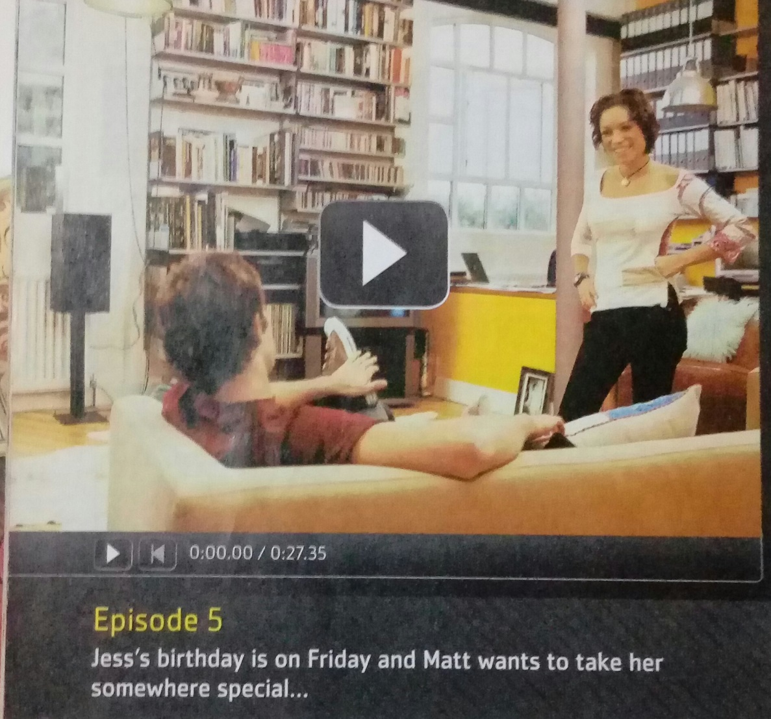
I’VE NEVER BEEN THERE!
Look at the information about an episode from an American TV series. Listen to part of the episode. Then answer the following questions
English File (Pearson)
Unit 12
CD 5 – track 51

Slide 21
Which restaurants has Jess eate in before?
The Peking Duck
Appetito
Luigi’s
Listen again and answer the questions.
When did Jess go to The Peking Duck and who with?
How many times has she been to Appetito?
What did Matt say happened when they went to Luigi’s?
Why is Jess angry?
Who does Jess think Matt went with to Luigi’s?
What does Matt say? Do you believe him?

Slide 22
BIBLIOGRAPHY
Harmer (2006) The practice of English Language Teaching
Richards J. and Rodgergs T. Approaches (2010) and Methods in Languages Teaching
Latham Ch. (2013)English File Elementary Student’s book
https://www.teachingenglish.org.uk/article/intensive-reading

