Slide 1
Full wave rectifier Instructor: Ms. Hira Akash

Slide 2
Full Wave Rectifier
The process of converting the AC current into DC current is called rectification. Rectification
can be achieved by using a single diode or group of diodes. These diodes which convert the AC current into DC current are called rectifiers.
Rectifiers are generally classified into two types: half wave rectifier and full wave rectifier.

Slide 3
Half-wave Rectifiers
Full-wave Rectifiers
A half-wave rectifier is one which converts the AC voltage into a pulsating DC voltage, using only one half-cycle of the applied AC voltage. For half-wave rectification, we use a junction diode.
A full-wave rectifier is one which converts on AC voltage into a pulsating DC voltage using both half-cycles of the applied AC voltage. For full-wave rectification we use two or four junction diodes.

Slide 4
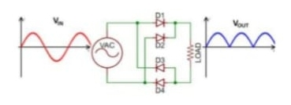
Fig : 1.1
As Show In the above figure, the full wave rectifier converts both positive and negative half cycle of the input AC signal into output pulsating DC signal.

Slide 5
Classification of Full Wave Rectifier:
The full wave rectifier can be further divided mainly into following types:
Center Tapped Full Wave Rectifier.
Full Wave Bridge Rectifier

Slide 6
Center Tapped Full Wave Rectifier
In the center tapped full wave rectifier two diode were used.
These are connected to the center tapped secondary winding of the transformer.
The positive terminal of two diode is connected to the two ends of the transformer.
Center tap divides the total secondary voltage into equal parts.
The center-tap is usually considered as the ground point or the zero voltage reference point.

Slide 7
Full Wave Bridge Rectifier
Full wave bridge rectifier four diodes are arranged in the form of a bridge.
This configuration provides same polarity output with either polarity.
The main advantages of this bridge circuit is that it does not require a special center tapped transformer.
The single secondary winding is connected to one side of the diode bridge network and the load to the other side.

Slide 8
Characteristic of full wave rectification
Ripple factor
Rectifier efficiency
Peak inverse voltage (PIV)
DC output current
DC output voltage
Root mean square (RMS) Value of current I_{RMS}
Root mean square (RMS) Value of the output load voltage V_{RMS}

Slide 9
Characteristic of full wave rectification

Slide 10
Ripple Factor

Slide 12
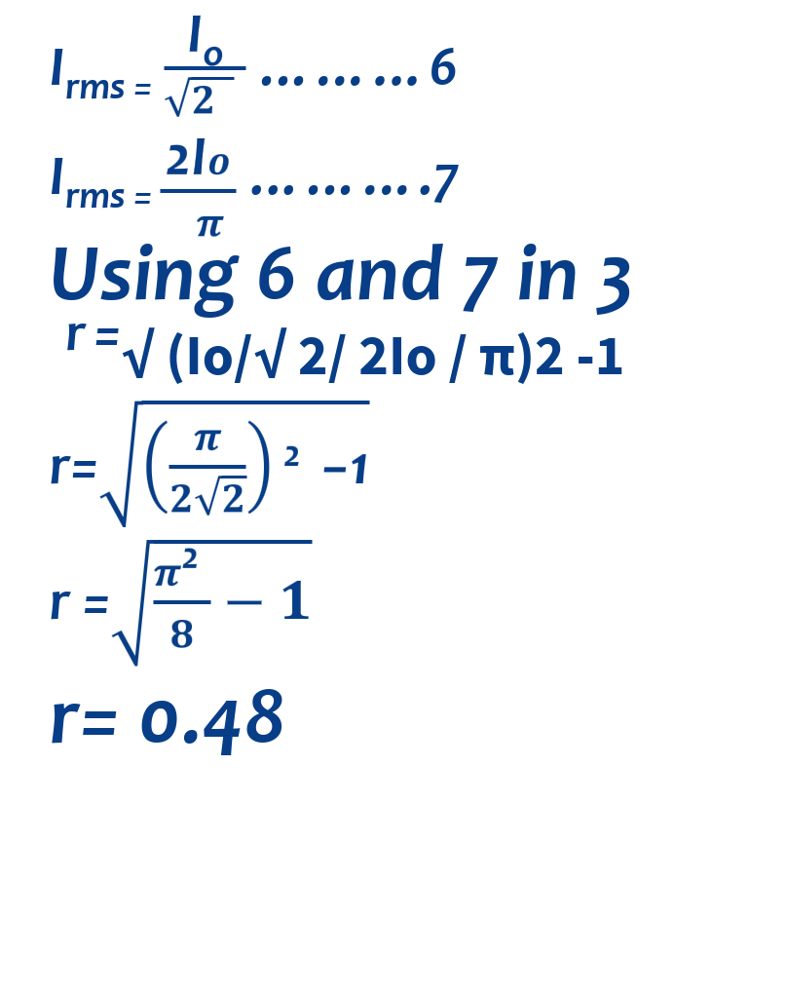

Slide 13
Advantages of full wave rectifier:
Ripple frequency is two times the input frequency.
The output and efficiency of center tap full wave rectifier are high because AC supply delivers power during both the halves.
For the same secondary voltage bridge rectifier has double output.

Slide 14
Disadvantages of full wave rectifier
it is difficult to locate the center tap on the secondary winding .
The DC output is small as each diode utilize on the one half of transformer’s secondary voltages.
The diode used have high peak inverse voltage.
Full wave rectifier requires more diodes i.e. two for center tap rectifier and four for bridge rectifier.
when a small voltage is required to be rectified this full wave rectifier circuit is not suitable.

