Slide 1
Reverse-Biased junction diode

Slide 2
P-N junction diode
A p-n junction diode is a piece of silicon that has two terminals . One of the terminal is doped with P-type material and other with N-type material.

Slide 3
p-n junction diode
(fig 1.1)

Slide 4
Reverse biased junction diode
The process by which a p-n junction diode blocks the electric current in the presence of applied voltage is called reverse biased p-n junction diode.

Slide 5
In reverse biased p-n junction diode, the positive terminal of the battery is connected to the n-type semiconductor material and the negative terminal of the battery is connected to the p-type semiconductor material.

Slide 6
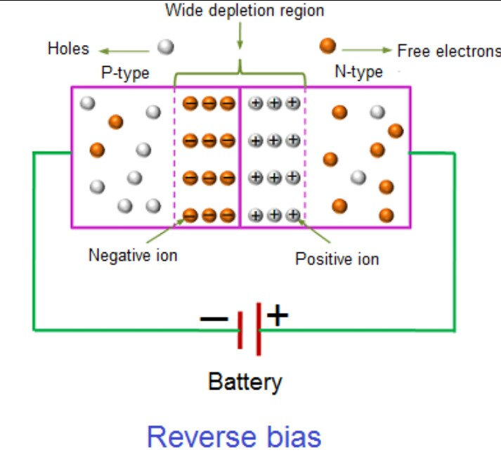
(fig 1.2)

Slide 7
In the reverse biased p-n junction diode, the free electrons begin their journey at the negative terminal whereas holes begin their journey at the positive terminal.

Slide 8
Free elctrons, which begin their journey at the negative terminal, find large number of holes at the at the p-type semiconductor and fill them with electrons.

Slide 9
On the other hand, holes or positive charges, which begin their journey at the positive terminal, find large number of free electrons at the n-type semiconductor and replace the electrons positions with the holes.

