Slide 1
Effects of temperature on conductivity
Instructor: Ms. Hira Akash

Slide 2
Outline:
Conductor
Conductivity
Thermal conductivity
Electric conductivity
Effects of temperature on thermal conductivity
Effects of temperature on electric conductivity

Slide 3
Conductor:
A conductor is any piece of material that easily allows heat or electricity to pass through it.A conductor allows electrons to flow freely across its surface.

Slide 4
Thermal Conductors

Slide 5
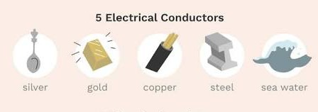
Electrical conductors

Slide 6
Conductivity:
The abilty of a material to conduct heat or electricity is called its conductivity

Slide 7
Conductivity

Slide 8
Thermal conductivity:
The thermal conductivity of a material is a measure of its ability to conduct heat

Slide 9
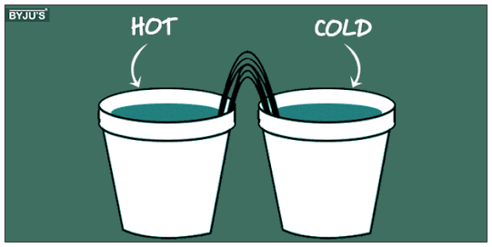

Slide 10
Electric conductivity:
Electrical conductivity is a measure of the rate at which an electric current can pass through a material and is measured in reciprocal ohm metres (Ω−1 m−1).

Slide 11
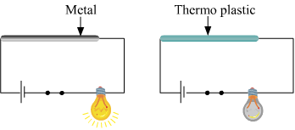

Slide 12
Effects of temperature on thermal conductivity:
The thermal conductivity of the metal is expected to increase. ... For Platinum, the thermal conductivity increases with increase in temperature. In gases, molecular collisions increase with the increase in temperature.

Slide 13
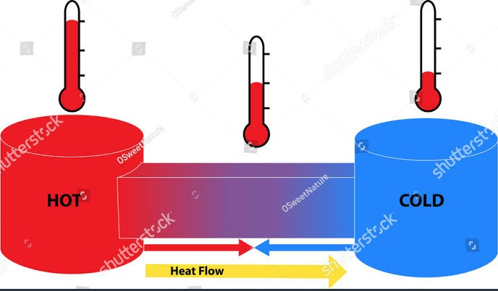

Slide 14
Effects of temperature on electric conductivity:
A metals electrical conductivity increases with decrease in temperature and decreases with increase in temperature. As it cools down, there is no hindrance in the form of thermal excitation, enabling easier flow of carriers, increasing conductivity.

Slide 15
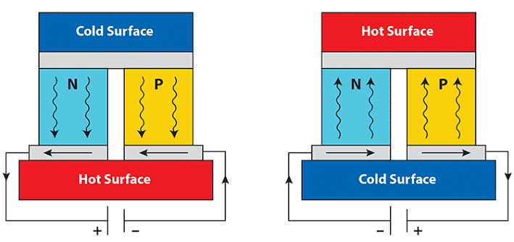

Slide 16
Thank you

