Slide 1
Bipolar junction diode

Slide 2
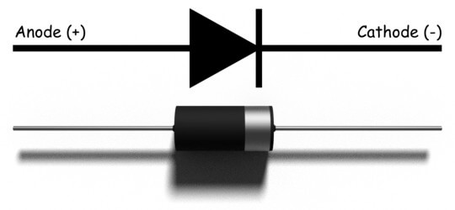
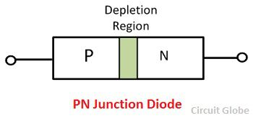
Diode:
Fig(a) Diode
Fig(b) Diode

Slide 3
Diode is an electrical component that allows the flow of current in only one direction.
Simple diodes are made up from two pieces of semiconductor material to form a simple pn-junction.
The current flow in the forward biased condition. That means the anode is connected to the p side and the cathode is connected to the n side.
Diodes can be used as rectifiers, signal limiters, voltage regulators, switches, signal mixers, and oscillators.

Slide 4
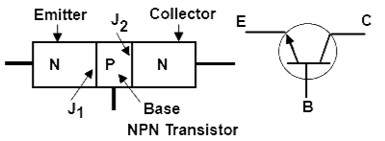
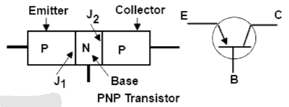
Bipolar junction diode:
Fig(c) Bipolar junction diode Fig(d) Bipolar junction diode

Slide 5
Bipolar junction diode is also know as bipolar junction transistor because transistor have three terminals.
The BJT consist of three semiconductors that are made by joining of two diodes in series that is produces a three layer, two juntions and three terminal device.
There are two basic types of bipolar transistor construction, NPN and PNP, which basically describes the physical arrangement of the P-type and N-type semiconductor materials from which they are made.
In fig(c) the emitter region is n-type, the base region is p-type and the collector region is n-type. Such a transistor is called an npn transistor.
Emitter is highly doped and it's function is to suppy the electrons, base is lightly doped and collector is moderate doped and it's function is to collect the electrons.
There are two junctions emitter-base junction(EBJ) and collector-base junction(CBJ). They are depending on the bias condition (forward and reverse) of each of these junction, different mode of operation of the BJT are obtained.
The BJT can be operating four regions:
Active region
Cut off region
Saturation region
Reverse active region

Slide 6
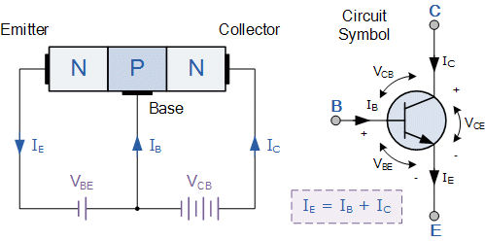
BJT circuit and symbol (NPN) :
Fig(e) BJT circuit and symbol (NPN)

Slide 7
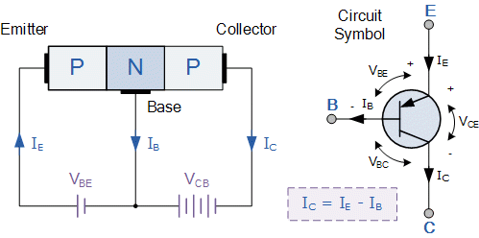
BJT circuit and symbol (PNP) :
Fig(f) BJT circuit and symbol (PNP)

Slide 8
For normal operation of a transistor, it's emitter-base junction is alway forward biased and collector-biase junction is reverse biased. In case of NPN transistor both collector and base are positive but the collector is kept more positive than the base. Because of forward-biasing, the potential barrier at the EB junction is low and it has smaller resistance. The CB junction is reverse-biased, therefore the potential barrier of this junction is high and it has much larger resistance. Electrons in N-type emitter cross into the base,in base few entering electrons may be neutralized by the hole there. But the base is narrow, majority of the electrons will diffuse across the base-collector junction. If based region is narrow than the collector current Ic is very nearly as large as the emitter current Ie. It means that transister transfer current from low-resistant to high resistance with almost no loss. That's why transistor obtained from two words transfer and resistor .

Slide 9
BJT Modes:
Saturation:
The transistor acts like a short circuit. Current freely flows from collector to emitter.
Cut-off:
The transistor acts like an open circuit. No current flows from collector to emitter.
Active:
The current from collector to emitter is proportional to the current flowing into the base.
Reverse-Active:
Like active mode, the current is proportional to the base current, but it flows in reverse. Current flows from emitter to collector (not, exactly, the purpose transistors were designed for).

Slide 10
Mode EBJ CBJ
Active region
Cut off region
Saturation region
Reverse active region
Forward bias Reverse bias
Reverse bias Reverse bias
Forward bias Forward bias
Reverse bias Forward bias

Slide 11
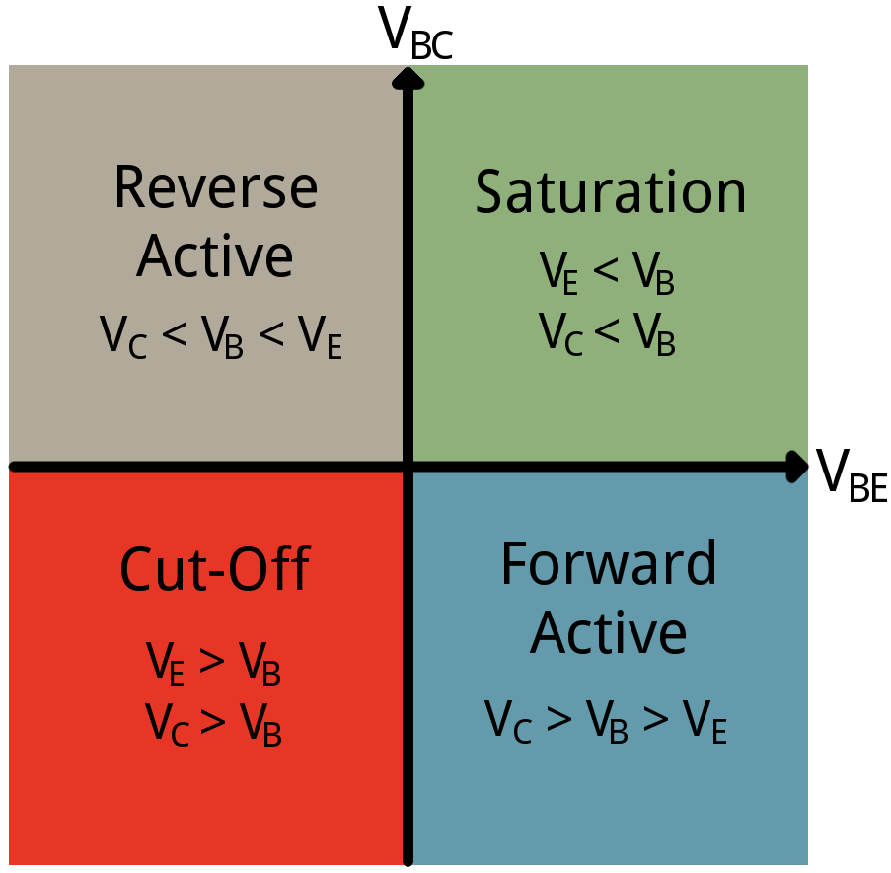
Fig(g) BJT Modes

Slide 12
Applications of BJT:
The applications of the bipolar junction transistor are as follows:
1) These are the transistors that are preferred in the logic circuits.
2) It is used in the circuits of amplification.
3) These are preferred in the oscillation circuits.
4) These are preferred in the multi-vibrator circuits.
5) In the clipping circuits, these are preferred for wave shaping circuits.
6) It used in the circuits of the timer and the circuits of the time delay.
7) These are used in the circuits of switching.
8) Used in the circuits of detector or as demodulation.

