Slide 1
BRIDGE RECTIFIER

Slide 2
WHAT IS BRIDGE RECTIFIER?
A BRIDGE RECTIFIER IS AN ALTERNATING CURRENT (AC) TO DIRECT CURRENT (DC) CONVERTER.
BRIDGE RECTIFIERS ARE WIDELY USED IN POWER SUPPLIES.
IT CAN B E CONSTRUCTED WITH FOUR OR MORE DIODES.

Slide 3
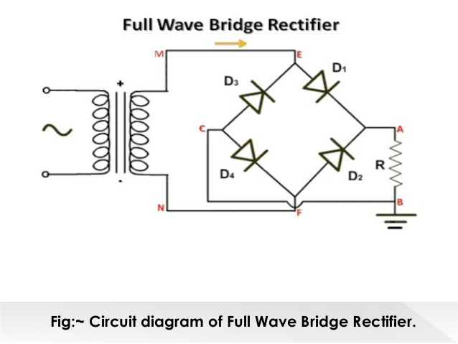
CONSTRUCTION: CIRCUIT DIAGRAM OF FULL WAVE BRIDGE TYPE RECTIFIER .IT CONSIST OF A STEP DOWN TRANSFORMER, FOUR DIODES D1,D2,D3AND D4 AND A LOAD RESISTANCE CONNECTED AS SHOWN IN FIGURE.

Slide 4
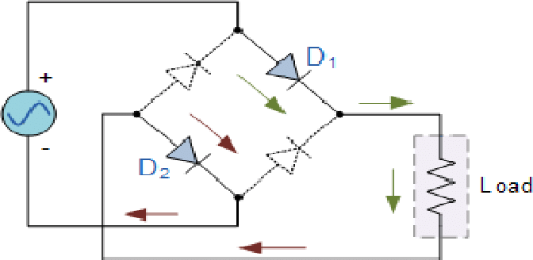
THE A.C VOLTAGE IS FIRST APPLIED TO THE PRIMARY OF TRANSFORMER WHICH IS STEP DOWN WITH THE HELP OF STEP DOWN TRANSFORMER AND APPLIED TO SECONDARY OF STEP DOWN TRANSFORMER. DURING POSITIVE HAIF CYCLE OF APPLIED VOLTAGE:

Slide 5
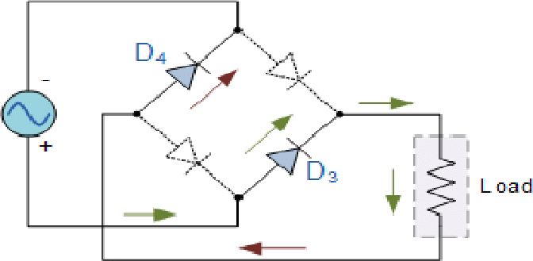
POINT A BECOMES AT POSITIVE(+) AND POINT B WILL BE(-).SO DIODE D1 AND D3 BECOMES FORWAED BIAS AND BEHAVES LIKE A CLOSED SWITCH .WHEREAS DIODE D2 AND D4 BECOMES IN REVERSE BIAS AND BEHAVES LIKE AN OPEN SWITCH.SO CURRENT WILL START TO FLOW FROM POINT A THROUGH DIODE D1 TO THE POINT THROUGH LOAD RESISTANCE RL TO THE POINT B THROUGH DIODE D3 AND FINALLY REACHES TO POINT B. DURING NEGATIVE HAIF CYCLE:

Slide 6
DURING NEGATIVE HAIF CYCLE POINT A WILL BE NEGATIVE(-) AND POINT WILL(+).SO DIODE D1 AND D3 COMES IN REVERSE BIAS AND BEHAVES LIKE AN OPEN SWITCH. WHEREASE DIODE D2 AND D4 COMES IN FORWARD BIAS AND BEHAVES LIKE A CLOSED SWITCH.
SO DURING NEGATIVE HAIF CYCLE THE CURRENT WILL START TO FLOW FROM POINT B.
THEN THROUG RESISTANCE H DIODE D2 TO POINT THROUGH LOAD RESISTANCE RL TO POINT SMALL DIODE D4 AND FINALLY REACHES TO POINT A.

Slide 7
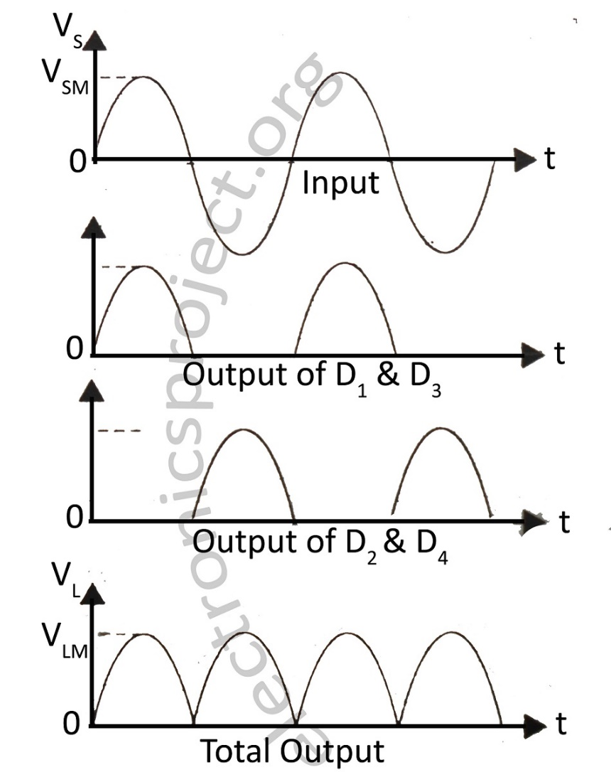
SO WE SAW THAT FOR POSITIVE HAIF CYCLE AS WELL AS NEGATIVE HAIF CYCLE THE DIRECTION OF CURRENT THROUGH THE LOAD IS SAME FROM POINT A TO POINT B.SO THE VOLATAGE WHICH WILL DEVELOP ACROSS THE LOAD WILL BE D.C. IN THIS WAY THE FULL WAVE RECTIFIER CONVERT BOTH CYCLE OF AN A.C VOLTAGE INTO D.C.

