Slide 1
Unit 2 : Phylum Porifera
Topic: Distinguish Features of Phylum Porifera
B.Ed (Hons) Secondary
Semester IV
Subject: Biology IV (Minor)
Course Title: Invertebrates Diversity
Represented By: Ms Sidra Younis
Department of Education(Planning and Development)
Lahore College for Women University, Lahore

Slide 2
Introduction
Sponge, any of the primitive multicellular aquatic animals that constitute the phylum Porifera. They number approximately 5,000 described species and inhabit all seas, where they occur attached to surfaces from the intertidal zone to depths of 8,500 metres (29,000 feet) or more. The members of one family, the Spongillidae, are found in fresh water; however, 98 percent of all sponge species are marine. Adult sponges lack a definite nervous system and musculature and do not show conspicuous movements of body parts.

Slide 3
Cont….
Robert Grant who coined the term Porifera which in Latin means pore bearing.
Animals (L. Porus=pore; ferre=to bear). It is believed that sponges might have evolved.
From the colonial choanoflagellate protozoans sponges represent an evolutionary blind offshoot.

Slide 4
Cont…
of
A phylum of primitive invertebrate animals comprising the sponges and having a cellular grade of construction without true tissue or organ formation but with the body permeated by canals and chambers through which a current of water flows and passes in its course through one or more cavities lined with choanocytes.

Slide 5
Habitat
Almost every species of Porifera lives in a marine climate, although some are learning to adapt to freshwater. Roughly 150 species of sponge are freshwater animals, 150 of the recorded 5,000 or more.
Sponges are found in almost every ocean in the biosphere. Because there are so many species living in many different biomes their preference for habitat differs greatly, for example living in depths ranging from 8,500 feet (some even found at 25,000 ft) to the intertidal zone (below sea level at high tide and above at low). As long as there is a suitable surface to attach itself to and substantial amounts of detritus, sponges will survive in almost any depth.

Slide 6
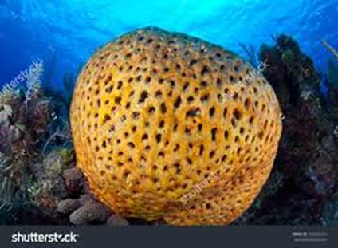
Pores
The name porifera means 'pore bearer' in Latin (a pore is a tiny hole). A sponge's body is covered by a skin, one cell thick. This skin has lots of small pores and a few large openings. In Sponges Collar cells pump water through the entire sponge and filter out food for the sponge cells to eat.

Slide 7
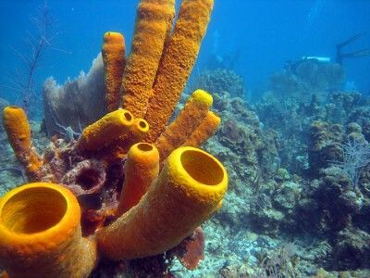
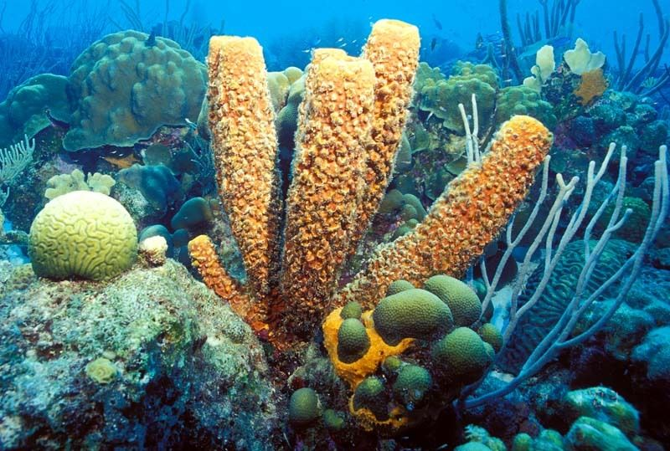
Size
Most sponges are only a few centimetres in size, but some urn-shaped or shapeless ones are less than a centimetre (0.4 inch); others, shaped like vases, tubes, or branches, may be one to two metres (3.3–6.6 feet) tall, and broad rounded masses may be one to two metres in diameter. Size within a species may vary with age, environmental conditions, and food supply.

Slide 8
Symmetry
Only sponges (Phylum Porifera) have asymmetrical body plans.
Some animals start life with one type of body symmetry, but develop a different type as adults; for example, sea stars are classified as bilaterally symmetrical even though their adult forms are radially symmetrical.

Slide 9
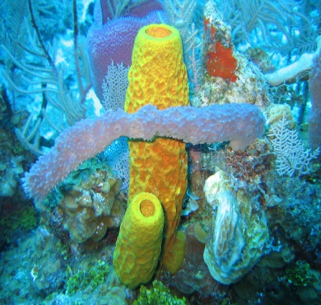
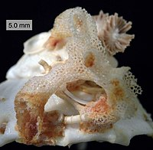
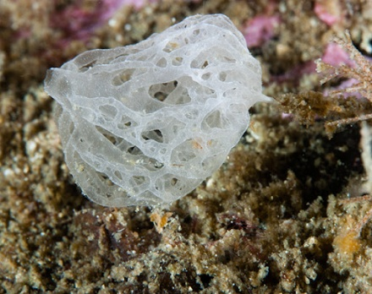
Classes of Phylum Porifera
The phylum Porifera, which means "pore bearing," consists of three classes of sponges, which together contain more than 5,000 species.
Class Demospongiae
Class Hexactinellida
Class Calcarea

Slide 10
Cont…
Class Desmospongiae
They are found in marine or freshwater.
The body is asymmetrical and cylindrical in shape.
The canal system is a leuconoid type.
Examples: Cliona, Spongia, Spongilla, Chalina
Class Hexactinellida
They are found in marine and the deep sea.
The body is cylindrical in shape and exhibit radial symmetry.
The canal system is Sycon or Leucon.
Examples: Euplectella, Hyalonema
Class Calcarea
They are found in marine, shallow, and coastal water.
The body is cylindrical and exhibits radial symmetry.
Examples: Clathrina, Leucosolenia, Scypha

Slide 11
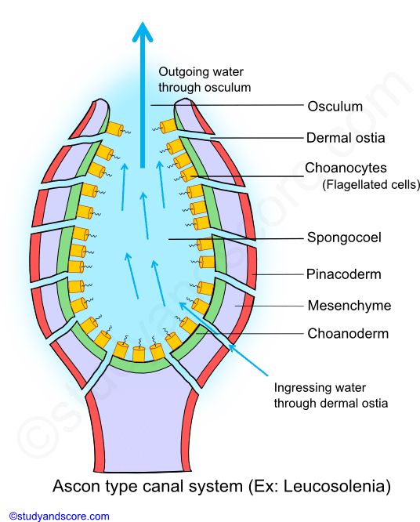
Canal System
The water circulatory system of sponges also called as canal system is the characteristic feature of the phylum Porifera. Canal system is also known as aquiferous system. The canal system of sponges helps in food acquisition, respiratory gas exchange and also in excretion. See in below diagram……

Slide 12
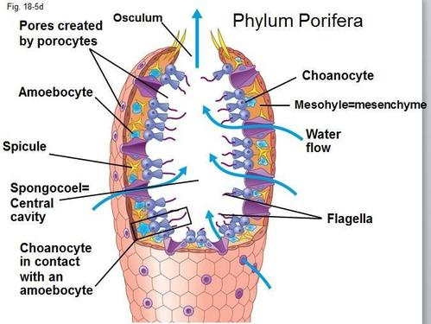
Body Wall
Choanocytes are versatile cells. These distinctive cells line the interior body walls of sponges. Their flagella beat to create the active pumping of water through the sponge, while the collars of the choanocytes are the primary areas that nutrients are absorbed into the sponge.
Clearly seen in Diagram…..

Slide 13
Functions of the Water Current
Water current plays the most vital role in the physiology of the sponges.
All exchanges between sponge body and external medium are maintained by means of this current.
Food and oxygen are brought into body through this water current
Also the excreta are taken out of the body with the help of this water current.
The reproductive bodies are carried out and into the body of the sponges by the water current.

Slide 14
Types of Canal System
Different sponges have different arrangement and grades of complexity of internal channels and accordingly the canal system is been divided into the following three types:
Ascon type of canal system
Sycon type of canal system
Leucon type of canal system

Slide 15
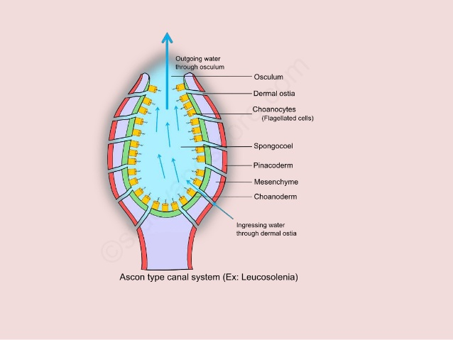
Ascon Type of Canal System
The body surface of the asconoid type of sponges is pierced by a large number of minute openings called as incurrent pores or ostia. These pores are intracellular spaces within the tube like cells called porocytes. These pores extend radially into mesenchyme and open directly into the spongocoel. The surrounding sea water enters the canal system through the ostia. The flow of the water is maintained by the beating of the flagella of the collar cells.

Slide 16
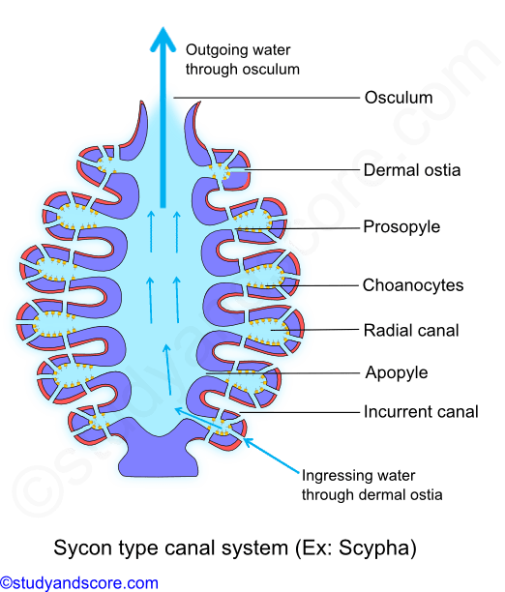
Sycon Type of Canal System
Sycon type of canal system is more complex compared to the ascon type. This type of canal system is the characteristic of syconoid sponges like Scypha. Theoretically this canal system can be derived from asconoid type by horizontal folding of its walls.
In sycon type of canal system, spongocoel is a narrow, non-flagellated cavity lined by pinacocytes. It opens to the exterior though an excurrent opening called osculum which is similar to that of the ascon type of canal system.

Slide 17
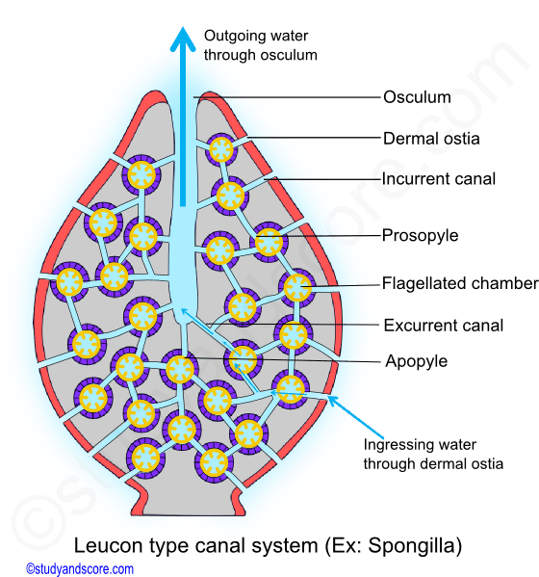
Leucon Type of Canal System
This type of canal system results due to further folding of body wall of the sycon type of canal system.
This canal system is the characteristic of the leuconoid type of sponges like Spongilla. In this type the radial symmetry is lost due to the complexity of the canal system and this result in an irregular symmetry.

Slide 18
Locomotion
Adult sponges are sessile which means they are fixed to a hard surface like a rock on do not move at all. some marine and freshwater sponges can move across the sea bed but only millimeters a day.
Sponges are generally sessile as adults and spend their lives attached to a fixed substratum. They do not show movement over large distances as do free-swimming marine invertebrates.

Slide 19
Nutrition
Sponges depend upon the food coming to them along with water current
Brought about by movement of flagella of choanocytes.
Food includes small animals, zooplankton, plants and phytoplankton.
Which constitute about 20% of their food.
The food enters the spongocoel cavity through ostia.
The flagellated cells, choanocytes, ingest the food.

Slide 20
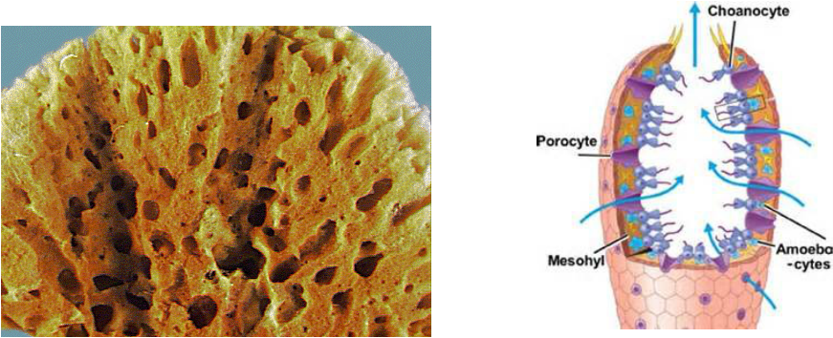
Respiratory System
Sponges have no distinct respiratory system because they are so primitive, but they do require oxygen to survive like any other organism. The small pores (also known as ostia) in the sponge allow the sponge to absorb oxygenated water to receive the oxygen it needs.

Slide 21
Circulatory System :
Sponges - or poriferans - do not have a true circulatory system as most animals do. There is no heart, there are no veins or arteries, and sponges do not have blood. However, they accomplish gas exchange and nutrient consumption through the movement of water.
EXCRETION :
The waste products either diffuse out of the sponge directly through the body wall .
Flow out through osculum.

Slide 22
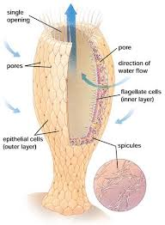
Nervous System :
Sponges are the only multicellular animals without a nervous system. They do not have any nerve cells or sensory cells. But if the sponge is touched or pressure to the outside of a sponge, it will cause a contraction of its body.

Slide 23
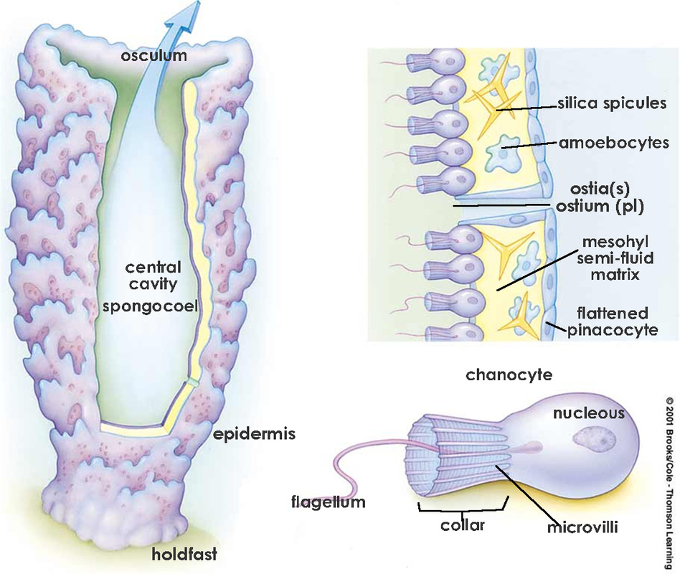
Digestive System
Sponges are sessile so they cannot catch their food. Their bodies are covered with pores and canals that allows water to pass through. The water moves in and out by the beating of flagella on the collar cells. the collar cells capture food like bacteria, algae, and protozoans brought in by the movement of the collar cells. The food is then taken in and processed.

Slide 24
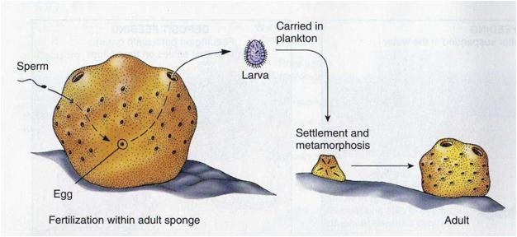
Reproduction
Sponges reproduce sexually and asexually. Sponges are hermaphrodites, meaning they are male and female. Sponges make sperm that flows through the water around them and is then absorbed into another sponge through its ostia. The sperm travels to the egg of another sponge. Fertilization occurs and, after a period of development, larvae are released into the surrounding water.

Slide 25
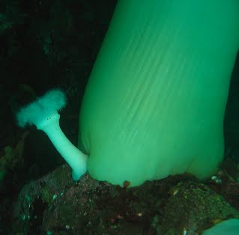
Cont...
Sponges also reproduce asexually by budding. The way budding works, is if a piece of the sponge is cut off or falls off, that piece will grow into a whole new sponge.

Slide 26
Other Facts……
They have the ability to regrow body parts if they are cut of accidently.
A new type of sponge are found yearly.
Sponges are one of the simplest animals on Earth
There are more then 5000 species of sponges
There are only 200 species are known as fresh water sponges.

