Slide 1
Unit 2 : Phylum Porifera Topic: General Characteristics of Phylum Porifera B.Ed (Hons) Secondary Semester IV Subject: Biology IV (Minor) Course Title: Invertebrates Diversity Represented By: Ms Sidra Younis Department of Education(Planning and Development) Lahore College for Women University, Lahore

Slide 2
Learning Outcomes
After this chapter students become enable to,
Explain the general characteristics of phylum porifera.
Understand the classification of phylum.
Identify the members of phylum on the basis of their characteristics and life form processes
Explain the distinguish features of phylum.

Slide 3
General Characteristics
Kingdom: Animalia.
Habitat: Aquatic, mostly marine, few are terrestrial.
Habit: They are solitary or colonial.
Grade of organization: Cellular grade of body.
Shape: Body shape is variable, mostly cylinder shaped.
Symmetry: Asymmetrical or radially symmetrical.

Slide 4
Cont…
Germ layer: Diploblastic animals.
Coelom: Absent, acoelomate but spongocoel is present
Surface of the body has numerous perforation called ostia (for the entry of water) and a large pore at the apex called osculum (for the exit of water).
Water canal system is present.
Endoskeleton: Either calcareous spicules (calcium carbonate) or siliceous spicules .

Slide 5
Cont…
Nutrition: Holozoic
Digestion: Intracellular
Nervous system: Absent
Circulatory system: Absent
Reproduction: Asexual: by budding or gemmule or regeneration; Sexual: gamatic fusion
Fertilization: Internal.

Slide 6
Cont…..
They are distributed between Arctic to Temperate regions.
Sponges are sessile and mostly marine. Some live in fresh water
They are solitary or colonial in nature found attached to stones or molluscan shells or wooden pieces in the waters.
Their body is vase-like, tubular, cushion-like or cylindrical in shape.
It has a vase-shaped cylindrical body measuring about 20-30 mm in length.

Slide 7
Cont…
Each cylinder opens to the exterior by an osculum.
Body surface contains numerous pores called ostia or incurrent pores.
Osculum is encircled by a fringe of monoaxon spicules.
Various colors like bright red, yellow, orange, pink or violet or even white and black.
Some sponges have symbiont algae and thus appear green in color.
Majority of sponges are asymmetrical and some are radially symmetrical

Slide 8
Cellular Grade of Organization
Porifera exhibit cellular grade of organization. They exhibit functional division of labour. There is no relation between two cells. No organs are present in sponges.
Body wall consists of two epitheloid layers (epitheloid resembles epithelium but lacks basal lamina and cell junctions): an outer pinacoderm and an inner choanoderm.
Pinacoderm covers the outer surface of the body and also lines some of the internal cavities of aquiferous system. Flattened cells of pinacoderm are called as pinacocytes. Pinacoderm also has porocytes each of which encloses an ostium. Porocytes extend up to spongocoel.

Slide 9
Cont:
Choanoderm is composed of choanocytes. They have a collar of microvilli around the flagellum. Water is pulled through the ostia by the beating of the choanocytic flagella.
Between the pinacoderm and choanoderm is a gelatinous mesohyl. Mesohyl has various types of amoebocytes like,
Sclerocytes which produce spicules
Spongocytes which produce spongin fibres.
Myocytes are the contractile cells found around osculum.
Archaeocytes are totipotent cells capable of giving rise to any other cell type.

Slide 10
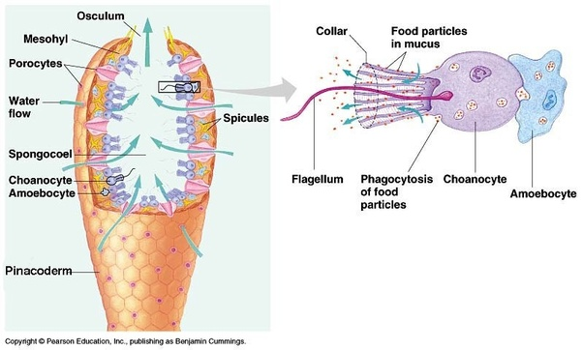

Slide 11
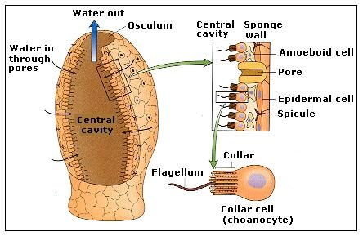
Central Cavity
The central cavity is called as spongocoel or atrium. It opens outside through an osculum.
The water circulatory system of sponges is called as canal system or aquiferous system. It helps in food acquisition, respiratory gas exchange and excretion.

Slide 12
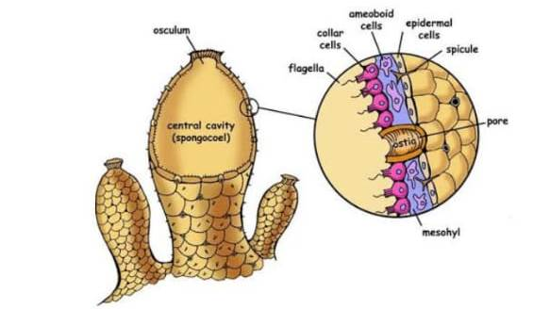
Cont..
ln an ascoid sponges, water enters the spongocoel through ostia and exits through osculum.
Aquiferous system and high totipotent nature of the cells.

Slide 13
Suspension Feeders or Filter Feeders:
An aquatic animal which feeds on particles suspended in water.
Digestion is intracellular.
Chanocytes engulf food particles in water, partly digests and passes to archeocyte for final digestion.

Slide 14
Excretory Wastes
Excretory wastes includes ammonia.
Respiratory gas exchange occurs by diffusion(movement or passive transport of molecules or ions via semi permeable membrane).
Contains contractile vacoule for osmoregulation (Maintenance of fluid pressure in an organism by control of water and salt).

Slide 15
Nerve Cells
Nerve cells (in CNS) and sensory cells (stimulus receptor) are absent.
Sponges are capable of responding to environmental stimuli by closure of osculum.
Osculum are the pores through which the water leaves the body.

Slide 16
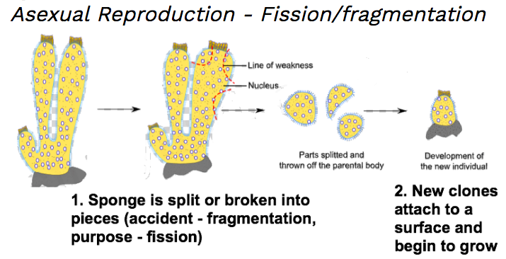
Mode of Reproduction
Asexual reproduction occurs by fission / fragmentation:
A process of reproduction in which an organism splits into fragments, then each fragment is developed and fully matured individuals identical to their parents. As seen in below diagram,

Slide 17
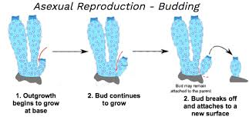
Budding
Sponges are also able to reproduce asexually through budding. This is when a small piece of sponge is broken off but is still able to survive and grow into another sponge (as in below diagram). Sponges are also able to repair damages to their bodies.

Slide 18
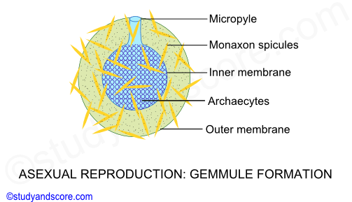
Formation of Gemmules
Gemmules are internal buds found in sponges and are involved in asexual reproduction. It is an asexually reproduced mass of cells, that is capable of developing into a new organism.

Slide 19
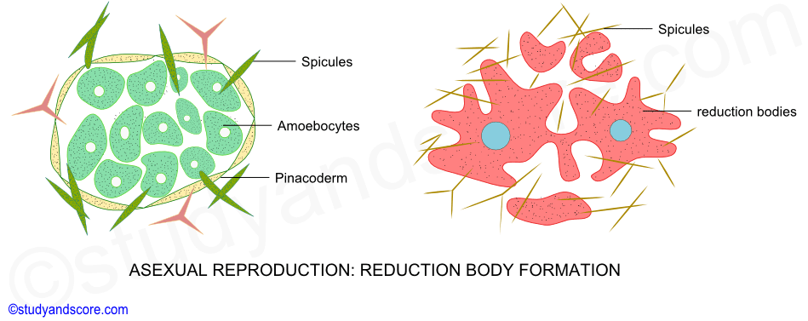
Reduction Bodies
It is very unusual method of asexual reproduction found in sponges. Some fresh water and marine sponges get disintegrated during adverse conditions. During unfavourable conditions, the sponge collapse leaving small rounded balls called as reduction bodies.

Slide 20
Protandry or Protogny
Most sponges are hermaphrodite (both Male and female sexes are present in a single sponge).
Exhibits protandry or protogyny
Protandry is the development of male organs or maturation, production of sperms first and ova later.
Protogyny means production of ova first and sperms later.
Spermatozoa (sperms) arises from choanocytes (collard flagellated cells).
Eggs arise from archaeocytes (a process of reproduction giving rise to sex cells).

Slide 21
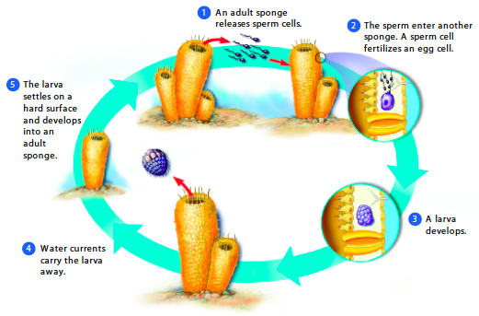
Sexual Reproduction
In sexual reproduction male' sponge would release sperm into the water, which would travel and then enter a 'female' sponge. After fertilization in the sponge, a larva is released into the water.
It floats around for a few days and then sticks to a solid to begin its growth into an adult sponge (Image below is showing the process of sexual reproduction in sponges).

Slide 22
Fertilization:
May be cross or internal
In internal fertilization, there is union of egg cell with a sperm during reproduction in female body.
In cross fertilization, the gametes are produced by separate individuals, it includes fertilization of an ovum from one individual with the spermatozoa of another.
In case of sponges spermatozoa are taken into the aquiferous system of neighbouring individuals. Choanocytes transfer them to eggs in mesophyl.

