Slide 1
Unit 1: Invertebrates Introduction and Phylum Protozoa Topic: Phylum Protozoa Example: Paramecium B.Ed (Hons) Secondary Semester IV Subject: Biology IV (Minor) Course Title: Invertebrates Diversity Represented By: Ms Sidra Younis Department of Education(Planning and Development) Lahore College for Women University, Lahore

Slide 2
Paramecium:
Paramecium Is a unicellular organism.
With the shape resembling to the sole of shoe.
Ranges from 50 to 300um in size.
Varies from species to species.
It is mostly found in a freshwater environment.
It is a single-celled eukaryote.
Well-known genus of ciliate protozoa.
It belongs to the phylum Ciliophora.
Its whole body is covered with small hair-like filaments called the cilia which helps in locomotion.
They have also a deep oral groove containing not so clear oral cilia.
These cilia helps in capturing the food.

Slide 3
Classification of Paramecium:
Paramecium can be classified into the following phylum and sub-phylum based on their certain characteristics.
Phylum | Protozoa
Sub-Phylum | Ciliophora
Class | Ciliates
Order | Hymenostomatida
Genus | Paramecium
Species | Caudatum

Slide 4
Cont....
Being a well-known ciliate protozoan, paramecium exhibits a high-level cellular differentiation
Paramecium containing several complex organelles performing a specific function to make its survival possible.
Besides a highly specialized structure, it also has a complex reproductive activity.
Out of the 10 total species of Paramecium, the most common two are P.aurelia and P.caudatum.

Slide 5
Structure and Functions:
Structure and Functions of Paramecium include:
Shape and Size
Nucleus
Vacuoles
Pellicle
Cilia

Slide 6
Shape and Size:
Size Ranges from 170 to 290 um or upto 300 to 350 um.
Visible to the nacked eye.
Peramicium has elongated slipper like shape.
Posterior end of the body is pointed and anterior part is broad and blunt.
The body of Peramicium is asymmetrical.
It has well defined central or oral surface.
It has convex aboral or dorsal body surface.

Slide 7
Pellicle:
Pellicle is flexible ,thin and firm membrane.
These pelicles are elastic in nature.
It is made up of gelatinous substance.
These pellicles support the cell membrane.

Slide 8
Cilia:
Small hair like projection that covers the whole body.
Arranged in longitudinal rows with a uniform length (holotrichous).
Few longer cilia present at the posterior forming a caudal tuft (caudatum).
Structure of cilia is same as flagella.

Slide 9
Cont...
Outer fibriles are thicker than the inner ones.
Cilium arising from a basal granules.
Cilia have a diameter of 0.2 um and helps in locomotion.
Fibrils are present in the form of rings.
Some cilia are distributed on the surface of body.

Slide 10
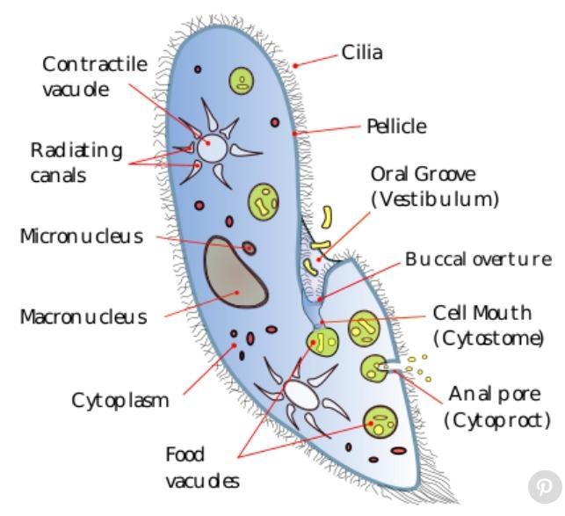
Cytosome:
A cytoplasm within a cell, the cell outside within the nucleus.
A type or cellular organelle which is enclosed by a membrane.
Cytosome contain different parts. Such as:
Oral groove
Cytopyge, etc.

Slide 11
Parts of cytosome:
Oral Groove:
Cytopyge:
Cytoplasm:
Large oblique shallow depression on the ventro-lateral side of the body.
It give an asymmetrical appearance.
It extend further into a depression called vestibule.
The vestibule extend into the cytosome through the opening.
Than esophagus leads to the food.
Lying on the central surface,just behind the cytosome.
Cytosome is the cytopyge also called cytoproct.
All the undigested food is eliminated through the cytopyge.
It is a jelly like substance further differentiated into cytoplasm.
Ectoplasm is a narrow peripheral layer.
It is a dense and clean layer with an inner mass of:
Endoplasm or semi fluid plasma sol.
Endoplasm is granular in shape.

Slide 12
Cont...
Ectoplasm:
Endoplasm:
Trichocysts:
It is a Clean , dense ,and clear outer layer.
Ectoplasm contain cilia, trichocytes,and fibril structures.
Ectoplasm is further bounded to pellicle.
Formed by a jelly like Substance called cytoplasm.
It is one of the most detailed part of cytoplasm.
It contain several differentiated granules.
It contains different structures and inclusions like:
Vacuoles
Mitochondria
Nuclei
Food vacule
Contractile vacules.
These are small spindle like bodies embedded in the cytoplasm.
They are filled with the dense refractive fluid containing swelled substances.
This is a conical head at the spike at the outer end.
Trichocysts are perpendicular to the ectoplasm.

Slide 13
Nucleus:
The nucleus further consist of macro nucleus and micro nucleus.
Macro Nucleus:
Kidney like or ellipsoidal in shape.
It’s densely packed writhing the DNA.
Control all the vegetative functions hence,called vegitative nucleus.

Slide 14
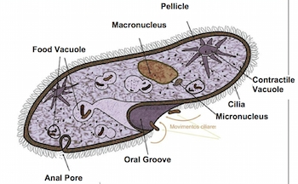
Continue..
Micro Nucleus:
Found close to the macro nucleus.
It is a small and compact structure , spherical in shape.
Fine chromatin threads and granules are uniformly distributed.
Control reproduction of the cell.
There is no nucleolus present in the paramecium.

Slide 15
Vacuoles:
Vacuoles are membrane bounded sacs within the cytoplasm of the cell.
Paramecium consist of two types of vacuoles.
These vacuoles are contractile and non-conractile.
These vacuoles are:
Contractile vacuole
Food vacuole
These vacuoles are present at dorsal side of the Paramecium.

Slide 16
Types of vacuoles:
Contractile Vacuoles:
Food Vacuoles:
There are two contractile vacuoles in Peramicium.
They are filled with fluid and present at fixed position.
They disappear periodically and hence called temporary organs.
Each vacuole is connected to last five to twelve radical canals.
Food vacuole is non-conractile.
It is rough spherical in shape.
In the endoplasm the size of food vacuoles varies And digest food particles.
These food vacuoles are associated with the digestive granules that aid in food digestion.

Slide 17
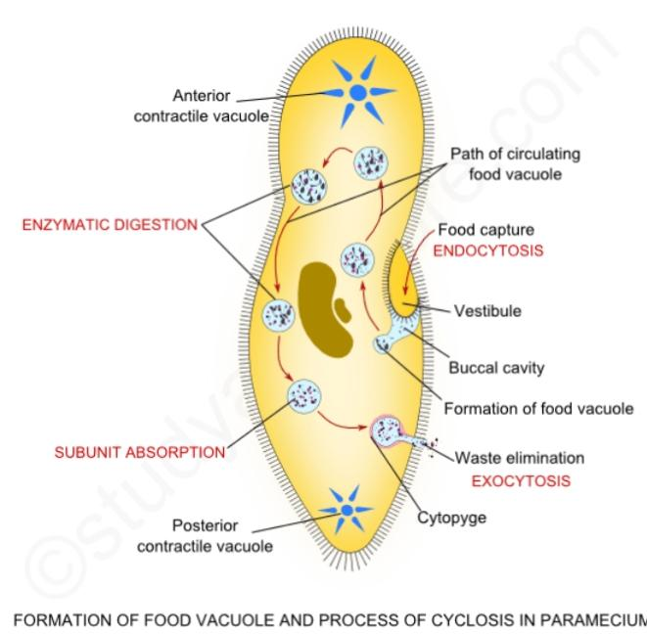
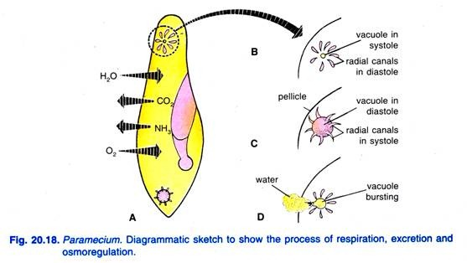

Slide 18
Characteristics Of Paramecium
Characteristics of Paramecium include its:
Habit and Habitat
Movement and Feeding
Symbiosis
Reproduction

Slide 19
Habit and Habitat:
Paramecium has a world wide distribution.
Free-living organism.
It usually lives in the stagnant water of pools, lakes, ponds, fresh water and slow flowing water.
Slow flowing water is rich in decaying organic matter.

Slide 20
Movement and Feeding:
Its outer body is covered by the tiny hair-like structures called cilia.
Cilia are in constant motion and help it move with a speed that is four times its body’s length per second.
As the organism moves forward, rotating around its own axis, this further helps it to push the food into the gullet.
By reversing the motion of cilia, paramecium can move in the reverse direction as well.
A process known as phagocytosis, the food is pushed into the gullet through cilia which further goes into the food vacuoles.

Slide 21
The food is digested with the help of certain enzymes and hydrochloric acid.
Once the digestion is completed the rest of the food content is quickly emptied into cytoproct also known as the pellicles.
The water absorbed from the surroundings through osmosis is continuously expelled from the body with the help of the contractile vacuoles present on either end of the cell.
Paramecium also feeds on other microorganisms like yeasts and bacteria.
The food it makes use of its cilia, making quick movements with cilia to draw the water along with its prey organisms inside the mouth opening through its oral groove.
The food further passes into the gullet through the mouth.
Once there is enough food accumulated a vacuole is formed inside the cytoplasm, circulating through the cell with enzymes entering the vacuoles.
The vacuole reaches the anal pore with all of its digested nutrients it ruptures and expels all of its waste material into the environment.

Slide 22
Symbiosis:
It refers to the mutual relationship between two organisms to benefit each other
P.bursaria Form a symbiotic relationship with green algae.
They take food and nutrients from green algae.
Also provide protection from certain predators.

Slide 23
Reproduction:
Paramecium also consist of one or more diploid micronuclei and a plywood macro nucleus.
It contain a dual nuclear apparatus.
Micronucleus:
The function of micronucleus is to maintain the genetic stability.
It also called Germaine or generative nucleus.
Paramecium reproduces:
Sexually(autogamy, conjugation)
Asexually (transverse binary fission).
Paramecium reproduce sexually when conditions are favourable.
While, asexual reproduction take place spontaneously.

Slide 24
Asexual Reproduction in Paramecium:

Slide 25
Sexual Reproduction in Paramecium:

