Slide 1
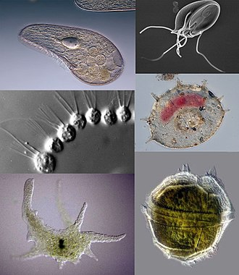
Unit 1: Invertebrates Introduction and Phylum Protozoa Topic: Phylum Protozoa Introduction and General Characteristics B.Ed (Hons) Secondary Semester IV Subject: Biology IV (Minor) Course Title: Invertebrates Diversity Represented By: Ms Sidra Younis Department of Education(Planning and Development) Lahore College for Women University,Lahore

Slide 2
Learning Outcomes:
After this chapter students become enable to,
Explain the general characteristics of phylum protozoa.
Understand the classification of phylum.
Identify the members of phylum on the basis of their characteristics and life form processes
Explain the distinguish features of phylum.

Slide 3
History of Protozoans
Protozoa (in Greek Proto = first and zoa = animal’s)
These are usually associated with animals due to mobility and heterotrophy.
An organism belonging to this group may be known as protozoans or protozoans.
Protozoans are vitally important ecologically as key links in food chains.
Protozoa occupy a range of trophic levels.

Slide 4
Protists were a dominant form of life on Earth 1.5 billion years ago. While protozoans evolved early and have survived to the present day as unicellular organisms, they have undoubtedly undergone considerable evolutionary change.
That many species must have become extinct as others appeared can be deduced from the limited fossil record of protozoans. The most abundant and important fossil protozoans are the foraminiferans.
Towle (1989) reports that over 56,000 species of protozoa have been identified, the great majority (over 60 percent) of which move by pseudopodia, false feet or temporary projections of the cell.
Protozoa also play a vital role in controlling bacteria populations and biomass.
Some protozoa are important as parasites and symbionts of multicellular animals. Among these, several are powerful agents of human disease.
Most protozoa, whether free-living or parasitic, lack a protective outer covering (Towle 1989).

Slide 5
Introduction:
They are microscopic.
Protozoans belong to “kingdom Protista”.
Term protozoa introduced by German Palaeontologist.
Rooted into the old two kingdoms of classification.
This group have 65,000 species known.
They are generally referred as acellular.
Protozoa are currently classified into 6 phyla.
Protozoa animals exhibit protoplasmic grade of organization.
They are non-photosynthetic parasites.
They have structure for propulsion or other type of movement.

Slide 6
Some protozoans produce diseases.
Virtually all humans have protozoa living in or on their Body.
They may be solitary or colonial.
They are without tissues and organs.
Their body having one or more nuclei.
They have variable shapes.
Protozoans have cell membrane which bound the organelles.
The nucleus of protozoans is vesicular.
Protozoans are free-living found in virtual every possible habitat.
Protozoa also have in place locomotory structures such as pseudopodia, flagella and cilia which are used for movement.

Slide 7
Definition
It is a diverse group of unicellular, non-phototropic, eukaryotic organisms With no cell walls. Historically, protozoa were define as single-celled animals or organisms with animal like behaviour, such as motility and predation.

Slide 8
General Characteristics Of Protozoa:
Protozoa also means ‘little animals. Because use many species act like small animals.
The protozoans are minute, generally microscopic and eukaryotic organisms.
They are the simplest and primitive of all the animals
They have simple body organization, i.e. Protoplasmic grade of organization.
They are unicellular organisms without tissues and organs.

Slide 9
Habitat and Habit:
They may be either free-living or parasitic.
Some are commensals in habit.
Protozoans are either solitary or colonial.
The individual are alike or may be independent.
Free-living forms occur in fresh water lakes, ponds, open ocean, river and even in temporary pools.

Slide 10
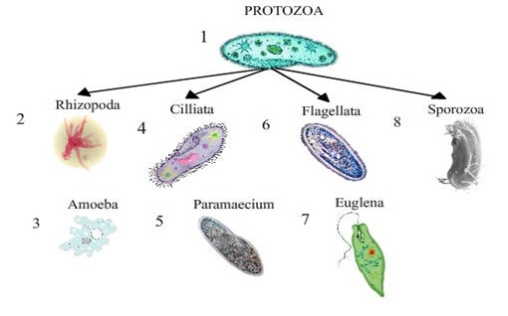
Size and Shape:
protozoa are mainly microscopic.
Siza ranges from 10 to 25 micrometers. They can be as large as 1mm.
Small species may be the size of fungal cells; large species may be visible to the unaided eye.
Largest are the deep-sea dwelling xenophyophores, whose shells can reach 20cm.
Protozoa have no cell wall therefore, have infinite variety of shapes.
Protozoa body consist of mass of protoplasm(acellular or non-cellular).

Slide 11
Locomotion:
Protozoa species move on their own.
They have three types of locomtary organs:
Flagella
Cilia
Pseudopodia
Flagella and cilia are structurally similar, having a “9-plus-2”
Some protozoa are sessile,and do not move at all.

Slide 12
Structure:
Protozoa have single nucleus, but some have both a macronucleous and one or more micro nuclei.
Contractile vacuoles may be present.
Cytoplasm is the extra-nuclear part of the protozoan body.
They do not have cell wall.
Body is bounded by a cell membrane or plasmalemma.
They exhibit all type of symmetry.
Most species occur in single but many are colonial.
Protozoa are pale in colour generally.
Protozoa has no inner or outer skeleton.

Slide 13
Life Process:
Protozoa have no physiological division of labour.
Vital activities of life are performed by single cell.
Nutrition may be holozoic, Holophitic and parasitic.
Euglena
Mode of nutrition is mixotrophic.
Digestion take place inside the food vacuoles.
Respiration occur by diffusion.
They are amonotelic.
Contractile vacule perform osmoregulation.

Slide 14
Nutrition:
In protozoa nutrition is holozoic, holophytic,and parasitic.
Protozoa may take in food by osmotrophy.
They may feed by phagocytosis.
They take in food through the cytosome.
There are two types of protozoans:
Free-living protozoa
Parasitic protozoa
Holozoic Nutrition:
Nutrition like plants
Holophytic:
Nutrition like animals.
Cytosome:
Mouth like aperture.

Slide 15
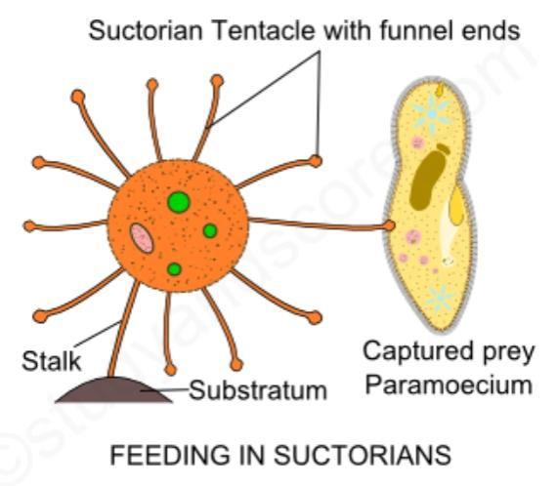
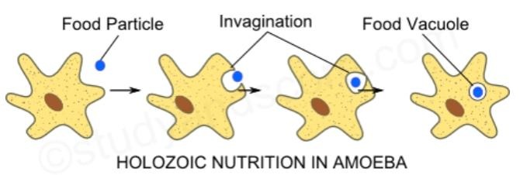
Holozoic nutrition in Protozoa
Saprophitic Nutriotn in protozoa

Slide 16
Digestion:
Digestion in protozoa is intracellular, occur in food vacuoles.
Protozoa takes in food via the water.
Store food into sacs.
Food is also digested through vacuoles.
They eat tiny algae and bacteria.

Slide 17
Reproduction:
There are two modes of nutrition in protozoa’s
Aerobic protozoa:
Species of free-living protozoa are aerobic.
They can’t live without oxygen.
Aerobic protozoa are tiny.
Examples:
Amoeba proteus.
Anaerobic Protozoa:
They can survive in the absence of oxygen.
They may be either parasites or symboints of Multiellular organisms.
Examples:
Giardia
Trichomonads

Slide 18
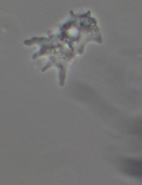
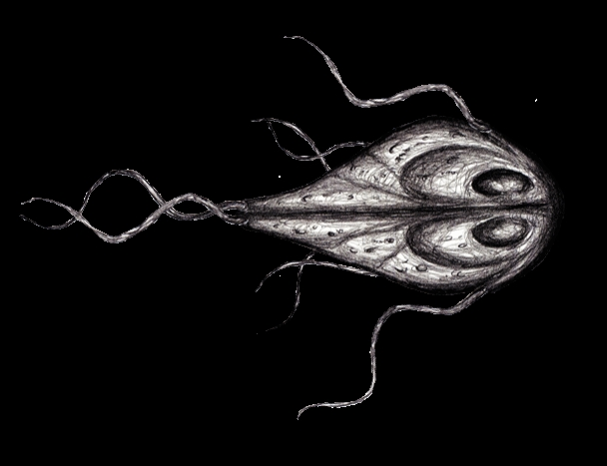
Giardia
Amoeba proteus

Slide 19
Life Cycle:
Protozoa can have very diverse life cycle with multiple morphological stages.
Morphological stages:
Cyst stage
Dormant
Highly resistant to environmental stress.
Tropozoite stage
Active , Reproductive and feeding stage.
Infect only humans.
Encystation:
Cnversation of tropozoite to cyst.
Excystation:
Process of transforming back into a tropozoite.
Parasites may be multiply by:
Asexual division.
Sexual division.
Four main modes of transmission:
Direct
Feacaĺ-oral
Vector-borne
Predator-pray

Slide 20
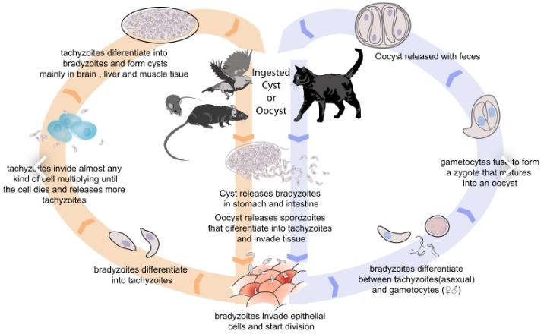

Slide 21
Modes of Transmission used by protozoan:
Direct Transmission of trophozoites:
Transmission through intimate body contact.
Example:
Trichomonas spp.
Feacal-oral Transmission:
Passed in faeces of one host and ingested with food/water by another.
Example:
Entamoeba histolytica
Vector-borne Transmission:
Trophozoites taken up by sucking blood of arthropods and passed to new host when they next feed.
Example:
Trypanosoma brucei
Predator-prey Transmission:
Zioites encrusted within the tissue of prey animal being eaten by a predator.
Example:
Toxoplasma gondii

Slide 22
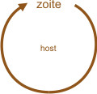
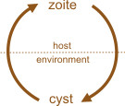
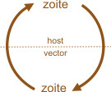
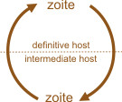
Modes of transmission To move from host-to host:
Direct faecal-oral vector-borne predator-prey

Slide 23
Asexual and sexual Reproduction in protozoans:
Asexual Reproduction is of the following types:
Binary fission
Multiple fission
Binary fission:
Body of the individual is divided into two equal halves.
Multiple fission:
Body divides and the number of the daughter individual is formed.
In protozoa the sexual Reproduction occur by the following processes:
Syngamy or copulation
Conjugation
Syngamy:
In which union of two sex cells called gametes occur.
Conjugation:
Temporary union of two individuals belonging to same species for the purpose of exchange of nuclear material.

Slide 24
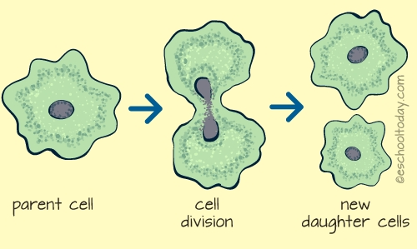
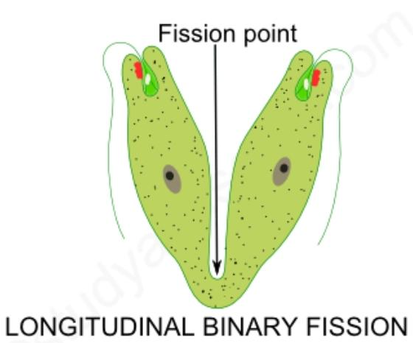
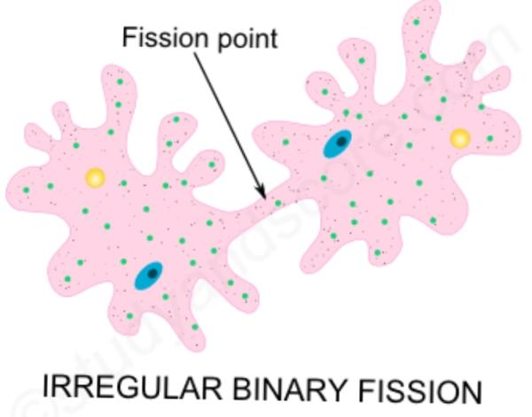
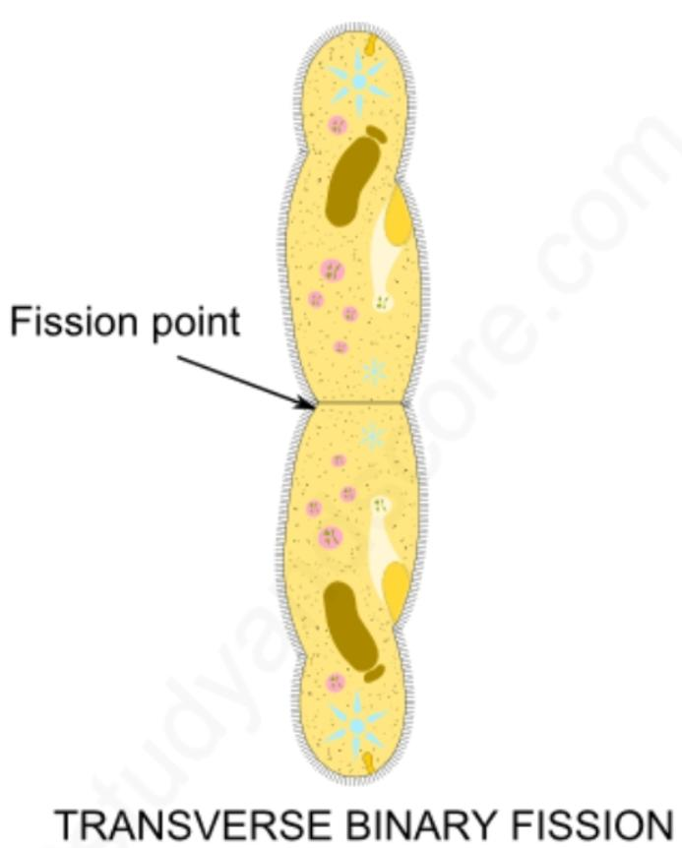
Types of Sexual Reproduction:
Multiple fission

Slide 25
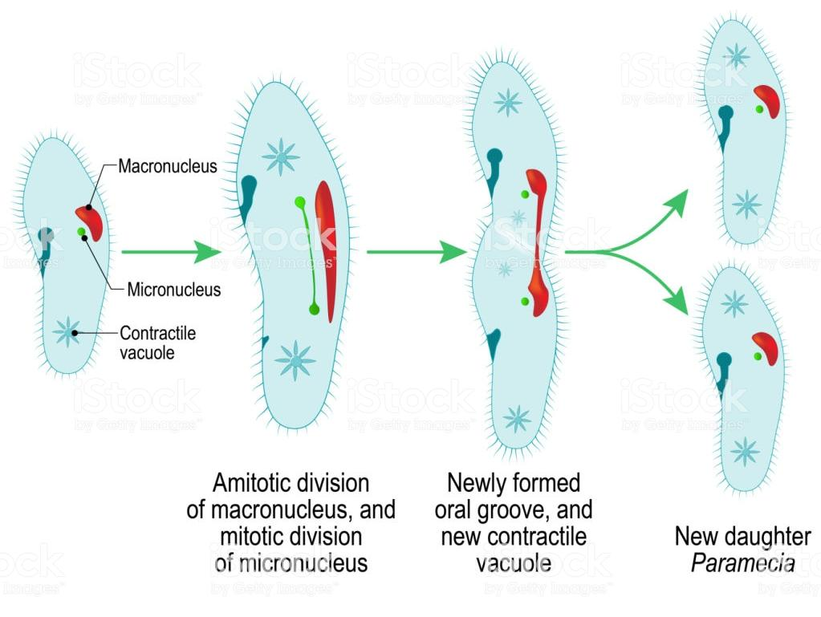
Asexual Reproduction in Protozoa:

