Slide 1
Unit 1: Invertebrates Introduction
Topic: Classification of Invertebrates
B.Ed (Hons) Secondary
Semester IV
Subject: Biology IV (Minor)
Course Title: Invertebrates Diversity
Represented By: Ms Sidra Younis
Department of Education(Planning and Development)
Lahore College for Women University, Lahore

Slide 2
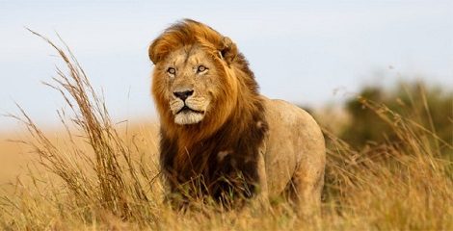
Classifying living things
We put living things into two large groups:
Animals
Plants

Slide 3
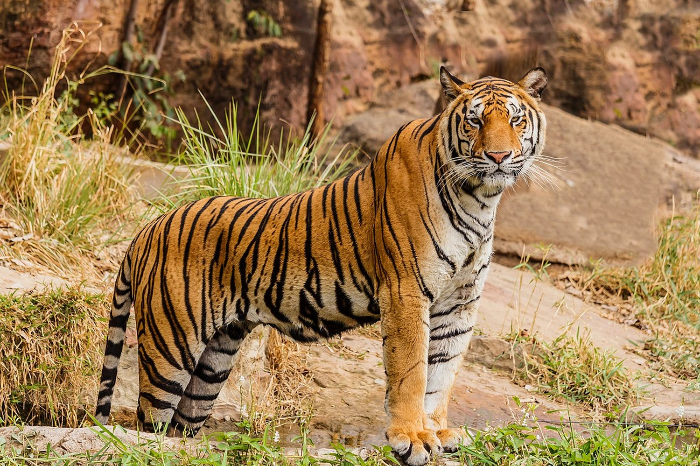
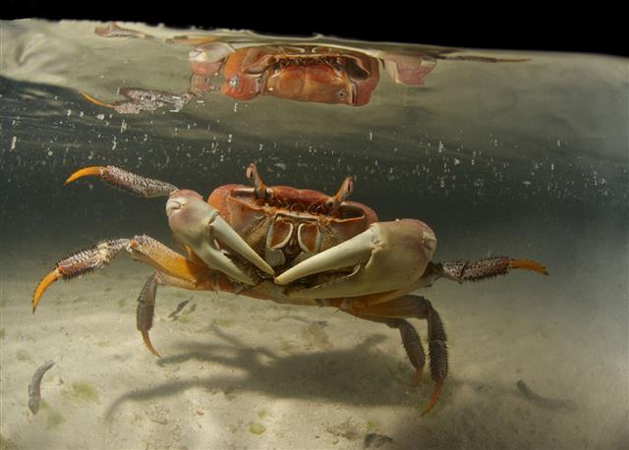
ANIMALS
Vertebrates
Invertebrates

Slide 4
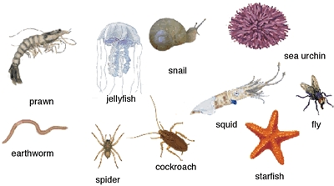
invertebrates
No internal backbone or skeleton

Slide 5
General characteristics of invertebrates
Habitat: All the 30 phyla most probably originated in the sea, but not all have successfully invaded the land or its freshwater habitats. About 80 per cent are found in the terrestrial habitats. No doubt Porifera, Coelenterata are represented in freshwaters but by fewer species than in the seawaters.
Shape: Animals of varied shapes are included in the invertebrates. Amoeba possesses an irregular ever-changing body shape, sponges and coelenterates display plant-like appearance, flatworms are leaf-like or ribbon-shaped and annelids, nematodes are vermiform, while the starfishes are star-shaped, etc

Slide 6
Size: The invertebrate animals exhibit a great variation in size. They range from microscopic protozoans to large-sized cephalopods.
Symmetry: Invertebrates represent all types of symmetries. Protozoans display bilateral as well as radial symmetry. Some are asymmetrical. Sponges are either asymmetrical or radially symmetrical. Coelenterates are radially symmetrical. The members of the remaining phyla are mostly bilaterally symmetrical.
Grades of Organization: Invertebrates display all grades of organization. The protoplasmic grade is seen in Protozoa. The cellular grade is characteristic of sponges. The cell-tissue grade is observed in coelenterates. The tissue-organ grade is exhibited by flatworms. The organ-system grade organization is characteristic of all higher invertebrates.

Slide 7
Classification of invertebrates
Why they classify?
The organization of invertebrates into each phyla is based on their evolutionary relationships to each other. Within each phyla, the organisms share certain traits and a certain level of structural organization.
Invertebrates can be classified into several main categories.
Some of which are taxonomically debatable but still used for convenience

Slide 8
Invertebrates classify into 9 phylums;
Phylum Protozoa (Amoeba, Paramecium)
Phylum Porifera (Sponges)
Phylum Cnidaria (Hydras, Corals)
Phylum Platyhelminthes (Flat worms)
Phylum Aschelminthes or Nematoda (Round worms)
Phylum Annelida (Leech)
Phylum Mollusca (Snails)
Phylum Arthopoda (Insects)
Phylum Echinodermeta (Star Fishes)

Slide 9
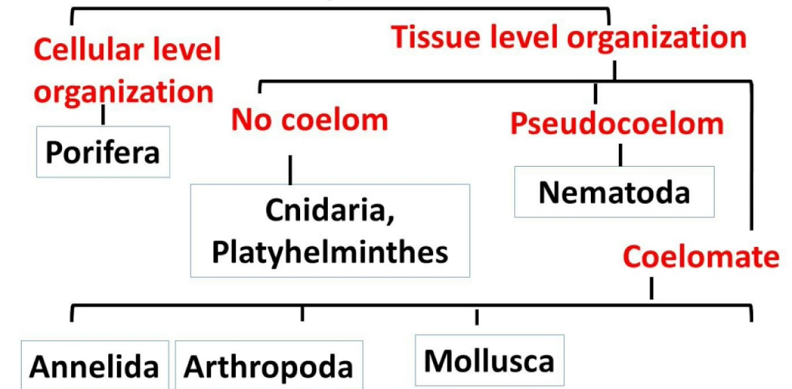
Classification on the basis of grade of organization
Protozoa
Echinodermeta

Slide 10
1ST Phylum
pROTOZOA
Protozoans are unicellular, minute, microscopic, eukaryotic organisms
They are free living or parasitic
They are either solitary or colonial
They are simplest with protoplasmic grade of organization
Body is either naked or covered with pellicle
They have infinite variety of shapes. cells are encloses only in cell membrane
Flagella, cilia, pseudopodia are locomotory organs
Amoeba, paramecium, plasmodium, euglena, entamoeba are the examples of protozoans

Slide 11
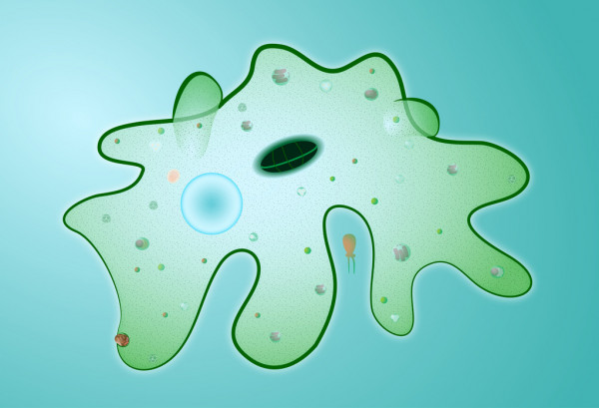
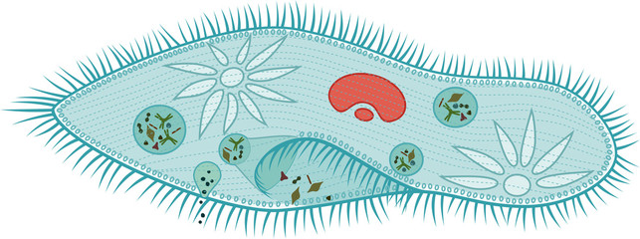
EXAMPLES
AMOEBA
PARAMECIUM

Slide 12
2nd Phylum
porifera
Porifera are pore bearing animals
They are macroscopic
They are aquatic
They are solitary or colonial
These animals are multicellular
Cellular grade of organization
They are asymmetrical
They are sessile spending their lives attached to the rock
Two main pores ; ostia, osculum
Aquiferous and totipotent nature of the cells are the main character of this phylum
Sponges are the example of it

Slide 13
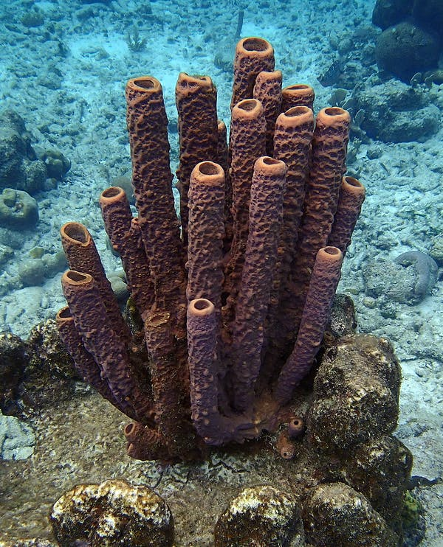
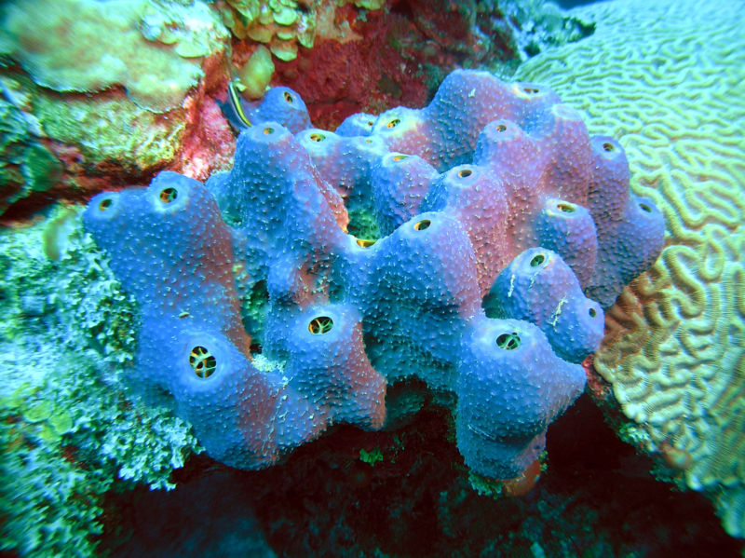
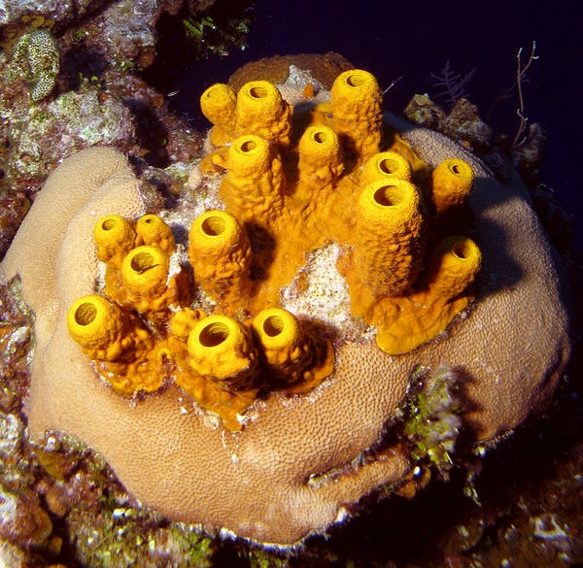
EXAMPLES
SPONGES

Slide 14
3rd Phylum
cnidaria
Cnidarians are stinging animals
They have stinging cells (cnidocytes) on tentacles
They have gastrovascular cavity called coelenterons
They are aquatic
Many are colonial some are solitary
They are at tissue grade of organization
They have a radially symmetrical body
They Show polymorphism
Hydra, jelly fishes, sea anemone, coral reefs are the examples

Slide 15
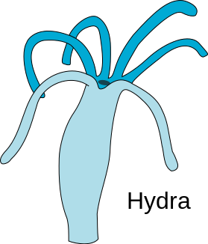
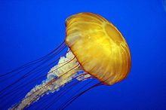
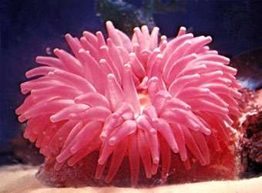
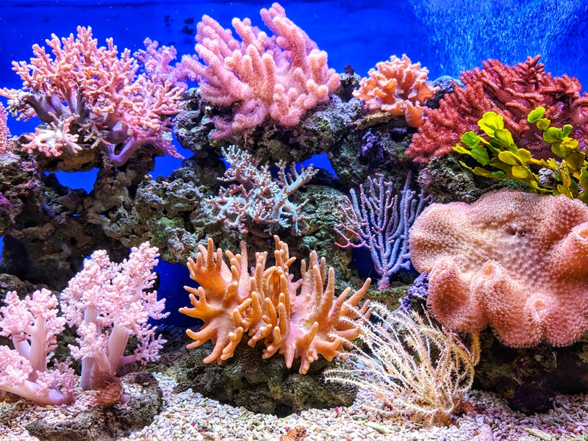
EXAMPLES
HYDRA
JELLY FISH
SEA ANEMONE
CORAL REEFS

Slide 16
4th Phylum
platyhelminthes
The platyhelminthes drieved from two Greek word the ‘‘Platy’’ means ‘‘flat’’ and ‘‘helminth’’ means ‘‘worm’’
They are soft bodied invertebrates and unsegmented
They are ecto-endo parasitic few are free living
They are bilaterian
They are triploblastic
Suckers hookers present
They are acoelomates
Flat worm, planaria, liver fluke are the examples

Slide 17
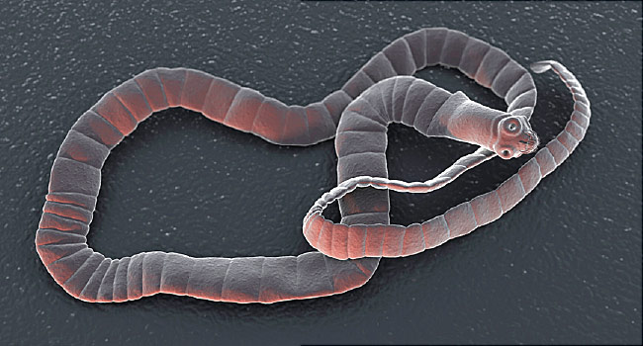
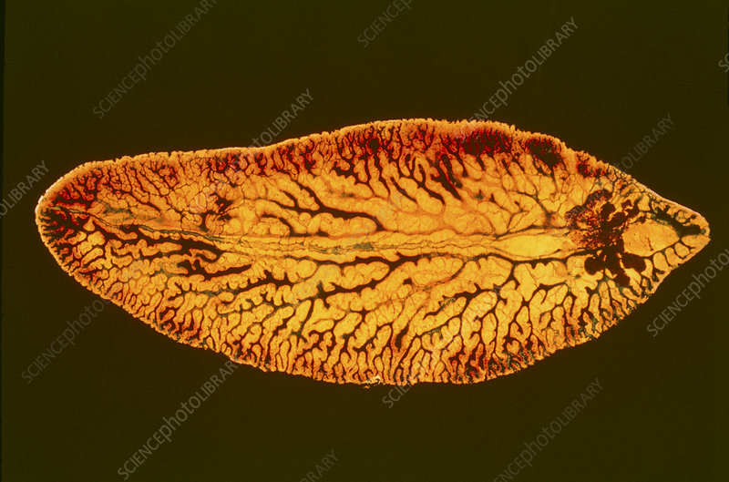
EXAMPLES
PLANARIA
LIVER FLUKE
TAPE WORM

Slide 18
5th Phylum
Nematoda
This also known as aschelminthes, nemahelminthes or pseudocoelomate
They are Soft bodied
Mostly free living some are parasitic
They are cylindrical, unsegmented, triploblastic animals
They have elongated rounded body with pointed ends
Body cavity called Pseudocoelom
They are bilaterally symmetrical
Round worm, thread worm, eel worm are the examples

Slide 19
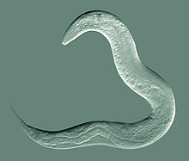
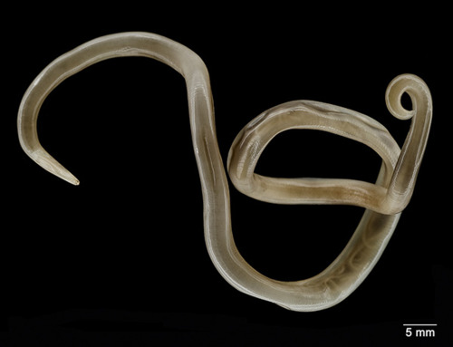
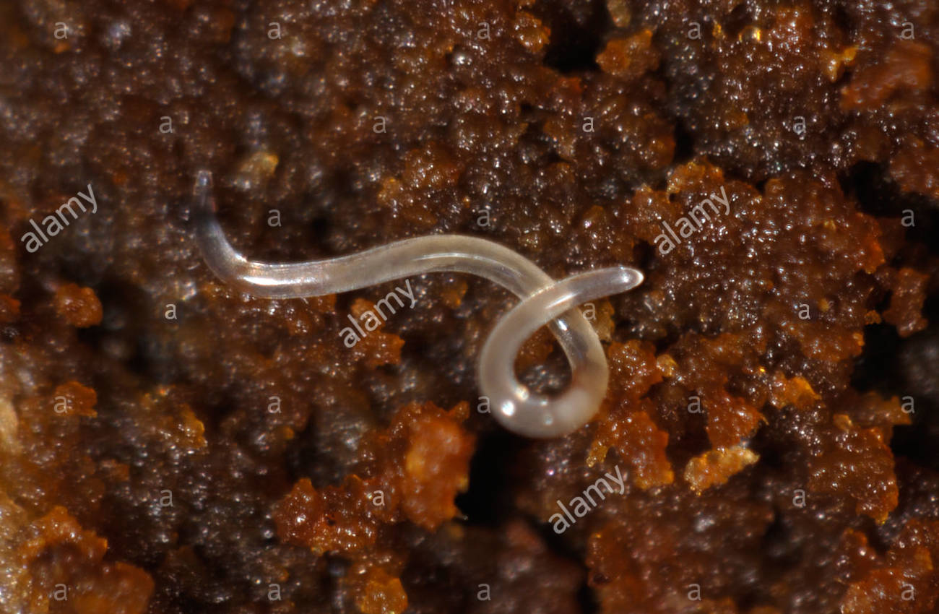
EXAMPLES
ROUND WORM
THREAD WORM
EEL WORM

Slide 20
6TH Phylum ANNELIDA
They word Annelida is derived from latin word Anellus, ‘‘little ring’’ also known as the ringed worms or segmented worms
They are triploblastic and coelomate organisms
They are soft bodied and covered with thin cuticle
They live in ocean, fresh water and damp soils
Pair of parapodia for locomotion. Most annelids have moveable bristles called setea
They are bilaterally symmetrical
They show metamerism
Leech, earth worm

Slide 21
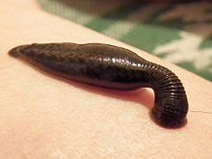
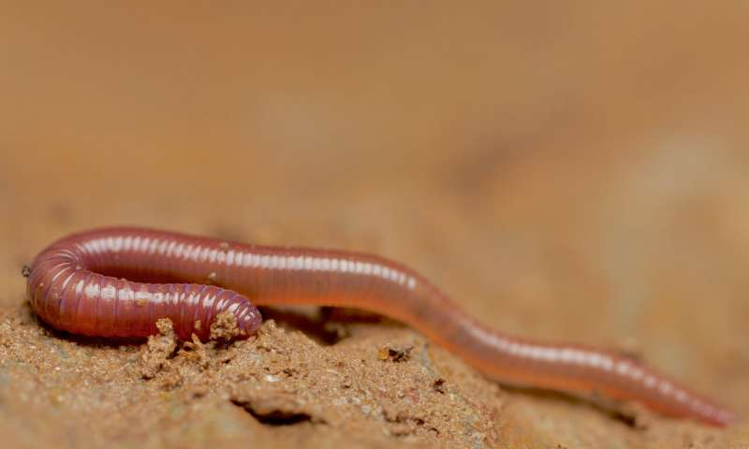
EXAMPLES
LEECH
EARTH WORM

Slide 22
7th phylum mollusca
The animals of this phylum are soft bodied, Non metameric, triploblastic, coelomates
They are bilaterally symmetrical invertebrates
They are sluggish animals
Molluscs are aquatic and a few are adapted to terrestrial environment
There body is divided into head, muscular foot and containing most of the internal organs
Mantle and shell present
Oyster, snail, octopus , cuttle fish are the examples

Slide 23
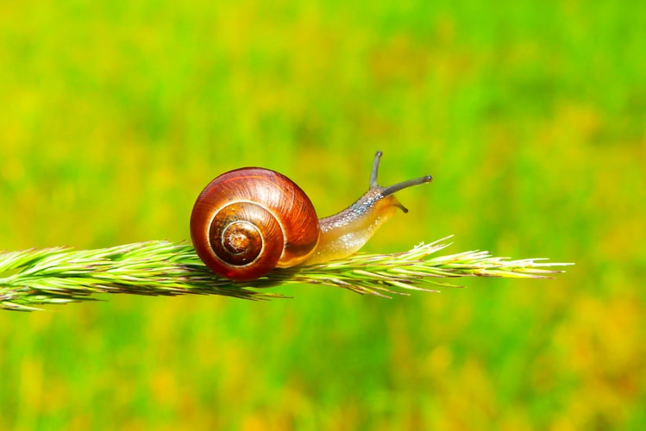
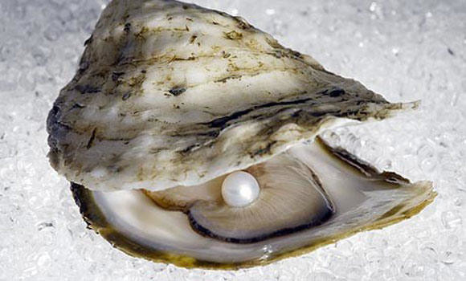
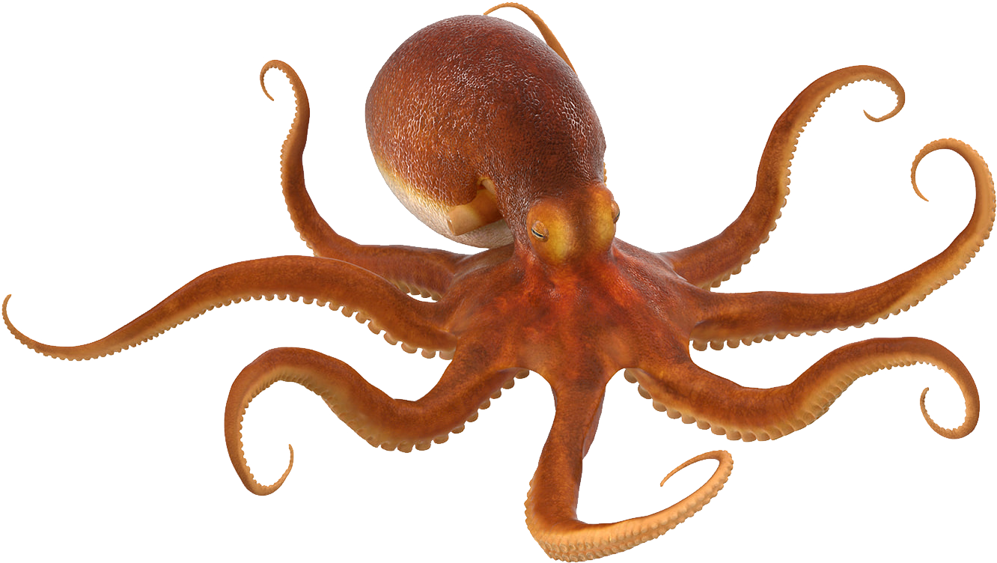
EXAMPLES
SNAIL
OYSTER
OCTOPUS

Slide 24
8th phylum ARTHOPODA
An arthopod is an invertebrate animal having an exoskeleton
They have a segmented body
They have Pairs of jointed limbs
These are bilaterally symmetrical
They are marine, fresh water, terrestrial, and aerial
They show the process of molting
They show Metamorphosis
Cockroah, centipedes, millipedes, spiders, crabs, scorpio are the examples

Slide 25
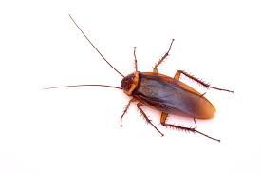
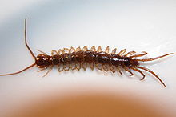
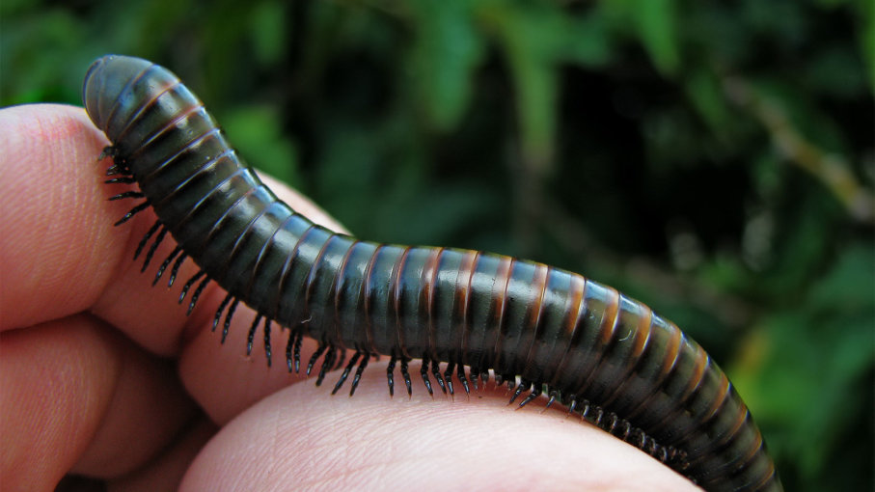
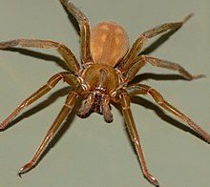
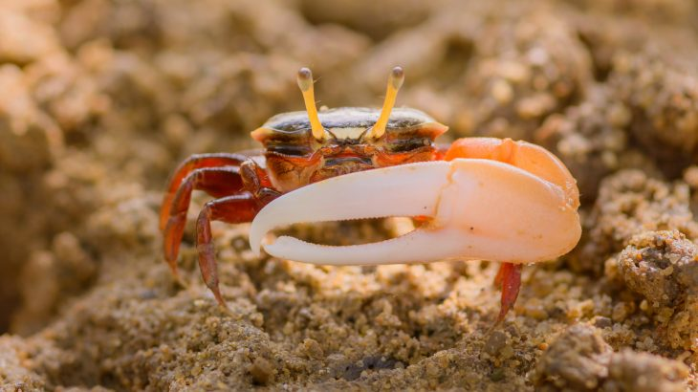
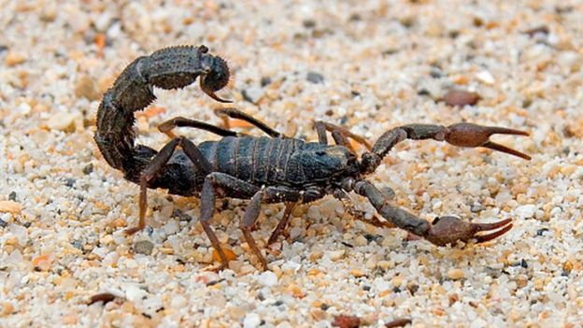
EXAMPLES
MILLIPEDES
COCKROACH
CENTIPEDES
SCORPIO
CRAB
SPIDER

Slide 26
9TH phylum ECHINODERMETA
Echinoderms are a major group of only marine animals
Echinodermata comes from Greek word ‘‘echinos’’ meaning ‘‘Spiny’’ and ‘‘dermos’’ meaning ‘‘skin’’
They are triploblastic, and have a true coelom
They have fivefold Radial symmetry
They have Organ grade of organization
They are Non segmented
They show Ambulacural system and Regeneration phenomenon
They have Oral-aboral surfaces
Star fish, sea urchin, sea cucumber are the examples

Slide 27
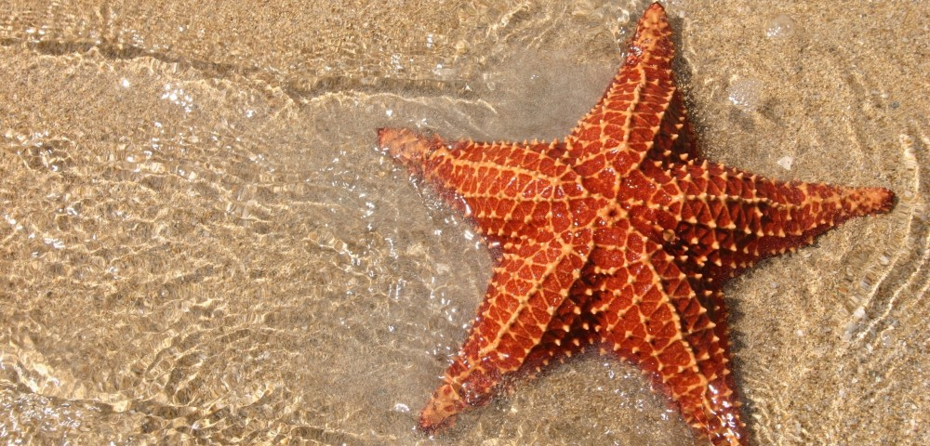
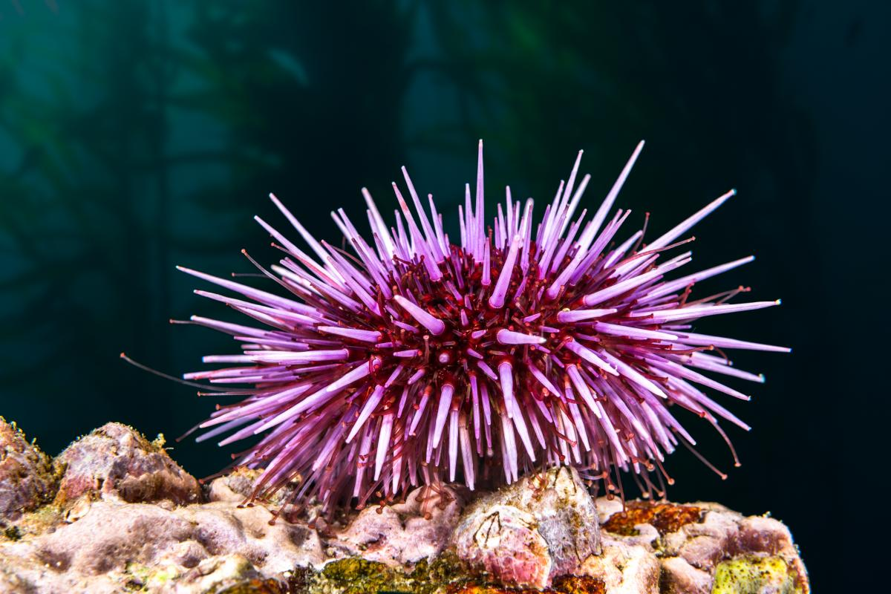
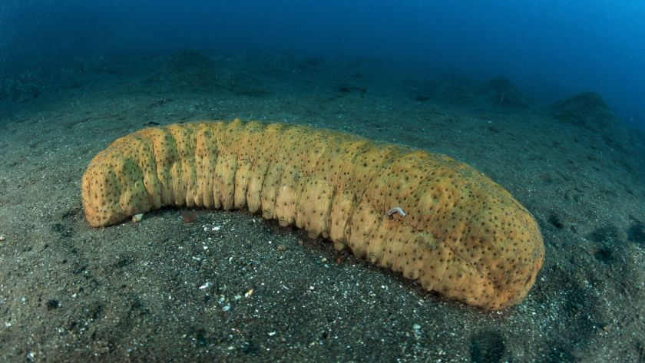
EXAMPLES
STARFISH
SEA URCHIN
SEA CUCUMBER

