Slide 1
Unit 2: Phylum Porifera Topic: Classification of Phylum Porifera B.Ed (Hons) Secondary Semester IV Subject: Biology IV (Minor) Course Title: Invertebrates Diversity Represented By: Ms Sidra Younis Department of Education(Planning and Development) Lahore College for Women University, Lahore

Slide 2
Classification of Phylum Porifera:

Slide 3
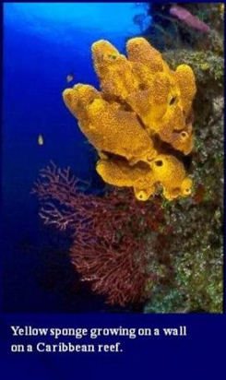
INTRODUCTION:
There are 500 living species of sponges in phylum Porifera. All adult sponges are sessile.
Grouped into three classes depending upon their nature(Skeleton).
Lives in both marine and freshwater forms.
Sponges are simple invertebrate animals that live in aquatic habitats.
Many sponge species grow upright in branching tree-like or tubular vase-like.
Many of the small sponges that hide under rocks or live on coral reefs are colored in vivid hues of red, yellow, orange, purple.
They live upto a depth of 8500 m in the sea.

Slide 4
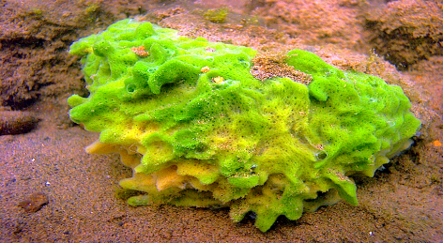
CONT...
Generally flourish in warm waters.
Size varies from few cm to several meters.
No respiratory system
No circulatory system
Macroscopic

Slide 5
CONT....

Slide 6
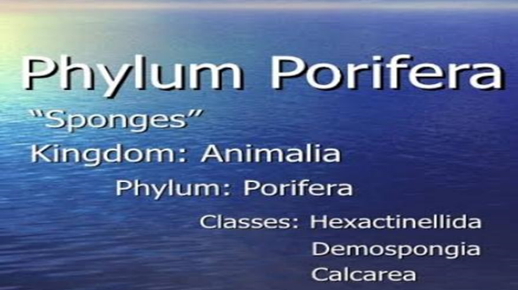
CONT....
The phylum Porifera has four classes, namely the Calcarea, Demospongiae, Hexactinellida . Exclusively marine, calcareous sponges inhabit shallow waters. They are often small and vase-like form.

Slide 7
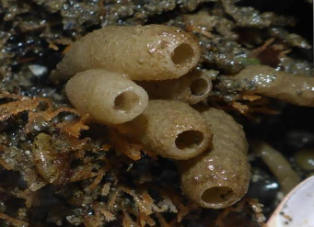
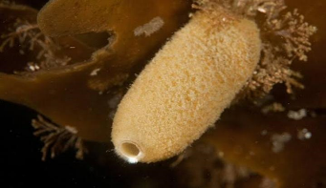
CLASS CALCAREA:
Size:
Sponges of this class are small.
Habitat:
Lives in marine forms living in shallow waters.
Skeleton:
Skeleton is made up of calcareous spicules.
Body Shape:
May be cylindrical or vase like.

Slide 8
CONT....
Colonies:
They may either live in colonies or solitarily
Body Organization:
Body organization may be asconoid, syconoid or leuconoid type.
Development:
Development includes coeloblastula or amphiblastula larva

Slide 9
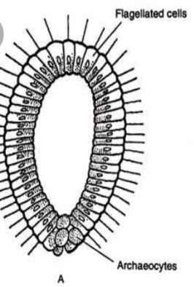
COELOBLASTULA:
Coeloblastula is an embryonic stage of blastula.
It us a characteristic of Coelenterata.
It is formed as a result of complete cleavage(division or spliting).

Slide 10
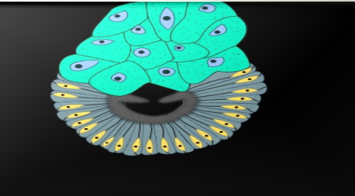
AMPHIBLASTULA:
A poriferan (sponge) larva in which the area of flagellated cells is equal to the area of non-flagellated cells.
At metamorphosis the flagellated cells move to the interior and become choanocytes.

Slide 11
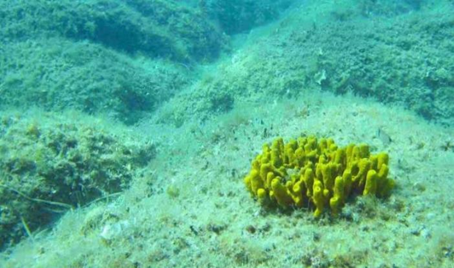
CONT….
Osculum narrow and placed.
Osculum provided with oscular fringe.
Comparatively large collared cells.
Spicules contain more CaCO3 (87%) than Magnesium carbonate.

Slide 12
CONT....
Megascleres are monaxon, triaxon or tetraxon.
Spicules are structural elements found in most sponges. They provide structural support and deter predators.
Large spicules that are visible to the naked eye are referred to as megascleres,
Smaller, microscopic ones are termed microscleres.

Slide 13
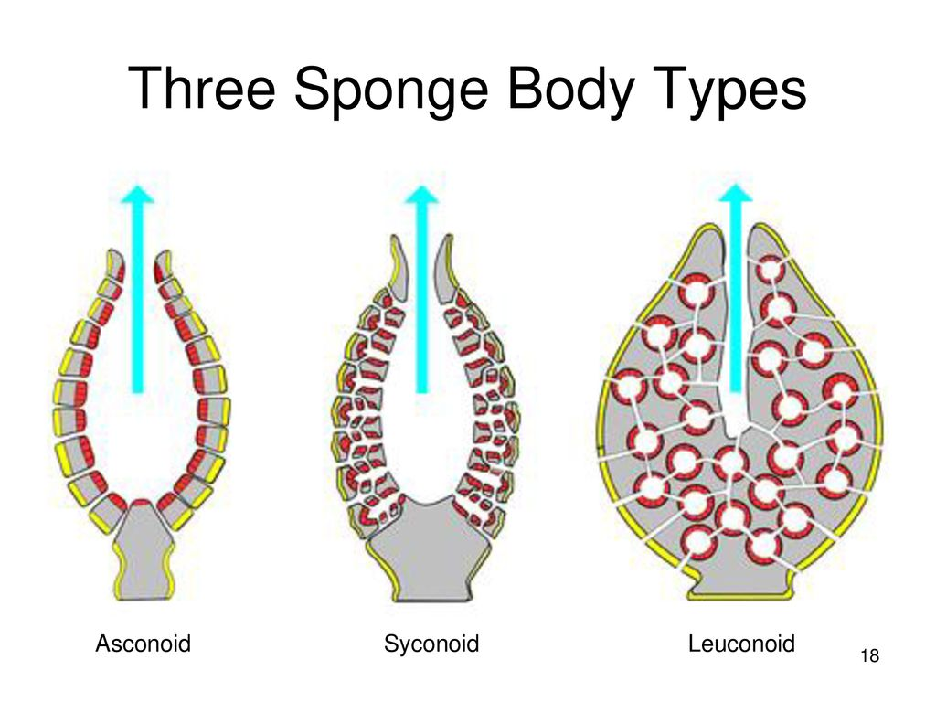
CONT....
Canal system is asconoid, syconoid and leuconoid type.
Asconoid type of canal system is found only in the class Calcarea.
Sycnoid and ascnoid water canal system generally have a radial symmetry(like star fish).
Leucnoid water canal system has an asymmetrical body shape, they lack symmetry.

Slide 14
EXAMPLE OF CLASS CALCAREA:

Slide 15
CLASS HEXACTINELLIDA
Glass sponges.
Hexactinellida sponges are sponges with a skeleton made of four- and/or six-pointed siliceous spicules.
Size:
Moderate(Medium)size.
Habitat:
In marine forms, living in deep water.

Slide 16
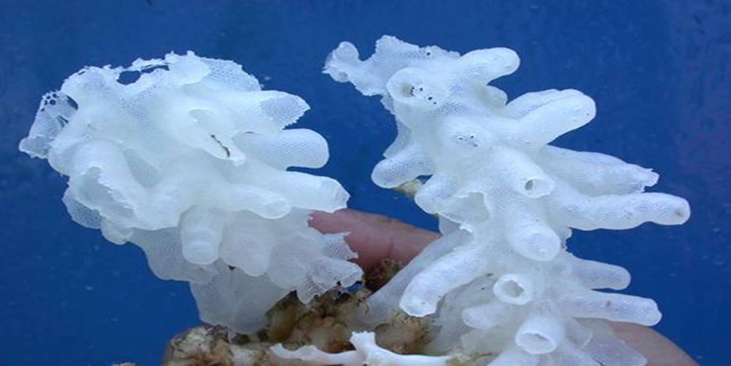
CONT....
Skeleton:
Made up of six –rayed siliceous spicules.
Large sized sponge and on average 10 to 30 cm in height, live mainly in the deep waters of sea.

Slide 17
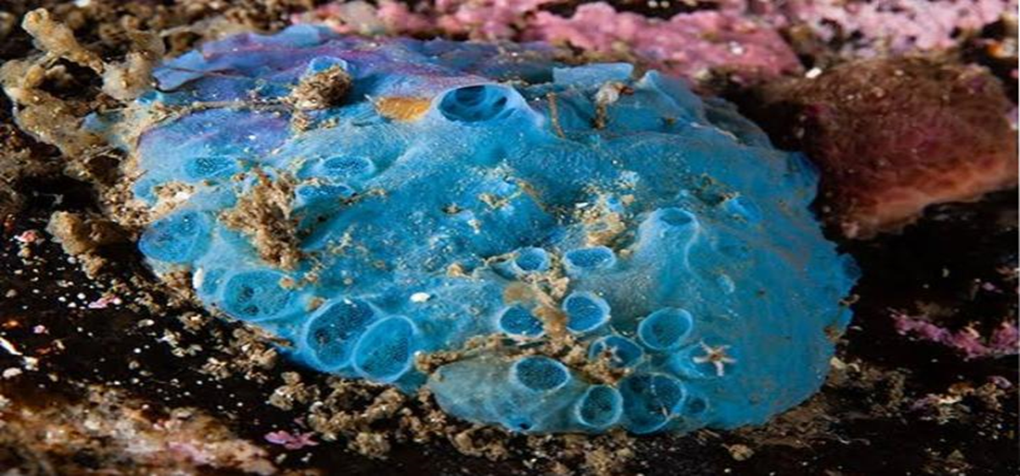
CONT….
Body:
Mayb e ,cup or vase like in shape.
Lives in colonies or solitarily.
Development :
Its development includes trichemella larva.
Choanocytes restricted to finger-like simple or folded chambers.

Slide 18
CONT....
Wall encloses a spongocoel (- atrium) which opens by a wide osculum.
Canal system may be either syconoid or leuconoid type.
There is no cellular dermal epithelium.
Dermal epithelium is made up of closely packed epithelial cells, and the dermis, made of dense, irregular connective tissue that houses blood vessels, hair follicles, sweat glands, and other structures.
Commonly called “glass sponge”.

Slide 19
EXAMPLES OF CLASS HEXACTINELLIDA:
Example: Euplectella (Venus’s flower basket), Hyalonema(Glass rope Sponge).

Slide 20
CLASS DESMOSPONGIE:
Size:
The sponges of this class are large sized.
Habitat:
Lives in marine water or brackish water or in the fresh water forms.
Skeleton:
Made up of siliceous spicules or springing fibres or both or none.

Slide 21
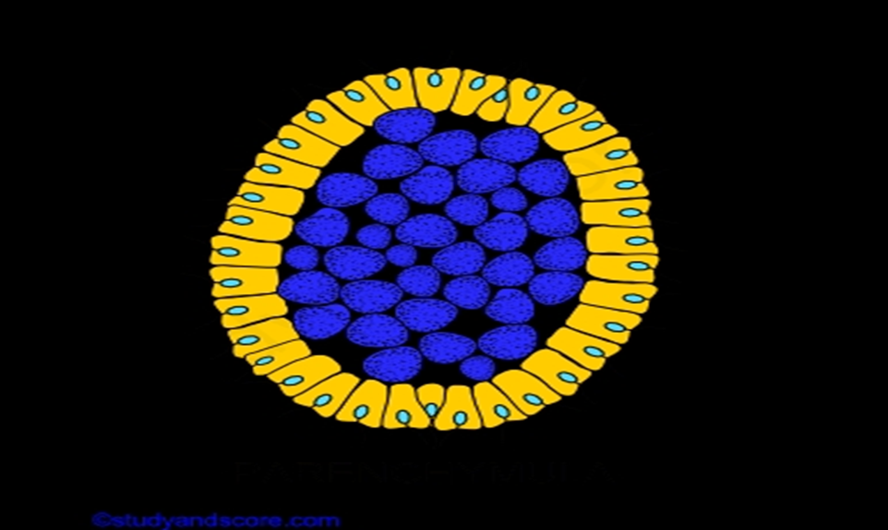
CONT....
Lives in colonies or they may either live solitarily
Body Organization:
It is leuconoid type.
Development :
It includes Paremchymula.
Coloration:
Brilliant coloration in most species, for the presence of pigment granules within amoebocytes.

Slide 22
CONT....
Flagellated chambers small and rounded.
Freshwater species have contractile vacuoles used for elimination of water from the cells.
Canal system of leuconoid type only. The leuconoid type canal system is derived from a larval canal system of leuconoid type only.
The leuconoid type canal system is derived from a larval stage, called the rhagon type which does not occur in any adult animals.
(Demospongiae) live in galleries in shells of mollusks, in corals, in limestone, and in other calcareous materials.

Slide 23
EXAMPLES OF CLASS DESMOSPONGIE:
Examples: Euspongia (Bath sponge), Thena, Cliona,
Spongilla (Fresh water sponge)

