Slide 1
Unit 5: Plant Physiological Processes Topic: Nitrogen Metabolism B.Ed (Hons) Secondary Semester: III Subject: Biology III Minor Course Title: Plant Physiology and Ecology Represented By: Ms Sidra Younis Department of Education (Planning and Development) Lahore College For Women University, Lahore

Slide 2
INTRODUCTION OF NITROGEN
Nitrogen is a naturally occurring element .
Essential for growth and reproduction of plants and animals .
It is found in amino acid that make up proteins .
78% of nitrogen gas present in Earth’s atmosphere.

Slide 3
Nitrogen Metabolism
The soil has limited amounts of nitrogen .
Nitrogen cannot utilize directly to plants.
Plants and microbes compete for this nitrogen.
Therefore , it is a limiting for both agricultural and natural ecosystems.

Slide 4
Nitrogen Fixation
It is the conversion of molecular nitrogen into ammonia or related nitrogenous compound in soil
N2 NH3

Slide 5
TYPES OF NITROGEN FIXATION
Physical Nitrogen Fixation
Biological Nitrogen Fixation
Symbiotic Nitrogen Fixation

Slide 6
PHYSICAL NITROGEN FIXATION NATURAL NITROGEN FIXATION
Under the influence of lightening and thunder ,nitrogen and oxygen of the air react to form nitric oxide N+O2 NO2
The nitric acid further oxidized with oxygen to form nitrogen peroxide.
NO+O2 N2O4
During the rain ,nitric oxide combine with water to form nitrous acid and nitric acid .
NO + rainwater HNO2+HNO3.

Slide 7
INDUSTRIAL NITROGEN FIXATIOIN
The conversion of nitrogen and hydrogen at high pressure and temperature to form ammonia.
N2 +H2 NH3

Slide 8
BIOLOGICAL NITROGEN FIXATION
The conversion of atmospheric nitrogen into the nitrogenous compounds through the agency of living organisms is called biological nitrogen fixation.
SYMBIOTIC NITROGEN FIXATION
Symbiotic nitrogen fixation is part of a mutualistic relationship in which plants provide a niche and fixed carbon to bacteria in exchange for fixed nitrogen.
Both get benefited.

Slide 9
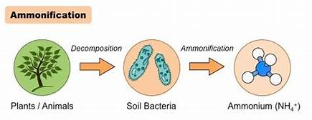
STEPS OF NITROGEN FIXATION

Slide 11
ASSIMILATION
Nitrogen compounds in various forms, such as nitrate, nitrite, ammonia, and ammonium are taken up from soil by plants which are then used in the formation of plant and animal protein.

Slide 13
IMPORTANCE OF NITROGEN FIXATION:
Essential to life.
Inorganic nitrogen compounds required for biosynthesis.
Essential for agriculture and in manufacture of fertilizers.
Use in explosives, pharmaceuticals and dyes.

Slide 14
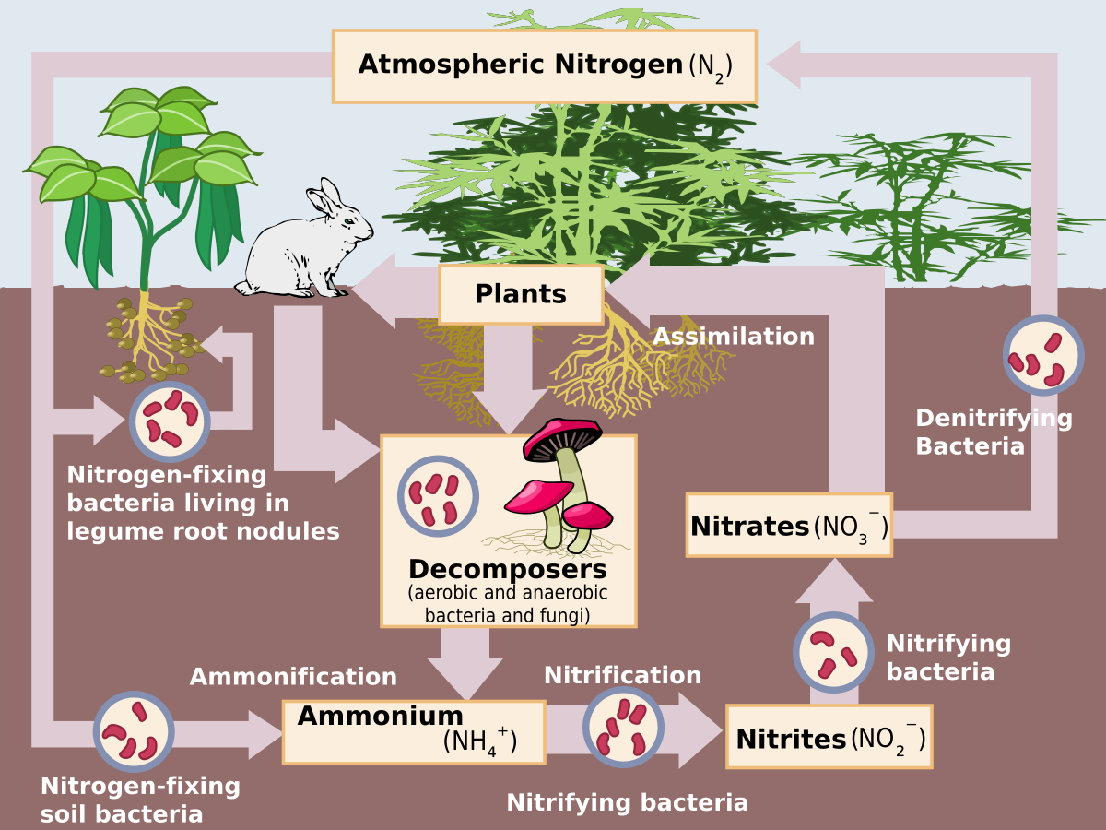
NITROGEN CYCLE

