Slide 1
Unit 5: Plant Physiological Processes Topic: Mechanism of Respiration B.Ed (Hons) Secondary Semester: III Subject: Biology III Minor Course Title: Plant Physiology and Ecology Represented By: Ms Sidra Younis Department of Education (Planning and Development) Lahore College For Women University, Lahore

Slide 2
DEFINITION
It is a biochemical process.
Cells of an organism obtain energy by combining oxygen and glucose.
In result they release carbon dioxide, water and ATP.

Slide 3
CELLULAR RESPIRATION FORMULA

Slide 4
PROCESS OF RESPIRATION
Respiration involves taking in oxygen and release of carbon dioxide by process of breathing.
The taken oxygen is utilized to oxidize chemical energy stored in the food to release energy in the form of ATP along with carbon dioxide and water.
Respiration involves exchange of gases; oxygen with carbon dioxide.

Slide 5
Types of Respiration
There are two types of respiration.
Aerobic respiration.
Anaerobic respiration.

Slide 6
AEROBIC RESPIRATION
In the presence of oxygen, complete oxidation of glucose occurs with maximum release of energy.
In the first phase of aerobic respiration, a molecule of glucose is broken down into two molecules of pyruvic acid.
In the second phase, molecules of pyruvic acid are completely oxidized to CO2 and water and all energy is released.

Slide 7
ANAEROBIC RESPIRATION
In anaerobic respiration, the first phase is similar to aerobic respiration.
A molecule is broken down into two molecules of pyruvic acid.
But in the second phase, pyruvic acid is not completely oxidized (due to absence of oxygen).
It is transformed into lactic acid.
Many C-H bonds are left unbroken in the products.

Slide 8
Anaerobic respiration is further classified as
Alcoholic fermentation
Lactic acid fermentation.

Slide 9
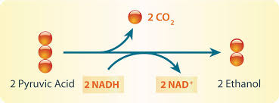
Alcoholic Fermentation
It occurs in bacteria, yeast etc.
In this type of anaerobic respiration, pyruvic acid is further broken down into alcohol (C2H5OH) and CO2.

Slide 10
LACTIC ACID FERMENTATION
It occurs in skeletal muscles of humans and other animals during extreme physical activities.
This also happens in the bacteria present in milk like lactobacillus.
In this type, each pyruvic acid molecule is converted in to lactic acid (C2H6O3).
Pyruvic acid lactic acid

Slide 11
GLYCOLYSIS
It is the main process involved in cellular respiration.
It is the pathway that converts sugar into energy, or glucose into pyruvate generating ATP during the conversion.
The energy by products, ATP and NADH, do require oxygen to be utilized.

Slide 12
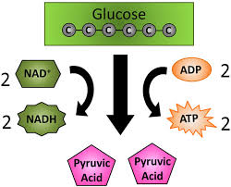
Formula

Slide 13
STEPS OF GLYCOLYSIS
Glycolysis is an extramitochondrial pathway and is carried by a group of eleven enzymes. Glucose is converted to pyruvate in 10 steps by glycolysis. The glycolytic pathway can be divided into two phases:
The first step in glycolysis is the conversion of D-glucose into glucose-6-phosphate. The enzyme that catalyzes this reaction is hexokinase.
The second reaction of glycolysis is the rearrangement of glucose 6-phosphate (G6P) into fructose 6-phosphate (F6P) by glucose phosphate isomerase.
Phosphofructokinase, with magnesium as a cofactor, changes fructose 6-phosphate into fructose 1,6-bisphosphate.

Slide 14
The enzyme Aldolase splits fructose 1, 6-bisphosphate into two sugars that are isomers of each other. These two sugars are dihydroxyacetone phosphate (DHAP) and glyceraldehyde 3-phosphate (GAP).
The enzyme triphosphate isomerase rapidly inter- converts the molecules dihydroxyacetone phosphate (DHAP) and glyceraldehyde 3-phosphate (GAP). Glyceraldehyde phosphate is removed / used in next step of Glycolysis.
Glyceraldehyde-3-phosphate dehydrogenase (GAPDH) dehydrogenates and adds an inorganic phosphate to glyceraldehyde 3-phosphate, producing 1,3-bisphosphoglycerate.
Phosphoglycerate kinase transfers a phosphate group from 1,3-bisphosphoglycerate to ADP to form ATP and 3-phosphoglycerate.

Slide 15
The enzyme phosphoglycerate mutase relocates the P from 3- phosphoglycerate from the 3rd carbon to the 2nd carbon to form 2-phosphoglycerate.
The enzyme enolase removes a molecule of water from 2-phosphoglycerate to form phosphoenol pyruvic acid (PEP).
The enzyme pyruvate kinase transfers a P from phosphoenol pyruvate (PEP) to ADP to form pyruvic acid and ATP.
The net end products of glycolysis are two pyruvate, two NADH, and two ATP.

Slide 16
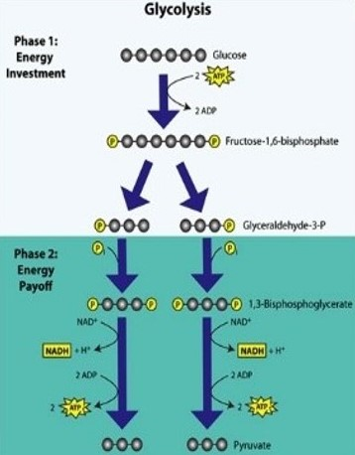

Slide 17
Krebs' cycle
It occurs in mitochondrial matrix.
Transfers energy from pyruvate to electron carriers to form ATP.
Also called Citric acid cycle or Tricarboxylic acid cycle.
Acetyl CoA ➔ CO2 + ATP +NADH2+FADH2

Slide 18
STEPS OF KREBS’ CYCLE
First the pyruvate molecules are converted to Acetyl CoA. This combines with oxaloacetate to form citrate.
Citrate is then converted to isocitrate. Isocitrate is then oxidized to alpha ketoglutarate which results in release of NADH and CO_{2.}
Alpha ketoglutarate is then oxidized to 4 carbon molecules when then picks up coenzyme A to form succinyl CoA. It also forms a NADH2 molecule.
Succinyl CoA is then converted to succinate and one GTP is released ATP.
Succinate is converted to fumarate and a molecule of FADH₂.
Fumarate is converted to Malate.
Malate is converted oxaloacetate and NADH2 is produced.

Slide 19
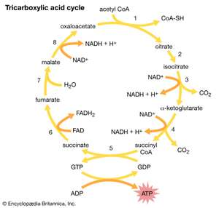
CYCLE

Slide 20
ELECTRON TRANSPORT CHAIN
Electrons carriers of chain carry protons and electrons from NADH2 and FADH2 to complexes 1, 2,3 and 4.
NADH2 is a good electron donor transfers electrons to complex 1.
FADH2 transfers electrons to complex 2.
Both electrons are passed to carriers Ubiquinone Q which becomes QH2.
Then electrons passed to complex 3 then to Cytochrome C then complex 4.
Now protons are pumped outside matrix to inter membrane space.
Proton gradient is created creating potential energy.
Potential energy helps to power ADP to produce ATP.
Hydrogen atoms combine with Oxygen to form water.
NADH2 + FADH2 ➔ ATP +H20 +FAD + NAD

Slide 21
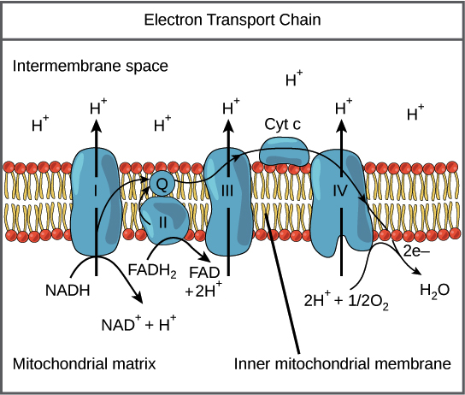
CYCLE

