Slide 1
Unit 2: Water Relations Topic: General Introduction B.Ed (Hons) Secondary Semester: III Subject: Biology III Minor Course Title: Plant Physiology and Ecology Represented By: Ms Sidra Younis
Department of Education (Planning and Development) Lahore College For Women University, Lahore

Slide 2
WATER POTENTIAL
Water potential is a measure of the potential energy in water. Plant physiologists are not interested in the energy in any one particular aqueous system, but are very interested in water movement between two systems. In practical terms, therefore, water potential is the difference in potential energy between a given water sample and pure water (at atmospheric pressure and ambient temperature). Water potential is denoted by the Greek letter ψ (psi) and is expressed in units of pressure (pressure is a form of energy) called megapascals (MPa). The potential of pure water (Ψ_{w}^{pure H}₂^{O}) is, by convenience of definition, designated a value of zero (even though pure water contains plenty of potential energy, that energy is ignored). Water potential values for the water in a plant root, stem, or leaf are therefore expressed relative to Ψ_{w}^{pure H}₂^{O}.
The water potential in plant solutions is influenced by solute concentration, pressure, gravity, and factors called matrix effects. Water potential can be broken down into its individual components using the following equation:
Ψ_{system} = Ψ_{total} = Ψ_{s} + Ψ_{p} + Ψ_{g} + Ψ_{m}

Slide 3
SOLUTE POTENTIAL
Solute potential (Ψ_{s}), also called osmotic potential, is negative in a plant cell and zero in distilled water. Typical values for cell cytoplasm are –0.5 to –1.0 MPa. Solutes reduce water potential (resulting in a negative Ψ_{w}) by consuming some of the potential energy available in the water. Solute molecules can dissolve in water because water molecules can bind to them via hydrogen bonds; a hydrophobic molecule like oil, which cannot bind to water, cannot go into solution. The energy in the hydrogen bonds between solute molecules and water is no longer available to do work in the system because it is tied up in the bond. In other words, the amount of available potential energy is reduced when solutes are added to an aqueous system. Thus, Ψ_{s} decreases with increasing solute concentration. Because Ψ_{s} is one of the four components of Ψ_{system} or Ψ_{total}, a decrease in Ψ_{s} will cause a decrease in Ψ_{total}. The internal water potential of a plant cell is more negative than pure water because of the cytoplasm’s high solute content . Because of this difference in water potential water will move from the soil into a plant’s root cells via the process of osmosis. This is why solute potential is sometimes called osmotic potential.
Plant cells can metabolically manipulate Ψ_{s} (and by extension,Ψ_{total}) by adding or removing solute molecules. Therefore, plants have control over Ψ_{total} via their ability to exert metabolic control over Ψ_{s.}

Slide 4
PRESSURE POTENTIAL
Pressure potential (Ψ_{p}), also called turgor potential, may be positive or negative .Because pressure is an expression of energy, the higher the pressure, the more potential energy in a system, and vice versa. Therefore, a positive Ψ_{p} (compression) increases Ψ_{total}, and a negative Ψ_{p} (tension) decreases Ψ_{total}. Positive pressure inside cells is contained by the cell wall, producing turgor pressure. Pressure potentials are typically around 0.6–0.8 MPa, but can reach as high as 1.5 MPa in a well-watered plant. As a comparison, most automobile tires are kept at a pressure of 30–34 psi. An example of the effect of turgor pressure is the wilting of leaves and their restoration after the plant has been watered. Water is lost from the leaves via transpiration and restored by uptake via the roots.

Slide 5
OSMOSIS
“Osmosis is a process by which the molecules of a solvent pass from a solution of low concentration to a solution of high concentration through a semi-permeable membrane.”
What is Osmosis?
Osmosis is a passive process and happens without any expenditure of energy. It involves the movement of molecules from a region of higher concentration to lower concentration until the concentrations become equal on either side of the membrane.
Any solvent can undergo the process of osmosis including gases and supercritical liquids.

Slide 6
CONT....
Osmotic Solutions
There are three different types of solutions:
Isotonic Solution
Hypertonic Solution
Hypotonic Solution
An isotonic solution is one that has the same concentration of solutes both inside and outside the cell.
A hypertonic solution is one that has a higher solute concentration outside the cell than inside.
A hypotonic solution is the one that has a higher solute concentration inside the cell than outside.

Slide 7
IMPORTANCE OF OSMOSIS
Osmosis influences the transport of nutrients and the release of metabolic waste products.
It is responsible for the absorption of water from the soil and conducting it to the upper parts of the plant through the xylem.
It stabilizes the internal environment of a living organism by maintaining the balance between water and intercellular fluid levels.
It maintains the turgidity of cells.
It is a process by which plants maintain their water content despite the constant water loss due to transpiration.
This process controls the cell to cell diffusion of water.
Osmosis induces cell turgor which regulates the movement of plants and plant parts.
Osmosis also controls the dehiscence of fruits and sporangia.
Higher osmotic pressure protects the plants against drought injury.

Slide 8
IMPORTANCE OF OSMOSIS
Osmosis influences the transport of nutrients and the release of metabolic waste products.
It is responsible for the absorption of water from the soil and conducting it to the upper parts of the plant through the xylem.
It stabilizes the internal environment of a living organism by maintaining the balance between water and intercellular fluid levels.
It maintains the turgidity of cells.
It is a process by which plants maintain their water content despite the constant water loss due to transpiration.
This process controls the cell to cell diffusion of water.
Osmosis induces cell turgor which regulates the movement of plants and plant parts.
Osmosis also controls the dehiscence of fruits and sporangia.
Higher osmotic pressure protects the plants against drought injury.

Slide 9
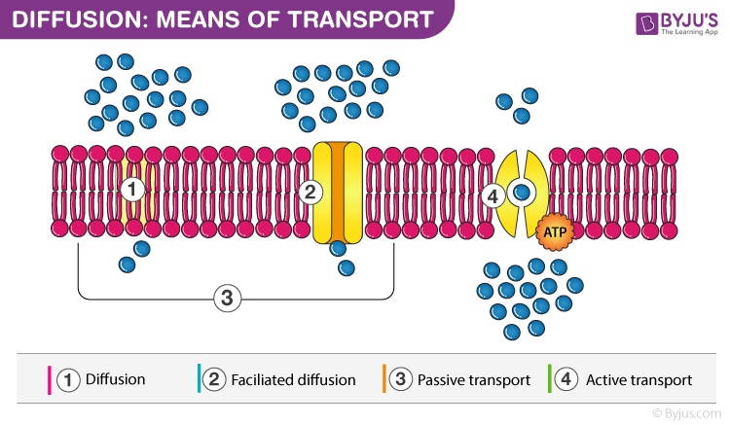
DIFFUSION
“Diffusion is the process of movement of molecules from a region of higher concentration to a region of lower concentration.”

Slide 10
IMPORTANCE OF DIFFUSION
Diffusion is a very important process for photosynthesis where carbon dioxide from the stomata diffuses into the leaves and finally into the cells. Also, during transpiration, the water and oxygen diffuse from the leaves into the environment.
It includes the movement of particles of a medium from the region of its higher concentration to the region of its lower concentration without the expenditure of energy. This process is slow and occurs mostly in gases and liquids. The rate of diffusion is affected by various factors like temperature and pressure, concentration gradient, separating membrane’s permeability etc.

Slide 11
IMPORTANCE OF DIFFUSION
The exchange of gases through stomata takes place by the process of diffusion.
Transpiration occurs by the principle of diffusion.
The ions are absorbed by simple diffusion.
The food material is translocated by this process.
This process keeps the walls of the internal tissues of the plant moist.
It is responsible for spreading the ions and molecules throughout the protoplast.
Aroma of flowers is due to the diffusion of aromatic compounds to attract insects.

Slide 12
IMBIBITION
Imbibition is a special type of diffusion that takes place when water is adsorbed by solids-colloids causing an increase in volume. Examples include the absorption of water by seeds and dry wood. If there is no pressure due to imbibition, seedlings would not be able to emerge from soil.
Water surface potential movement takes place along a concentration gradient; some dry materials absorb water. A gradient between the absorbent and the liquid is essential for imbibition. For a substance to imbibe a liquid, there must first be some attraction between them.
Imbibition occurs when a wetting fluid displaces a non-wetting fluid, the opposite of drainage in which a non-wetting phase displaces the wetting fluid. The two processes are governed by different mechanisms.

Slide 13
IMPORTANT OF IMBIBITION
Imbibition is also a type of diffusion since water movement is along the concentration gradient. The seeds and other such materials have almost no water hence they absorb water easily. Water potential gradient between the absorbent and liquid imbibed is essential for imbibition.
Imbibition is the first step of water absorption. It facilitates water absorption by roots and helps in the seed germination.

