Slide 1
Unit 2: Bacteria and Cynobacteria
Topic: Life Cycle of Nostoc
B.Ed (Hons) Secondary
Semester: II
Subject: Biology II (Minor)
Course Title: Diversity of Plants
Represented By: Ms Sidra Younis
Department of Education (Planning and Development)
Lahore College for Women University, Lahore

Slide 2
Nostoc
Taxonomic Position
Kingdom Bacteria
Phylum Cyanobacteria
Class Cyanophyceae
Order Nostocales
Family Nostocaceae
Genus Nostoc
Habitat
Nostoc can be found in soil, on moist rocks, at the bottom of lakes and springs (both fresh- and saltwater). It may also grow symbiotically within the tissues of plants.

Slide 3
Morphology
These bacteria contain photosynthetic pigments
in their cytoplasm to perform photosynthesis.
Thalli are present in the form of colony.
Ball like colony is enveloped by a gelatinous sheath.
Balls are greenish to bluish-green in color.
Each colony contains thousands of straight or twisted
filaments or trichomes.
A trichome consists of many cells arranged in a beaded
manner. Each cell is cylindrical or spherical in shape.
In filaments along the trichomes, larger specialized nitrogen-fixing cells called heterocysts.

Slide 4
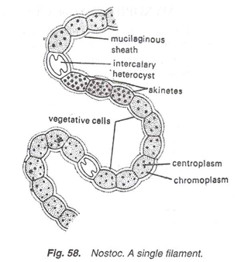
CONT…
Some cells of the filament become enlarged and filled with the food material. These thick-walled cells are called akinetes. Akinetes are generally present in chain.
Cells have no nucleus nor internal membrane system.

Slide 5
Life Cycle of Nostoc
The usual methods of reproduction in Nostoc are vegetative and asexual reproduction. The sexual reproduction is absent. The vegetative reproduction takes place by means of Fragmentation, hormogones, akinetes and heterocysts.
a)Fragmentation:
The colony breaks into two or more fragments at the junction of the heterocyst and the adjoining cell into a number of short fragments by mechanical or physiological means.
Each fragment is capable to develop into new colony.

Slide 6
CONT…
b)Hormogones:
In favourable conditions the filaments break in small pieces called the hormogones.
Each hormogone consists of two or more cells.
Usually the filaments break at the heterocysts.
Each hormogone is capable to give rise to a new plant.
The hormogones may germinate after liberation from the gelatinous-matrix or still within it.

Slide 7
CONT…

Slide 8
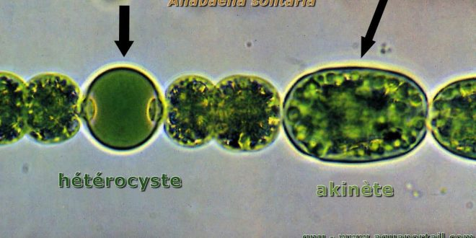
CONT…
c) Akinetes:
Some vegetative cells of the filament may become enlarged and thick walled containing reserve food. These are resting cells (spores) called akinetes.
They are larger and thick wall than vegetative cell.
They can survive in unfavorable conditions and germinate into a new filament of Nostoc when favourable condition arises.

Slide 9
CONT…
d) Heterocysts:
They are larger, thick walled cells present in certain intervals of the trichome.
At the time of germination heterocyst divide into 4 cells called germiling.
Ruptures the outer wall, comes out and develops into the new filaments.

Slide 10
CONT….

