Slide 1
Unit 2: Cell Biology Topic: Cell Organelles (Cell Wall & Cell Membrane) B.Ed (Hons) Secondary Semester: I Subject: Biology I (Minor) Course Title: General Biology Represented By: Ms Sidra Younis Department of Education (Planning and Development) Lahore College for Women University, Lahore

Slide 2
Cell wall
A cell wall is a structural layer surrounding some types of cells, situated outside the cell membrane. It can be tough, flexible, and sometimes rigid. It provides the cell with both structural support and protection, and also acts as a filtering mechanism. Cell walls are present in most prokaryotes (except mycoplasma bacteria), in algae, plants and fungi but rarely in other eukaryotes including animals. Animal cells however, do not have a cell wall. The cell wall conducts many important functions in a cell including protection, structure, and support. A major function is to act as pressure vessels, preventing over-expansion of the cell when water enters. Cell wall composition varies depending on the organism. In plants, the cell wall is composed mainly of strong fibers of the carbohydrate polymer cellulose. Cellulose is the major component of cotton fiber and wood and is used in paper production.

Slide 3
PLANT CELL WALL STRUCTURE
The plant cell wall is multi-layered and consists of up to three sections. From the outermost layer of the cell wall, these layers are identified as the middle lamella, primary cell wall, and secondary cell wall. While all plant cells have a middle lamella and primary cell wall, not all have a secondary cell wall.
Middle lamella - outer cell wall layer that contains polysaccharides called pectins. Pectins aid in cell adhesion by helping the cell walls of adjacent cells to bind to one another.​
Primary cell wall - The primary cell wall, generally a thin, flexible and extensible layer formed while the cell is growing. It is formed between the middle lamella and plasma membrane in growing plant cells. It is primarily composed of cellulose microfibrils contained within a gel-like matrix of hemicellulose fibers and pectin polysaccharides. The primary cell wall provides the strength and flexibility needed to allow for cell growth.​

Slide 4
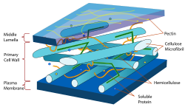
Secondary cell wall – A thick layer formed inside the primary cell wall after the cell is fully grown. It is not found in all cell types. It is formed between the primary cell wall and plasma membrane in some plant cells. Once the primary cell wall has stopped dividing and growing, it may thicken to form a secondary cell wall. This rigid layer strengthens and supports the cell. In addition to cellulose and hemicellulose, some secondary cell walls contain lignin. Lignin strengthens the cell wall and aids in water conductivity in plant vascular tissue cells.

Slide 5
PLANT CELL WALL FUNCTION
A major role of the cell wall is to form a framework for the cell to prevent over expansion. Cellulose fibers, structural proteins, and other polysaccharides help to maintain the shape and form of the cell. Additional functions of the cell wall include:
Support - the cell wall provides mechanical strength and support. It also controls the direction of cell growth.​
Withstand turgor pressure - turgor pressure is the force exerted against the cell wall as the contents of the cell push the plasma membrane against the cell wall. This pressure helps a plant to remain rigid and erect, but can also cause a cell to rupture.​
Regulate growth - sends signals for the cell to enter the cell cycle in order to divide and grow.
Regulate diffusion - the cell wall is porous allowing some substances, including proteins, to pass into the cell while keeping other substances out.​
Communication - cells communicate with one another via plasmodesmata (pores or channels between plant cell walls that allow molecules and communication signals to pass between individual plant cells).​
Protection - provides a barrier to protect against plant viruses and other pathogens. It also helps to prevent water loss.​
Storage - stores carbohydrates for use in plant growth, especially in seeds.

Slide 6
Cell Membrane/ Plasmalemma
The cell membrane, also known as the plasma membrane, is a double layer of lipids and proteins that surrounds a cell and separates the cytoplasm (the contents of the cell) from its surrounding environment. It is selectively permeable, which means that it only lets certain molecules enter and exit. It can also control the amount of some substances that go into or out of the cell. All cells have a cell membrane.
Structure of the Cell Membrane
Phospholipids are a main component of the cell membrane. These are lipid molecules made up of a phosphate group head and two fatty acid tails. The properties of phospholipid molecules allow them to spontaneously form a double-layered membrane. When in water or an aqueous solution, which includes the inside of the body, the hydrophilic heads of phospholipids will orient themselves to be on the outside, while the hydrophobic tails will be on the inside.

Slide 7
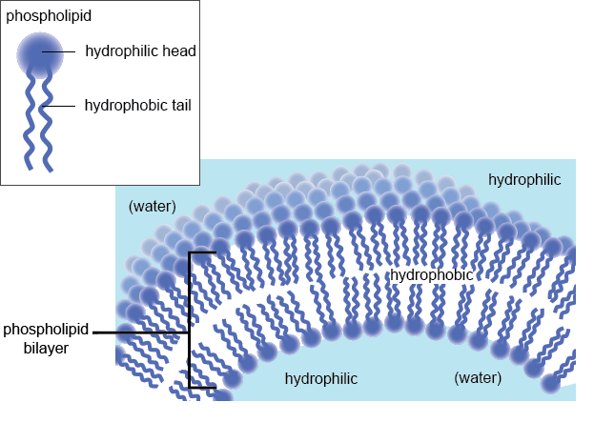
The technical term for this double layer of phospholipids that forms the cell membrane is a phospholipid bilayer. Eukaryotic cells, which make up the bodies of all organisms except for bacteria and archaea, also have a nucleus that is surrounded by a phospholipid bilayer membrane.

Slide 8
In addition, the cell membrane contains glycolipids and sterols. One important sterol is cholesterol, which regulates the fluidity of the cell membrane in animal cells. When there is less cholesterol, membranes become more fluid, but also more permeable to molecules. The amount of cholesterol in the membrane helps maintain its permeability so that the right amount of molecules can enter the cell at a time, not too many or too few.
The cell membrane also contains many different proteins. Proteins make up about half of the cell membrane. Many of these proteins are transmembrane proteins, which are embedded in the membrane but stick out on both sides. Some of these proteins are receptors which bind to signal molecules, while others are ion channels which are the only means of allowing ions into or out of the cell. Scientists use the fluid mosaic model to describe the structure of the cell membrane. The cell membrane has a fluid consistency due to being made up in large part of phospholipids, and because of this, proteins move freely across its surface. The multitude of different proteins and lipids in the cell membrane give it the look of a mosaic.

Slide 9
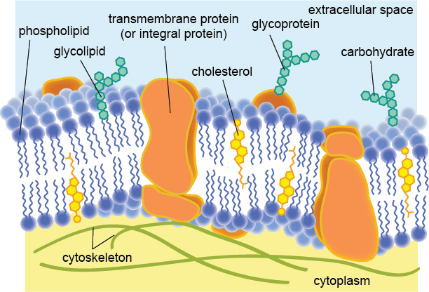

Slide 10
Functions of the Cell Membrane
The cell membrane gives the cell its structure. It separates the contents of the cell from its outside environment and it regulates what enters and exits the cell.
The cell membrane also plays a role in cell signaling and communication.
Oxygen, which cells need in order to carry out metabolic functions such as cellular respiration, and carbon dioxide, a byproduct of these functions, can easily enter and exit through the membrane.
Water can also freely cross the membrane, although it does so at a slower rate.
Highly charged molecules, like ions, cannot directly pass through, nor can large macromolecules like carbohydrates or amino acids. Instead, these molecules must pass through proteins that are embedded in the membrane. In this way, the cell can control the rate of diffusion of these substances.
The cell membrane can bring molecules inside it is through endocytosis. This includes phagocytosis (“cell eating”) and pinocytosis (“cell drinking”).

