Slide 1
Unit 4: Cell Division Topic: Mitosis B.Ed (Hons) Secondary Semester: I Subject: Biology I (Minor) Course Title: General Biology Represented By: Ms Sidra Younis Department of Education (Planning and Development) Lahore College for Women University, Lahore

Slide 2
MITOSIS
Mitosis is the step in the cell cycle that the newly duplicated DNA is separated, and two new cells are formed. This process is important in single-celled eukaryotes, as it is the process of asexual reproduction. In multi-celled eukaryotes, mitosis is how a single zygote can become an entire organism. Mitosis has several distinct stages, or phases, that will be discussed below. The other stages in the cell cycle include growth and the replication of DNA, both required for mitosis to take place. Below is a picture of where mitosis fits into the cell cycle.

Slide 3
PHASES OF MITOSIS
Though technically not part of mitosis, Interphase begins and ends mitosis. Interphase is the part of the cell cycle in which the cell grows and duplicates the DNA. After an identical set of DNA is synthesized, the cell enters Mitosis.
Prophase
Prophase is the first stage in mitosis. During prophase, the DNA is condensed. During interphase, when the DNA is replicated, it is in a loose and open form to allow the enzymes to do their work on the DNA and create a new strand.

Slide 4
CONT…..
However this chromatin, as it is called, would become tangled and break if the cell tried to move it without condensing it. During prophase, the cell’s machinery packages the DNA around special proteins, called histones, which allow it to condense into very tight packages. These tight packages of DNA can now be moved around with ease. During prophase the centrioles appear, which are centers on each side of the cell that organize microtubules. The microtubules will eventually reach out and grab the chromosomes of DNA.

Slide 5
CONT…..
In plants this stage is proceeded by a step that rearranges the cell to put the nucleus in the middle. In most animal cells, the nucleus exists in the center of the cell most of the time. In plants, it is often pushed to one side by large, water-containing vacuoles. This preprophase allows plants to organize their organelles for division.

Slide 6
CONT…..
Prometaphase
In order for the duplicated chromosomes to be split up, the microtubules have to reach them. In prometaphase, the nuclear envelope surrounding the cells falls apart. This membrane was separating the DNA from the cytosol of the cell. When the nuclear envelope dissolves, the microtubules are allowed to extend from the centromeres to the chromosomes. Each chromosome has a special area known as the centromere, and each centromere has a kinetochore. The microtubules are able to attach to these kinetochores, allowing the cell to move the chromosomes around. Microtubules from each side of the cell will attach to each chromosome during prometaphase.

Slide 7
CONT…..
Metaphase
During metaphase, the microtubules start pulling on the chromosomes. Each side pulls with equal force, and the chromosomes end up in the middle of the cell. This area is called the metaphase plate. The cells aligned on the metaphase plate represent two full copies of DNA. Each chromosome lines up next to its sister chromatid, or cloned DNA strand. In this way, when the microtubules pull the chromosomes apart, each cell gets an entire functioning genome. Below is a picture of a cell in metaphase. .

Slide 8
CONT…..
Anaphase
The sister chromatids, identical clones of the same part of DNA, are bound together at their centromeres. During anaphase of mitosis, the proteins that connect these chromatids are destroyed. Each now its own chromosome, the identical halves can be pulled to each cell. In the above picture, there are two white chromosomes and two grey chromosomes. During anaphase the proteins between the two sister chromatids in each chromosome would dissolve. In the above cell this would lead to 8 total chromosomes after the chromatids separate. In the next phase, they will be separated, to create 4 chromosomes in each cell, the number the cell had before it duplicated its DNA.
.

Slide 9
CONT…..
Telophase
The final phase of Mitosis, telophase, occurs when the chromosomes are pulled toward each centriole, and a cleavage furrow forms in the cell. The chromosomes will eventually get a nuclear envelope formed around them, and become their own cells. The centrioles will dissolve, and each cell will resume normal functioning. One crucial last step, cytokinesis, is needed before the cell function. This last process is not a step of mitosis, but rather the beginning of Interphase. Once divided, the cells can resume growing.

Slide 10
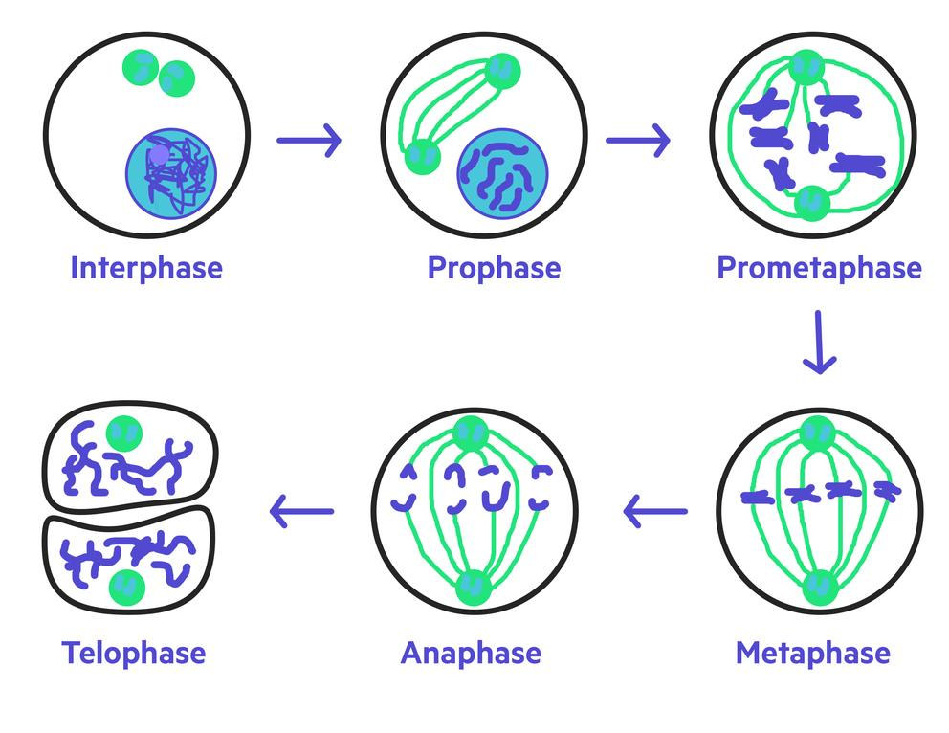
Stages of Mitosis

Slide 11
IMPORTANCE OF MITOSIS
Mitosis is important for three main reasons: development and growth cell replacement and asexual reproduction.
1. Development and growth
After meiosis has produced a gamete, and this has fused with another gamete to form an embryo, the embryo grows using mitosis. This growth continues throughout an organism’s life, in plants, animals, and fungi. In this way, the original chromosomal set is preserved.

Slide 12
CONT…..
2. Cell replacement
This occurs when the original cell is damaged or wounded. New cells are created to replace those that were damaged. Examples of this are the healing of a cut or a broken bone. When old cells die, new ones replace them to ensure continuing functionality.
3. Asexual reproduction
Single-celled organisms and certain multicellular organisms use mitosis for asexual reproduction. This includes reproduction by fragmentation, as in the case of planaria, and reproduction by budding, as in the case of sea anemones. Many plants reproduce using mitosis.

