Slide 1
Unit 3: Variety of Life Topic: Two Kingdom System of Classification B.Ed (Hons) Secondary Semester: I Subject: Biology I (Minor) Course Title: General Biology Represented By: Ms Sidra Younis Department of Education (Planning and Development) Lahore College for Women University, Lahore

Slide 2
Two kingdom classification system was given by Carlous Linaaeus in 1758. Carlous Linnaeus classified living things into two kingdoms Animal Kingdom which he called as Regnum Animale for animals and for plants he gave the Vegetable Kingdom which he called as Regnum Vegetabile; now known as the Plant Kingdom. He then divided each kingdom into classes and later grouped the classes into phyla for animals and divisions for plants.
Two Kingdoms : Plantae and Animalia
Linnaeus placed all the living organisms into two kingdoms. The two major kingdoms are Kingdom Plantae for plants and Kingdom Animalia for animals. This two kingdom classification laid the base for modern classification and was quite a reasonable at that period of time, plants and animals in this system could be very clearly distinguished.

Slide 3
Plants were fixed, stationary in the soil, they absorb water for growth and they could prepare their own food. On the other hand, animals are capable of movement and they got nutrition by feeding on other plants and animals for their growth and survival. These were the differences that lead to distinction of plants and animals in the two kingdom classification.
Kingdom Plantae
The Plant Kingdom includes the organisms that contain green plants, mosses, ferns, many colorless and color unicellular organisms, molds, fungi, lichens, bacteria and multicellular seaweeds. This classification kingdom was originally proposed by Linnaeus.

Slide 4
Following are the few distinguishing characters of plants in general:
Plants vary greatly in form and size. The body is usually asymmetrical. In higher forms of plants structures like leaves and plants have a definite form and shape.
Plants are fixed with root in the soil and they are not capable of motion. Certain localized movements may occur in plants.
Plants grow throughout their lifespan.
Nutrition in plants is usually autotrophic and saprophytic. Minerals in solution state are absorbed; particulate matter cannot be absorbed by the roots.
The body of the plant is composed of cells; all the cells of the plant body have a distinct cell wall. The cells have a vacuole filled with sap and plastids of different kinds. The plant cells do not have centrioles and lysosomes.
Plants have reserve food as starch.

Slide 5
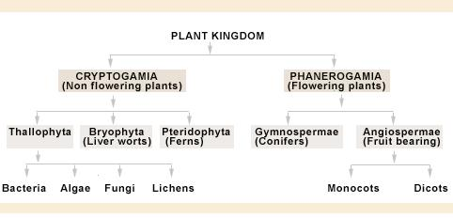
Classification of Kingdom Plantae
The plant kingdom is classified as follows:

Slide 6
Kingdom Animalia
Kingdom Animalia includes many unicellular protozoans and multicellular organisms,these organisms do not have chlorophyll and photosynthetic ability. Animal Kingdom was originally proposed by Carlous Linnaeus, this kingdom included protozoans, sponges, jelly fishes, worms. crabs, insects, spiders,frogs, snails, sharks, bony fishes, lizards, birds and mammals. Following are a few distinguishing characters of animals in general:
Body of animals exhibits a definite symmetry, form and shape.
Animals can move from place to place. Body growth in animals is determined and it occurs proportionately in all body parts.
Animals possess the capacity oto respond to stimulus.
Animal body is also made up of cells, the cells do not have cell wall. The cells do not contain plastids and vacuoles. Centrosomes and lysosomes are present.
Animal cells cannot synthesize some necessary amino acids, vitamins, and co-enzymes on their own, they are to be obtained from external sources.
Reserve food is in the form of glycogen.

Slide 7
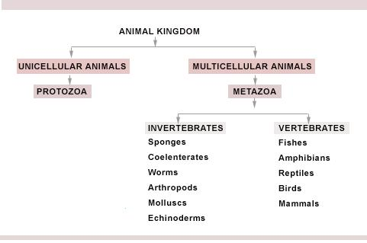
Classification of Kingdom Animalia
The animal kingdom is classified as follows:

Slide 8
Merits and Demerits of Two Kingdom Classification
The two kingdom classification was in use for a long period of time. As more information came into picture about various groups of plants and organisms, this system was found to be inadequate.
Merits:
Organisms were classified into plant kingdoms and animal kingdom based on their specific characters.
This system initiated systematic methods to classify living organisms.
Demerits:
The two kingdom system of classification was not suitable as due to a large diversity of among the organisms.
The main demerits of the system are:
Some protozoans like Euglena possess characters of both plants and animals, they are not classified in a particular group.
There is no proper distinction between prokaryotes and eukaryotes. Like in the case of bacteria without a nuclear envelope and cellular organelles are placed in the plant kingdom.

Slide 9
In the system both photosynthetic and non-photosynthetic organism are placed together in the kingdom plantae. For example the fungi lack chlorophyll and are saprophytic in nature, they are placed in the plant kingdom.
Organisms like the lichens do not fall either in the animal or plant kingdom.
Organisms like the diatoms are place under the plant kingdom while the protozoans are placed under the animal kingdom, these organisms are of the same level of organization and they reproduce by fission yet they are placed in different kingdoms.
Some organisms possess characters of both plants and animals like Euglena and Chlamydomonas, so they can belong to any kingdom.
Modes of nutrition considered in this system are assimilation and ingestion, absorption type of nutrition is not recognized.

