Slide 1
Unit 3: Variety of Life Topic: Classification of Living Things B.Ed (Hons) Secondary Semester: I Subject: Biology I (Minor) Course Title: General Biology Represented By: Ms Sidra Younis Department of Education (Planning and Development) Lahore College for Women University, Lahore

Slide 2
Classification of Living Things
In science, the classifying organisms is called taxonomy (Taxis means arrangement and nomos means method). The modern taxonomic system was developed by the Swedish botanist Carolus (Carl) Linneaeus (1707-1778). He used simple physical characteristics of organisms to identify and differentiate between different species, and is based around genetics.

Slide 3
Linneaeus developed a hierarchy of groups for taxonomy. To distinguish different levels of similarity, each classifying group, called taxon (pl. taxa) is subdivided into other groups. The taxa in hierarchical order:
Kingdom - Plantae, Animalia, Fungi, Protists, Eubacteria (Monera), Archaebacteria
Phylum
Class
Order
Family
Genus
Species - smallest classification

Slide 4
Kingdom The most basic classification of living things is kingdom. Currently there are five kingdoms. Living things are placed into certain kingdoms based on how they obtain their food, the types of cells that make up their body, and the number of cells they contain. Phylum The phylum is the next level following kingdom in the classification of living things. It is an attempt to find some kind of physical similarities among organisms within a kingdom. These physical similarities suggest that there is a common ancestry among those organisms in a particular phylum.

Slide 5
Classes Classes are way to further divide organisms of a phylum. Organisms of a class have even more in common than those in an entire phylum.
Order Organisms in each class are further broken down into orders. A taxonomy key is used to determine to which order an organism belongs. A taxonomy key is nothing more than a checklist of characteristics that determines how organisms are grouped together.

Slide 6
Families Orders are divided into families. Organisms within a family have more in common than with organisms in any classification level above it. Because they share so much in common, organisms of a family are said to be related to each other. Humans are in the Hominidae Family. Genus Genus is a way to describe the generic name for an organism. The genus classification is very specific so there are fewer organisms within each one. For this reason there are a lot of different genera among both animals and plants. When using taxonomy to name an organism, the genus is used to determine the first part of its two-part name.

Slide 7
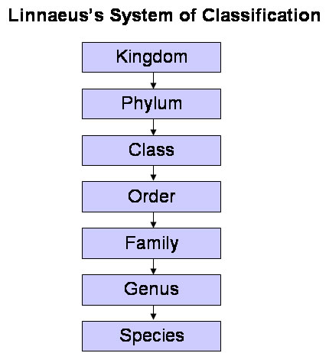
Species Species are as specific. It is the lowest and most strict level of classification of living things. The main criterion for an organism to be placed in a particular species is the ability to breed with other organisms of that same species. The species of an organism determines the second part of its two-part name.

Slide 8
Binomial Nomenclature
It is the system of giving a scientific name to an animal or a plant. Carolus Linnaeus (1707-1778), Swedish physician and botanist, was the founder of modern taxonomy. He used a system binomial nomenclature for naming living things and grouping similar organisms into categories.
Definition
The scientific systemof naming each species of organism with a Latinized name in two parts; the first is the genus, and is written with an initial capital letter; the second is some specific epithet that distinguishes the species within the genus.

Slide 9
Examples
Humans' scientific name is Homo sapiens. The genus is Homo, and the species is sapiens.
Solanum tuberosum (Potato)
Panthera leo (Lion)
Capsicum annuum (Green Chilli)
According to this system, any given animal or plant is given a scientific name consisting of two words. The first word refers to name of the genus while the second word refers to the name of the species. Both the genus and the species are generally given Latin names.

Slide 10
Binomial nomenclature avoids the confusion of using common names. An international committee has been established to frame the rules and regulations regarding binomial nomenclature for plants and animals. It is known as the International Council for Binomial Nomenclature (ICBN). Following are some of the major guidelines for scientific naming of plants and animals.
1. Every scientific name should have words either in Latin or be Latinized (i.e., follow Latin grammar).
2. The first word refers to name of the genus and the second word to the name of the species.
3. The name of the genus should start with a capital letter and name of the species with a small letter.

Slide 11
4. Both the names should be printed in italics or else they should be underlined separately.
5. Name of the scientist who first identified and described the species should be abbreviated and written after the species name, preferably in brackets. For example, Homo sapiens Linnaeus is written as Homo sapiens (Linn).

