Slide 1
Unit 2: Cell Biology Topic: Cell Organelles (Plastids) B.Ed (Hons) Secondary Semester: I Subject: Biology I (Minor) Course Title: General Biology Represented By: Ms Sidra Younis Department of Education (Planning and Development) Lahore College for Women University, Lahore

Slide 2
Plastids
Plastid is a double membrane-bound organelle involved in the synthesis and storage of food, commonly found within the cells of photosynthetic plants.
Plastids were discovered and named by Ernst Haeckel, but A. F. W. Schimper was the first to provide a clear definition.
They are necessary for essential life processes, like photosynthesis and food storage.
A plastid containing green pigment (chlorophyll) is called chloroplast whereas a plastid containing pigments apart from green is called a chromoplast. A plastid that lacks pigments is called a leucoplast and is involved mainly in food storage.

Slide 3
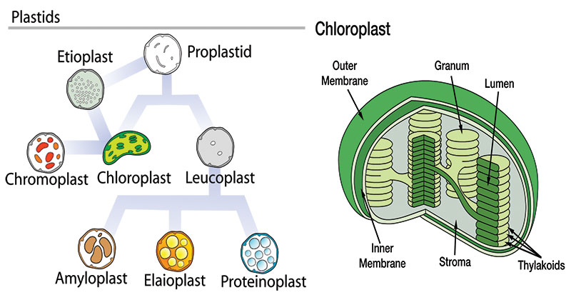

Slide 4
Types of Plastids
A. Chloroplasts
The chloroplasts are probably the most-known of the plastids.
These are responsible for photosynthesis.
The chloroplast is filled with thylakoids, which is where photosynthesis occurs, and chlorophyll remains.
B. Chromoplasts
Chromoplasts are units where pigments are stored and synthesized in the plant.
These are found in flowering plants, fruits, and aging leaves.
The chloroplasts actually convert over to chromoplasts.
The carotenoid pigments allow for the different colors seen in fruits and the fall leaves. One of the main reasons for these structures and the colors is to attract pollinators.

Slide 5
C. Leucoplasts
Leucoplasts are the non-pigmented organelles.
They are found in the non-photosynthetic parts of the plant, such as the roots.
Depending on what the plant needs, they may become essentially just storage sheds for starches, lipids, and proteins.
They are more readily used for synthesizing amino acids and fatty acids.
A leucoplast may be an amyloplast that stores starch, an elaioplast that stores fat, or a proteinoplast that stores proteins.
D. Gerontoplasts
Gerontoplasts are basically chloroplasts that are going through the aging process.
These are chloroplasts of the leaves that are beginning to convert into different organelles or are being re-purposed since the leaf is no longer utilizing photosynthesis (such as in the fall months).

Slide 6
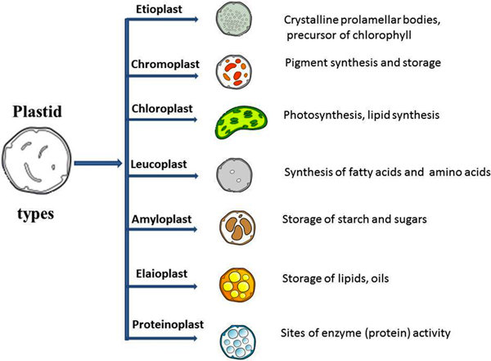

Slide 7
Structure of Plastids
Chloroplasts may be spherical, ovoid or discoid in higher plants and stellate, cup-shaped or spiral as in some algae.
They are usu­ally 4-6 µm in diameter and 20 to 40 in number in each cell of higher plants, evenly distributed throughout the cytoplasm.
The chloroplast is bounded by two lipoprotein membranes, an outer and an inner membrane, with an intermembrane space between them.
The inner membrane encloses a matrix, the stroma which contains small cylindri­cal structures called grana. Most chloroplasts contain 10-100 grana.

Slide 8
Functions of Plastids
Plastids are the site of manufacture and storage of important chemical compounds used by the cells of autotrophic eukaryotes.
The thylakoid membrane contains all the enzymatic components required for photosynthesis. Interaction between chlorophyll, electron carriers, coupling factors, and other components takes place within the thylakoid membrane. Thus the thylakoid membrane is a specialized struc­ture that plays a key role in the capture of light and electron transport.
Thus, chloroplasts are the centers of synthesis and metabolism of carbohydrates.

Slide 9
They are not only of crucial importance in photosynthesis but also in the storage of primary foodstuffs, particularly starch.
Its function largely depends on the presence of pigments. A plastid involved in food synthesis typically contains pigments, which are also the ones responsible for the color of a plant structure (e.g. green leaf, red flower, yellow fruit, etc.).
Like mitochondria, plastids have their own DNA and ribosomes. Hence, they may be used in phylogenetic studies.

