Slide 1
Unit 2: Cell Biology Topic: Cell Organelles (Ribosomes & Endoplasmic Reticulum) B.Ed (Hons) Secondary Semester: I Subject: Biology I (Minor) Course Title: General Biology Represented By: Ms Sidra Younis Department of Education (Planning and Development) Lahore College for Women University, Lahore

Slide 2
Ribosomes
The ribosome word is derived – ‘ribo’ from ribonucleic acid and ‘somes’ from the Greek word ‘soma’ which means ‘body’.
Ribosomes are tiny spheroidal dense particles (of 150 to 200 A⁰ diameters) that are primarily found in most prokaryotic and eukaryotic.
They are sites of protein synthesis.
They are structures containing approximately equal amounts of RNA and proteins and serve as a scaffold for the ordered interaction of the numerous molecules involved in protein synthesis.
The ribosomes occur in cells, both prokaryotic and eukaryotic cells.
In prokaryotic cells, the ribosomes often occur freely in the cytoplasm.
In eukaryotic cells, the ribosomes either occur freely in the cytoplasm or remain attached to the outer surface of the membrane of the endoplasmic reticulum.

Slide 3
Cont…
The location of the ribosomes in a cell determines what kind of protein it makes.
If the ribosomes are floating freely throughout the cell, it will make proteins that will be utilized within the cell itself.
When ribosomes are attached to the endoplasmic reticulum, it is referred to as rough endoplasmic reticulum or rough ER.
Proteins made on the rough ER are used for usage inside the cell or outside the cell.
The number of ribosomes in a cell depends on the activity of the cell.
On average in a mammalian cell, there can be about 10 million ribosomes.

Slide 4
Structure of Ribosomes
A ribosome is made from complexes of RNAs and proteins and is, therefore, a ribonucleo protein.
Around 37 to 62% of RNA is comprised of RNA and the rest is proteins.
Each ribosome is divided into two subunits:
A smaller subunit which binds to a larger subunit and the mRNA pattern, and
A larger subunit which binds to the tRNA, the amino acids, and the smaller subunit.
Prokaryotes have 70S ribosome's respectively subunits comprising the little subunit of 30S and the bigger subunit of 50S.

Slide 5
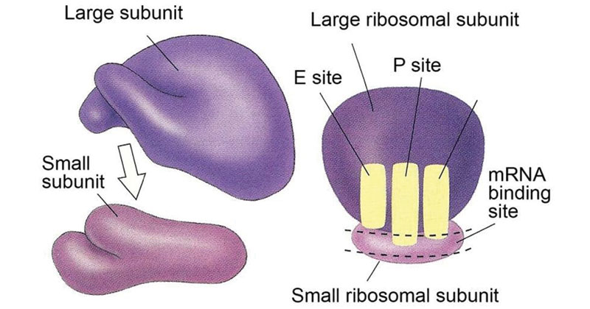
Structure of Ribosomes

Slide 6
Functions of Ribosomes
The ribosome is a complex molecular machine, found within all living cells, that serves as the site of biological protein synthesis (translation).
Ribosomes link amino acids together in the order specified by messenger RNA (mRNA) molecules.
Ribosomes act as catalysts in two extremely important biological processes called peptidyl transfer and peptidyl hydrolysis.

Slide 7
Endoplasmic Reticulum
Endoplasmic reticulum (ER) is an important organelle in eukaryotic cells. It plays a major role in the production, processing, and transport of proteins and lipids.
The ER produces transmembrane proteins and lipids for its membrane and for many other cell components including lysosomes, secretory vesicles, the Golgi apparatus, the cell membrane, and plant cell vacuoles.

Slide 8
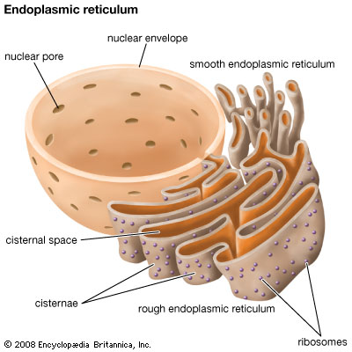

Slide 9
Structure of Endoplasmic Reticulum
The endoplasmic reticulum membrane system can be morphologically divided into two structures–cisternae and sheets.
Cisternae are tubular in structure, and form a three-dimensional polygonal network.
They are about 50 nm in diameter in mammals and 30 nm in diameter in yeast.
ER sheets, on the other hand, are membrane-enclosed, two-dimensional flattened sacs that extend across the cytoplasm.
They are frequently associated with ribosomes and special proteins called translocons that are necessary for protein translation within the RER.

Slide 10
Cont…
Endoplasmic reticulum is an extensive membrane network of cisternae (sac-like structures), which are held together by the cytoskeleton.
The phospholipid membrane encloses a space, the lumen from the cytosol, which is continuous with the perinuclear space.
The surface of the rough endoplasmic reticulum is studded with the protein manufacturing ribosome, which gives it a rough appearance. Hence it is referred as a rough endoplasmic reticulum.

Slide 11
Cont…
The smooth endoplasmic reticulum consists of tubules, which are located near the cell periphery. This network increases the surface area for the storage of key enzymes and the products of these enzymes.
Rough endoplasmic reticulum synthesizes proteins, while smooth endoplasmic reticulum synthesizes lipids and steroids. It also metabolizes carbohydrates and regulates calcium concentration, drug detoxification, and attachment of receptors on cell membrane proteins.
Endoplasmic reticulum varies extensive extending from the cell membrane through the cytoplasm and forming a continuous connection with the nuclear envelope.

Slide 12
Functions of Endoplasmic Reticulum
It is mainly responsible for the transportation of proteins and other carbohydrates to another organelle, which includes lysosomes, Golgi apparatus, plasma membrane, etc.
They provide the increased surface area for cellular reactions.
They help in the formation of nuclear membrane during cell division.
They play a vital role in the formation of the skeletal framework.
They play a vital role in the synthesis of proteins, lipids, glycogen and other steroids like cholesterol, progesterone, testosterone, etc.

