Slide 1
Unit 2:Chemistry of Carbonyl Compounds
Topic: Alcohol
(Lecture 1)
B.Ed (Hons) Secondary
Semester IV
Course Title: Inor-Organic Chemistry
Subject: Chemistry
Presented By: Dr. Faiza Arshed
Department of Education(Planning and Development Lahore College for Women University, Lahore

Slide 2
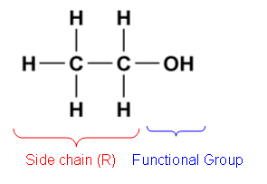
2
Introduction of alcohols
Alcohol is an homologous series in which the compounds contain a functional group called the hydroxyl group (-OH). Alcohols are all derivatives of hydrocarbons in which one or more of the hydrogen atoms in the hydrocarbon have been replaced by a hydroxyl group. The hydroxyl group is also responsible for imparting certain chemical and/or physical properties to the compound
The names of the alcohol are derived according to the alkane backbone. If the hydroxyl (-OH) group is attached to a methane backbone, the compound is called methanol or methyl alcohol. If the backbone is butane, the alcohol formed is butanol. So basically, to derive the name of an alcohol, take the name of the hydrocarbon backbone, remove the alphabet "E" from its name and replace it with "ol".

Slide 3
3
Nomenclature
Alcohols with one to four carbon atoms are frequently called by common names, in which the name of the alkyl group is followed by the word alcohol:

Slide 4
4
classification
Alcohols are classified as Monohydric, Dihydric and Trihydric depending upon the number of hydroxyl groups they contain in their molecules. Alcohols containing one hydroxyl group in their molecule are called Monohydric Alcohols and the alcohols containing two and three hydroxyl groups on different carbon atoms in their molecules are called Dihydric and Trihydric respectively. The alcohols having more than one molecules of hydroxyl group in the molecules are generally called Polyhydric alcohols.
2
2
3
2
2
2

Slide 5
Cont...
5
Monohydric alcohols are further classified as primary (prim-), secondary (sec-) and tertiary (tert-) alcohols.
1. Primary Alcohols
In a primary (1°) alcohol, the carbon atom that carries the -OH group is only attached to one alkyl group. Some examples of primary alcohols are shown below:

Slide 6
Cont...
6
2. Secondary Alcohols
In a secondary (2°) alcohol, the carbon atom with the -OH group attached is joined directly to two alkyl groups, which may be the same or different. Examples include the following:

Slide 7
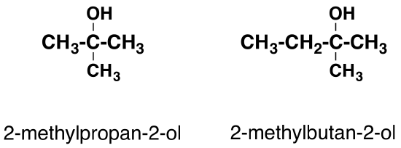
Cont...
7
3. Tertiary Alcohols
In a tertiary (3°) alcohol, the carbon atom holding the -OH group is attached directly to three alkyl groups, which may be any combination of the same or different groups. Examples of tertiary alcohols are given below:

Slide 8
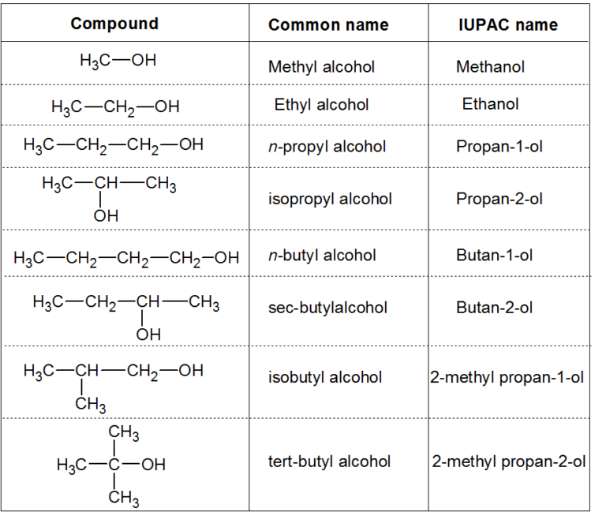
Names of some Alcohols in the two systems
8

