Slide 1
Early Childhood Education unit :04 part :01
Ms.Iqra Asim
B.Ed (Hons)
Spring 2020

Slide 2
LEARNING OUTCOMES
After completing this chapter, Students will be able to:
Understand the behavior management system for early childhood.
Identify with the use of different models of behavior management.

Slide 3
Behavior Management System
Behavior management is a process that guides people to change their actions within a specific context.
Behavior management is usually used to change negative behaviors and habits such as those that occur in education and behavioral health.
The process involves identifying the negative behavior, raising awareness about alternative behaviors, changing the environment to reduce negative behavior and offering positive reinforcement to encourage alternative behaviors.

Slide 4
Comprehensive Behavior Management Planning

Slide 5
Discipline
Over the years, discipline has been equated with punishment, specifically, corporal punishment. Punishment and discipline, however, are not the same thing.
Discipline involves teaching others right from wrong.
Specifically, discipline includes methods to prevent or respond to behavior problems so they do not occur in the future (Slavin, 2009).

Slide 6
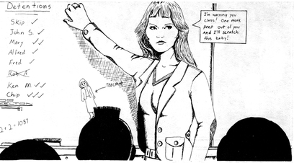
Assertive Discipline
Canter developed the assertive discipline model, originally based on major aspects on how the teacher responds to misbehavior. It is up to the teacher to keep students in line during class.
According to assertive discipline, Teachers have the right to determine the environmental structure, rules, and routines that will facilitate learning.

Slide 7
Cont..
Teachers should prepare a discipline plan in advance, including statements of their expectations, rules, and routines.
Teachers should use positive and negative consequences to convince students that it is to their benefit to behave appropriately.
Inappropriate behavior is motivated by unconscious needs, e.g., to gain attention, exercise power, exact revenge, or display inadequacy.
If the motive for attention is satisfied, inappropriate behavior associated with other motives will not be manifested.

Slide 8
Thank You

